Slide 1
Some Applications of Linear Algebra
Additional Materials for 线性代数B, Fall 2015
Bin Dong

Slide 2
Outline
X-Ray Computed Tomography (CT): Solving Linear Systems
Objects Classification: Application of Eigenvalue and Eigenvectors

Slide 3
X-Ray Computed Tomography (CT)
How is it related to solving linear systems?

Slide 4
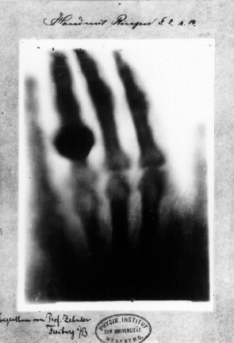
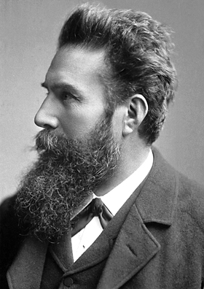

X-光：人体内部的秘密
Wilhelm Röntgen, German
Nobel Prize in Physics, 1901.
Hand mit Ringen (Hand with Rings): print of Wilhelm Röntgen's first "medical" X-ray, of his wife's hand, taken on 22 December 1895.

Slide 5
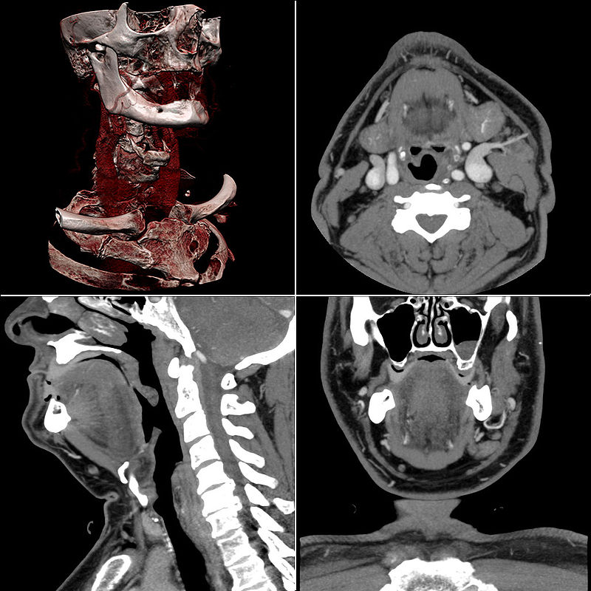
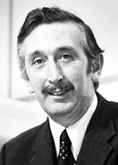
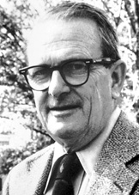
X-光：人体内部的秘密
Godfrey Newbold Hounsfield, United Kingdom
Allan MacLeod Cormack,
USA
现代三维CT
Nobel Prize in
Medicine, 1979

Slide 6
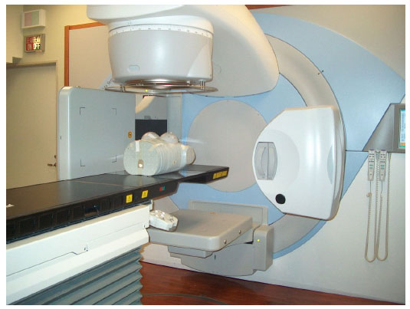
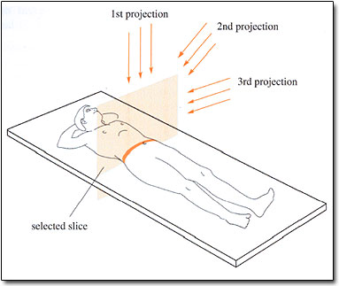

CT图像重建
CT 扫描仪
扫描过程示意图
需要重构的图像
采集到的数据

Slide 7
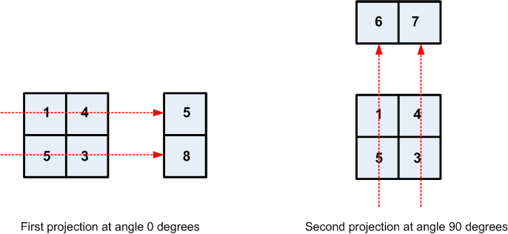
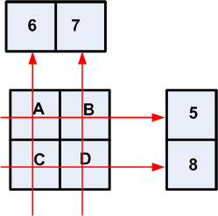
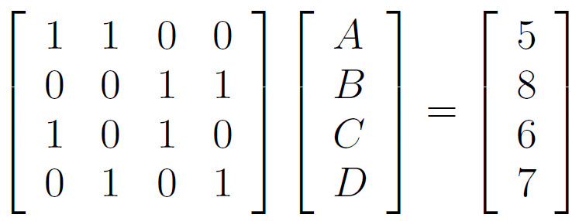
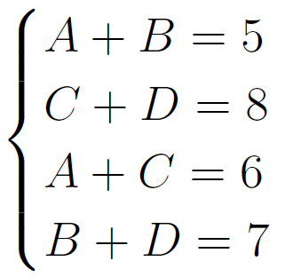
CT图像重建
数学家如何理解该问题？
扫描
解线性方程组
重建

Slide 8



CT图像重建
更一般的情况
=
0.1
0.45
0.45
P的行数 = Ｘ射线数
P的每一行对应于一根Ｘ射线
P的每一行的非零项对应于Ｘ射线穿过的格子

Slide 9
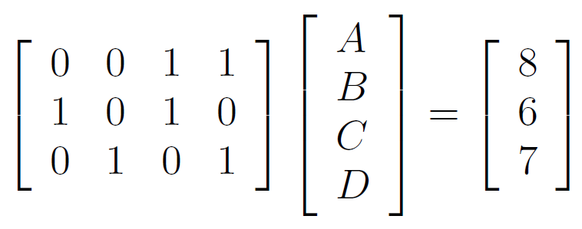
CT图像重建
这能有多难？
最大的挑战：
降低剂量从而减少危害
减少Ｘ射线的根数
未知数大于方程数
无穷多个解
如何选择最优解?
秩 = 3; 未知数 = 4; 无穷多解

Slide 10
Objects Classification
How is it related to finding eigenvalues and eigenvectors?

Slide 11
Objects Classification
… …
Apple
Octopus
Hammer
… …
Spoon
Tree
… …
… …
… …

Slide 12

What is an image?
Image
2D Array
0 0 0 0 0 0 0 0 0 0
0 0 0 0 0 0 0 0 0 0
0 0 0 0 0 0 0 0 0 0
0 0 0 0 0 0 8 12 8 0
0 0 0 0 0 0 12 20 12 0
0 0 0 0 0 0 8 12 8 0
0 0 8 12 8 0 0 0 0 0
0 0 12 20 12 0 0 0 0 0
0 0 8 12 8 0 0 0 0 0
0 0 0 0 0 0 0 0 0 0
Note: to visualize an image in MATLAB, use “imshow(f,[])” for a given image f.

Slide 13


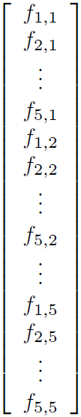
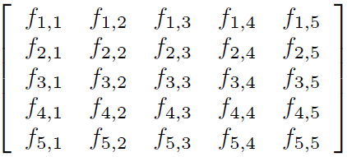
Images are Vectors
C1
C2
C1
C2
C3
C4
C5
C5

Slide 14

High Dimension => Low Dimension
Each image is of size 64 x 64, then each image is a vector in 4096-dimensional Euclidean space .
High dimensional data are hard to understand for both humans and computers.
We need to reduce the dimension of all the images to 2D or 3D spaces.
Caution: Classification may be messed up…

Slide 15
Naïve Dimension Reduction
Select 2 or 3 entries within the 4096 entries for each image vector.
It is a bad idea: similarity is not preserved
Entry 1 and 2
Entry 2 and 3
Entry 15 and 35

Slide 16
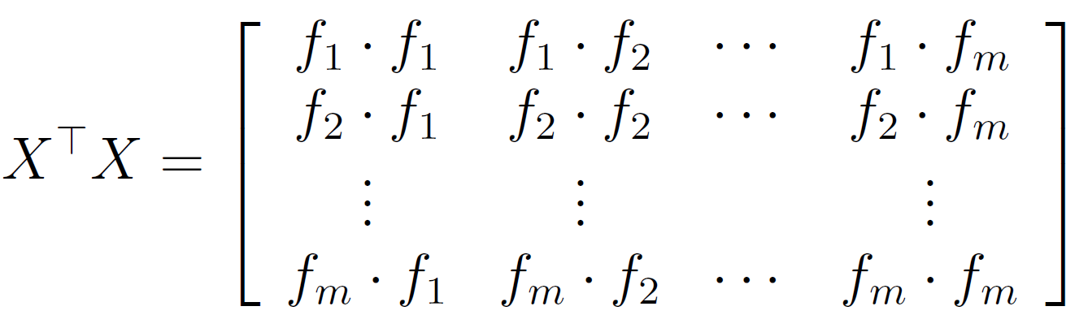
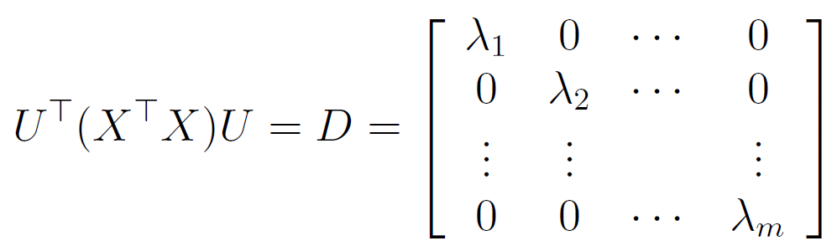
Serious Dimension Reduction
# pixels
# images
Form another symmetric matrix: covariate matrix in statistics
Find all eigenvalues and eigenvectors of the above matrix so that

Slide 17



Serious Dimension Reduction
The collection of eigenvectors forms a good linear transformation of X:
How does it help with dimension reduction?
We can now rank the coordinates according to their importance!
Use eigenvalues!

Slide 18
Serious Dimension Reduction
1st and 2nd largest coordinates
2nd and 3rd
3rd and 4th

Slide 19
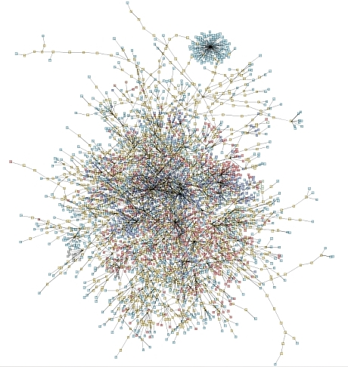

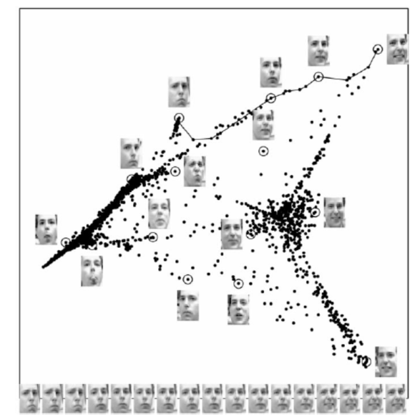
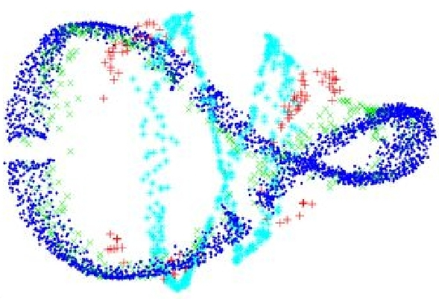
Other High-Dimensional Data Sets

