Slide 1
Lecture 7
(Wavelet) Frame Based Image Restoration Models and Beyond
B. Dong and Z. Shen, MRA-based wavelet frames and applications, IAS Lecture Notes Series,.
B. Dong and Z. Shen, Image restoration: a data-driven perspective, Proceedings of the ICIAM, 2015

Slide 2
Outline
Preliminaries
Analysis based approach
Balanced approach
Further extensions
Image segmentation
Blind inpainting
Blind deblurring
L0-minimization
Piecewise smooth image model
Connections: Wavelets approach v.s. PDE approach
Image restoration
(convex)
Image analysis
(nonconvex)
More challenging problem/model
(nonconvex)

Slide 3
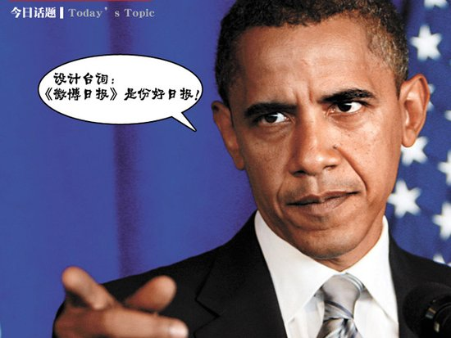
Idea
SPARSITY

Slide 4
Sparse Approximation
Sparsity and sparse approximation

Slide 5
Sparsity and Sparse Approximation
What is sparsity?
I
DCT
II

Slide 6
Sparsity and Sparse Approximation
Sparse approximation
IDCT

Slide 7
Sparsity and Sparse Approximation
Sparse approximation
DCT

Slide 8
Sparsity and Sparse Approximation
Sparse approximation
Different signals may have rather different sparse approximation
IDCT

Slide 9
Sparsity and Sparse Approximation
Sparse approximation of images
Wavelet Frame
Transform
Keeping 1% largest coefficients
Apply inverse wavelet transform

Slide 10


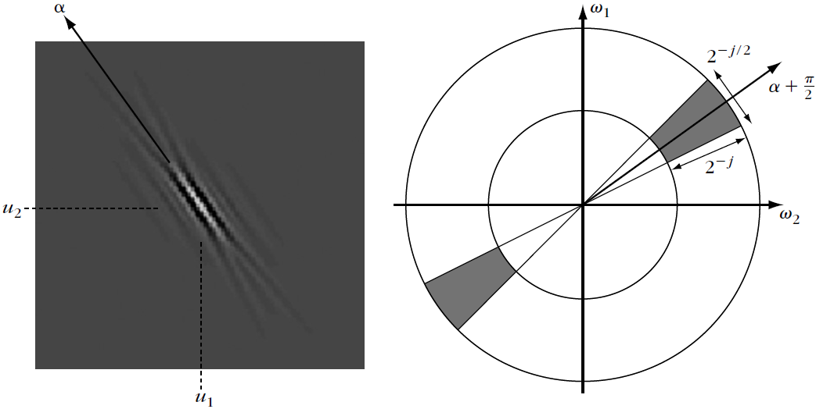
Other Sparse Representations for Images
Short-Time Fourier Transform:
Curvelets:
Bandlets, shearlets, contourlets, complex wavelets, etc…
Where and

Slide 11
Preliminaries
Basic notation and concepts

Slide 12







Fast Wavelet Frame Transform
Understand images as vectors: ; and also understand frame coefficients as vectors:
Decomposition:
Reconstruction:
Perfect reconstruction:
Redundancy:
Notes:
Specific form of the matrix W

Slide 13
Example: Decomposition
Decomposition
Sparse coefficients

Slide 14
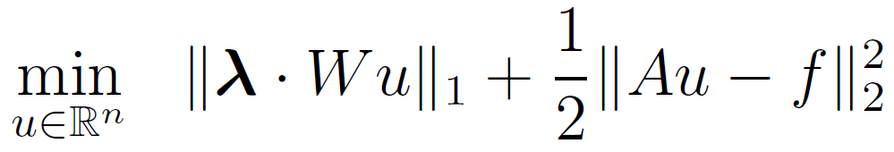
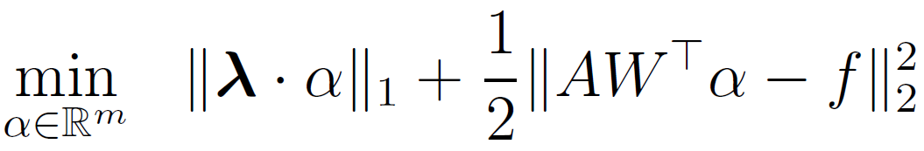
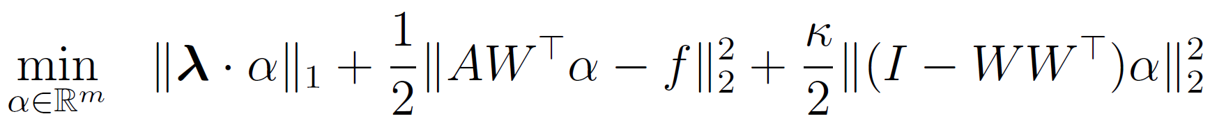
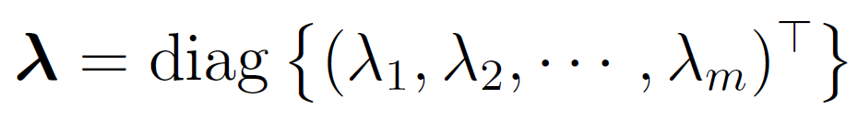

Frame Based Image Restoration Models
Analysis Based Approach
Synthesis Based Approach
Balanced Approach
Note:
Analysis = Synthesis = Balanced when
Notes:
Meaning of minimizing I-WW^top. WW^\top is orthogonal projection of alpha onto range(W).

Slide 15
Analysis Based Approach and Algorithm
Derivation and convergence

Slide 16
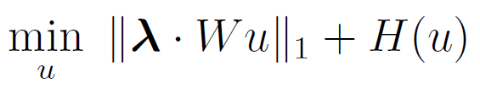
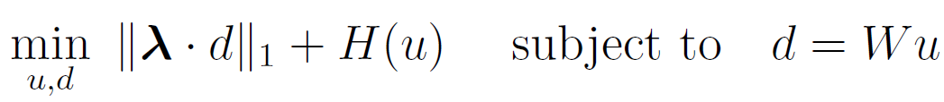

Algorithm: Alternative Direction Minimization of Multipliers (ADMM)
Efficient algorithm: Split Bregman Algorithm. Derivation by augmented Lagrangian method
Consider in general:
Substitution:
Rewrite:
Augmented Lagrangian:
Solve the saddle point problem
Convex and differentiable

Slide 17
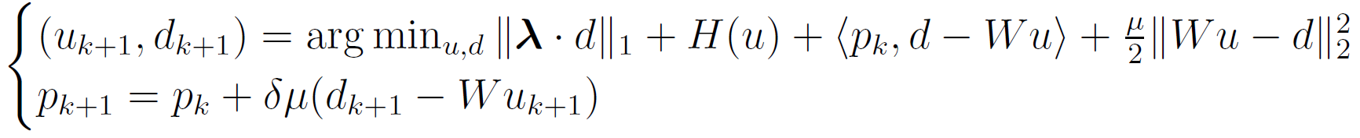

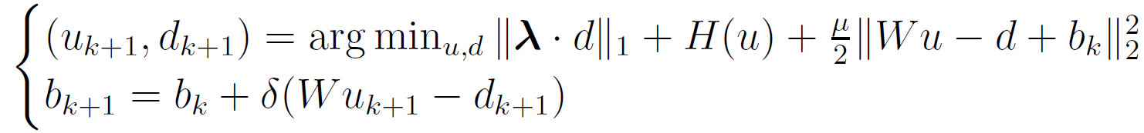
Algorithm: Alternative Direction Minimization of Multipliers (ADMM)
Solving the saddle point problem by:
Substitute :
Equivalent to:

Slide 18
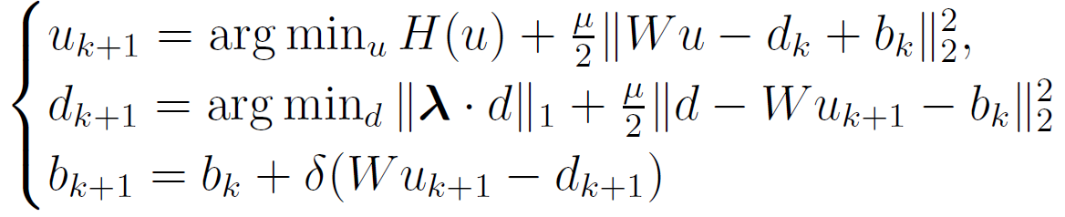
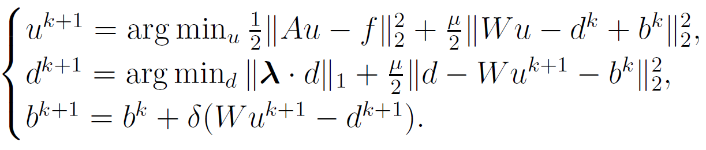

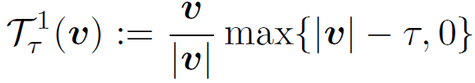
Algorithm: Alternative Direction Minimization of Multipliers (ADMM)
Solve the joint optimization alternatively for each variable:
Split Bregman (ADMM) algorithm:
Here
and

Slide 19
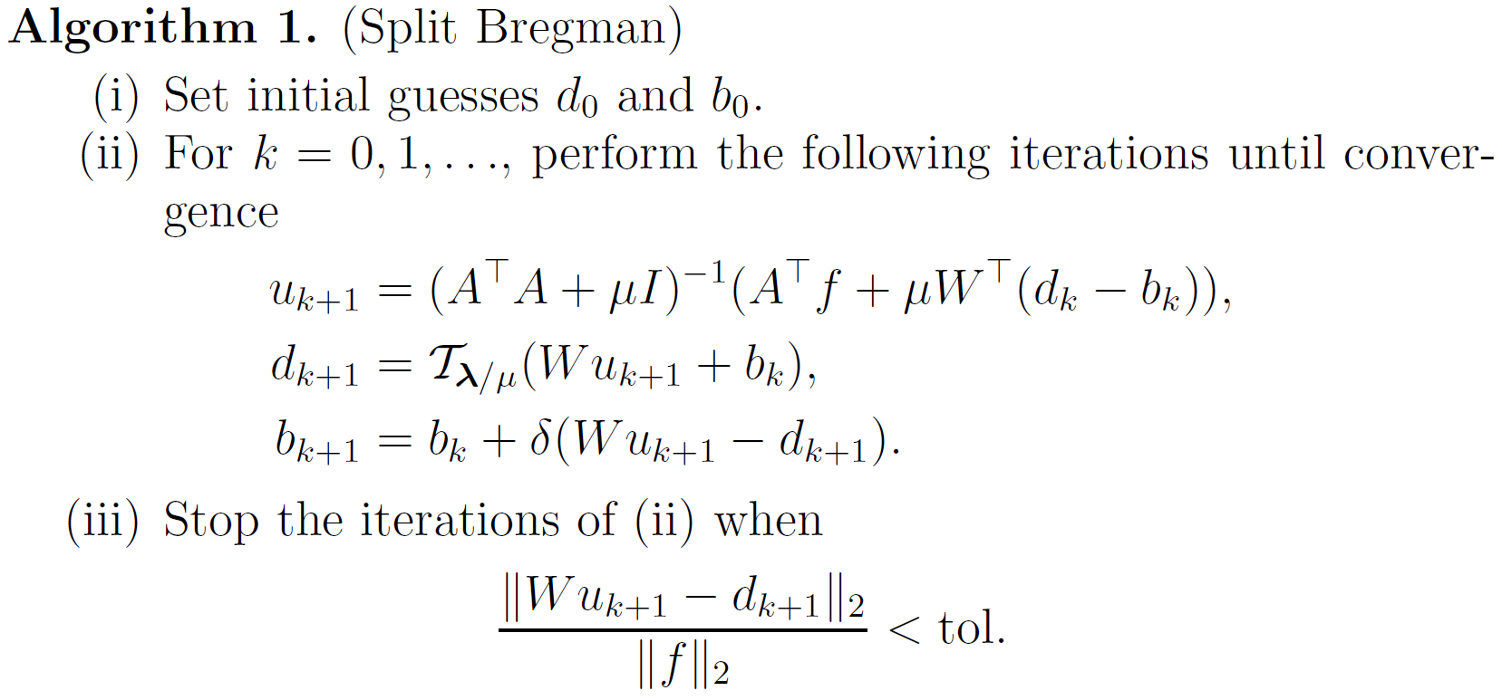
Algorithm: Alternative Direction Minimization of Multipliers (ADMM)
Homework 4
Note：Similar experiments as Homework 1 and compare with TV

Slide 20
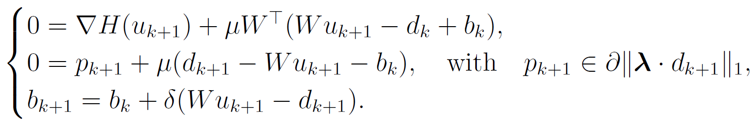
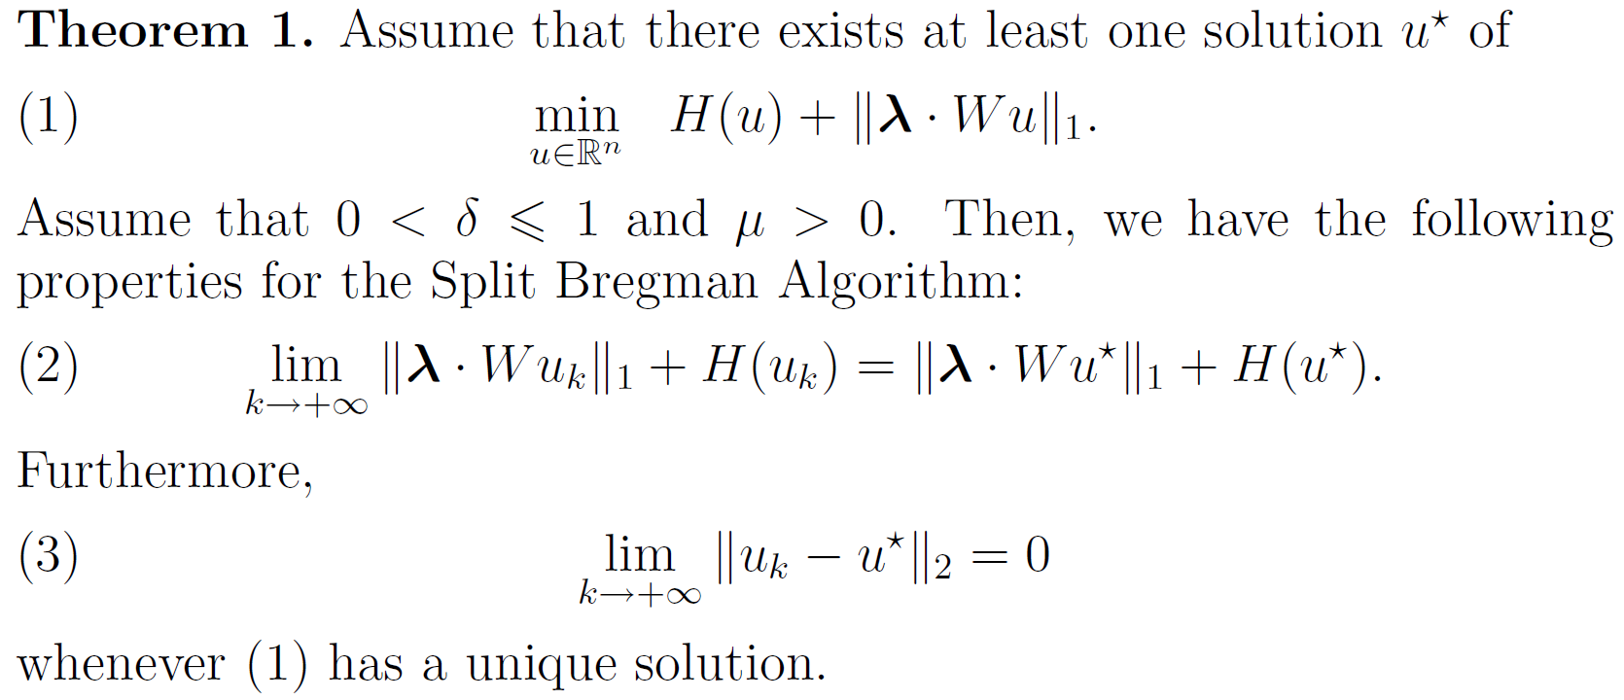
Convergence of Split Bregman
More general Split Bregman Algorithm:

Slide 21
Balanced Approach and Algorithm
Derivation and convergence

Slide 22
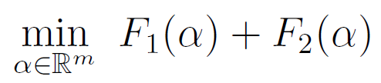

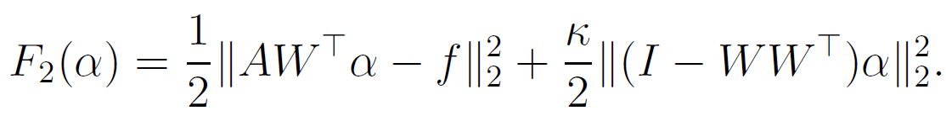





Balanced Approach: Algorithm
Consider the general problem:
Proximal Forward-Backward Spliting (PFBS):
where
and

Slide 23
Balanced Approach: Algorithm
Consider the general problem:
Proximal Forward-Backward Spliting (PFBS):
where
and

Slide 24
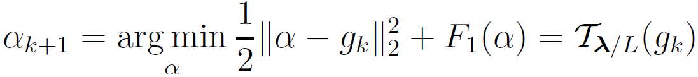
Balanced Approach: Algorithm
Consider the general problem:
Proximal Forward-Backward Spliting (PFBS):
where
and

Slide 25
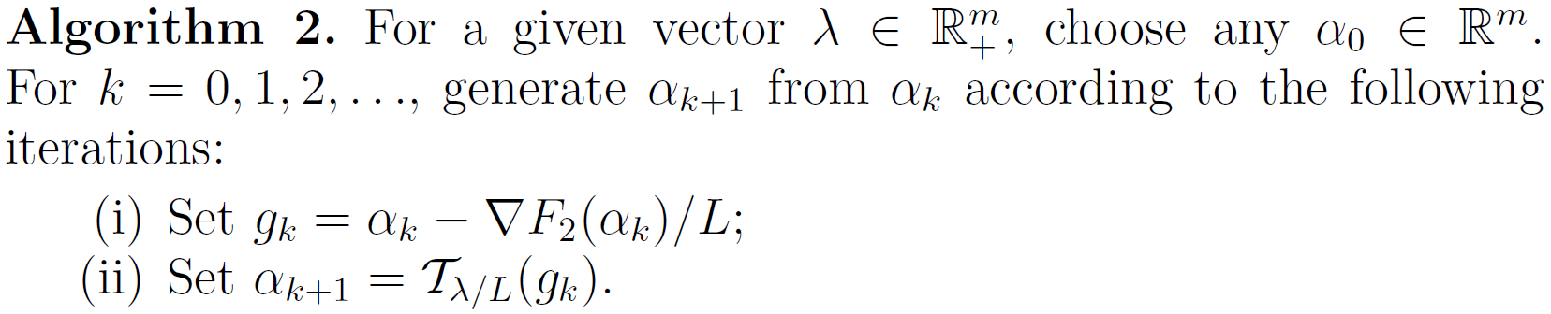
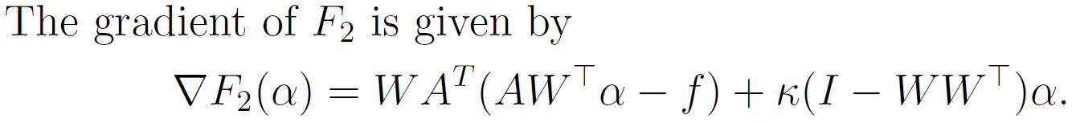
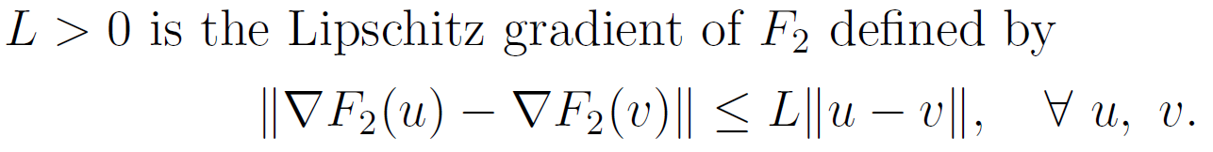

Balanced Approach: Algorithm
Consider the general problem:
Proximal Forward-Backward Spliting (PFBS):
where
and
Homework 4

Slide 26
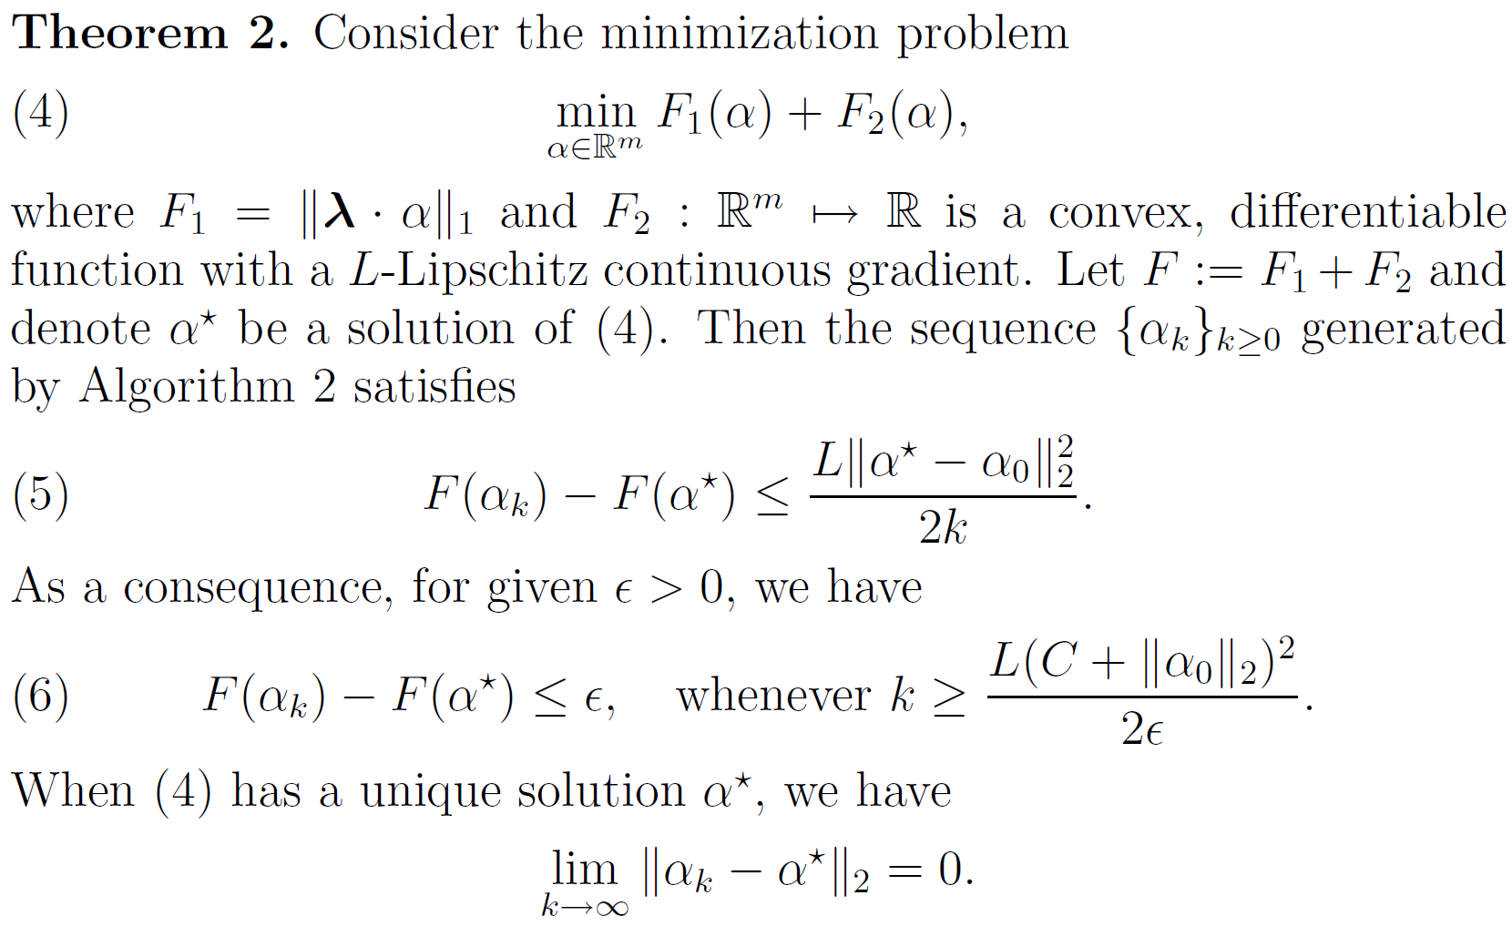
Convergence of PFBS
Linearly decreases

Slide 27
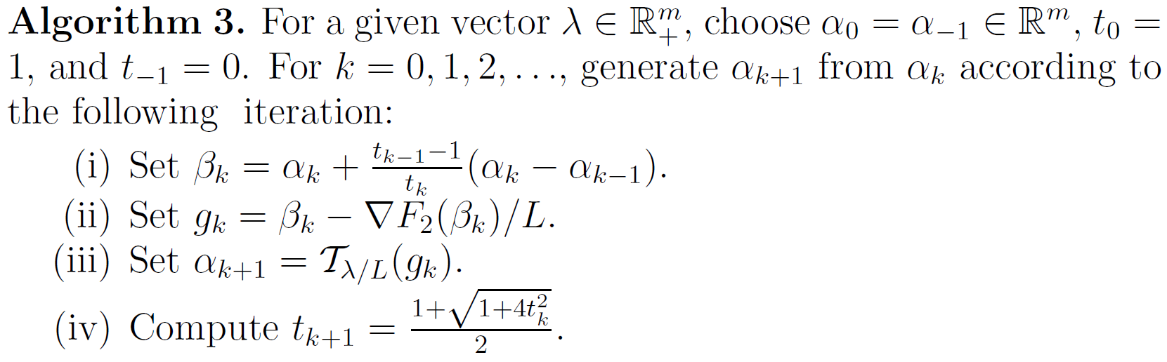
Balanced Approach: Algorithm
Consider the general problem:
Accelerated Proximal Gradient (APG) Method (also known as FISTA):
where
and

Slide 28
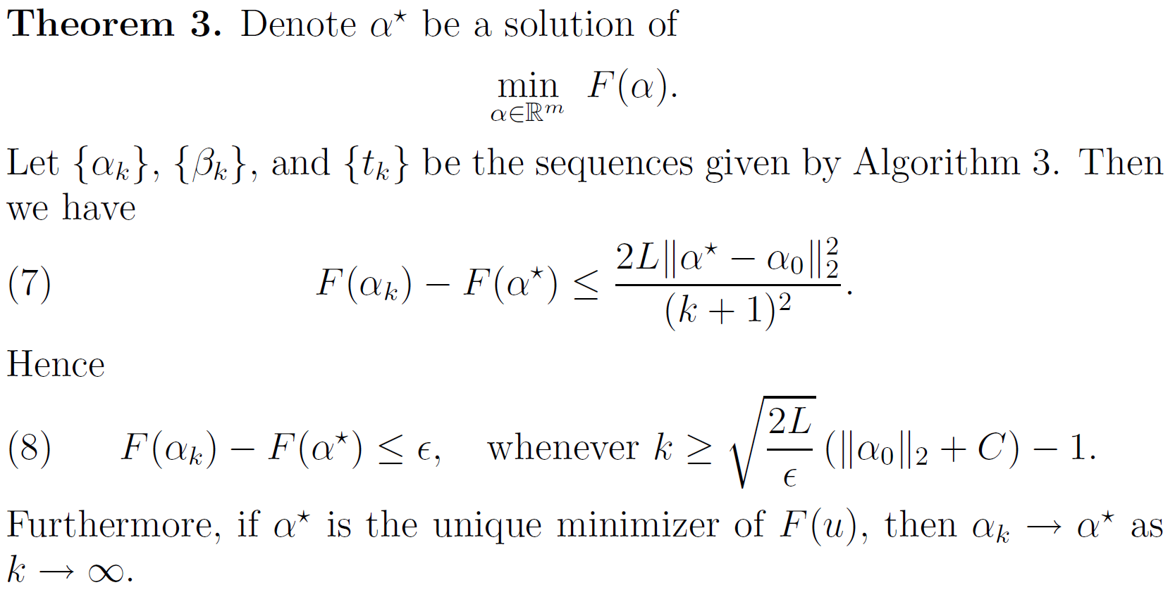
Convergence of APG
The speed of decay is optimal.
Further reading:
  Su, Boyd and Candes. "A differential equation for modeling Nesterov’s accelerated gradient method: theory and insights." NIPS 2014.

Slide 29
Further Extensions
More sophisticated models

Slide 30
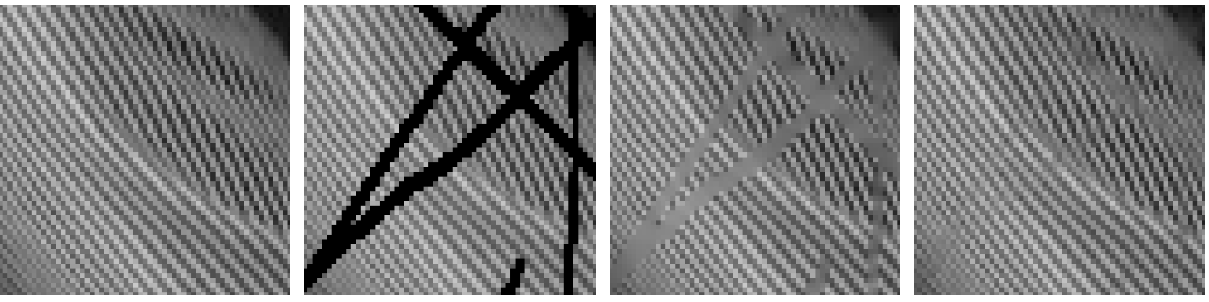
Further Extensions
Two-systems balanced model
Comparison with single-system model
Original
Corrupted
Single-System
Two-Systems

Slide 31
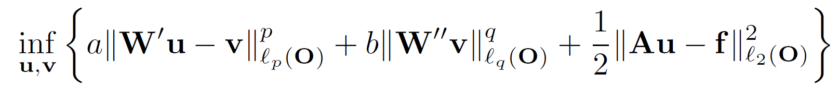
General Frame Based Model
A general wavelet frame model. [Dong, Shen and Xie, SIAM J. Math. Analysis, 2017]
Special case I: balanced model
Special case II: wavelet packet model
Special case III: two-layer model

Slide 32
Wavelet Frame Based Segmentation

Slide 33
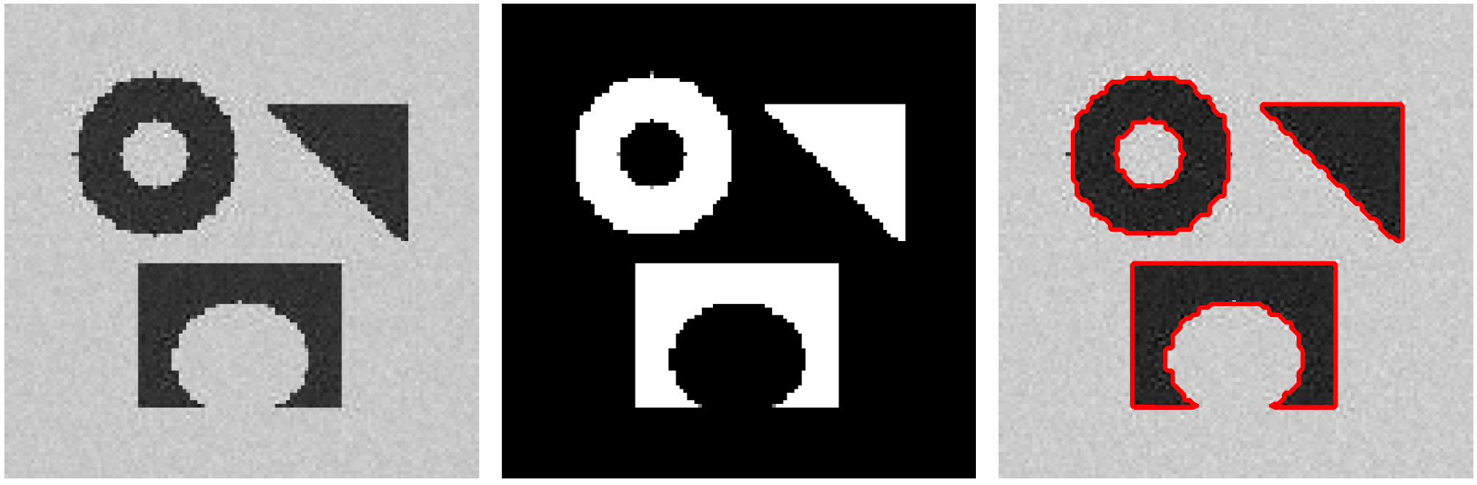

Frame Based Segmentation
What is image segmentation?
Mathematical model: piecewise constant Mumford-Shah

Slide 34
Frame Based Segmentation
Medical application: quantification of abnormalities.
Cortical Surface
Aneurysm
Plaque

Slide 35


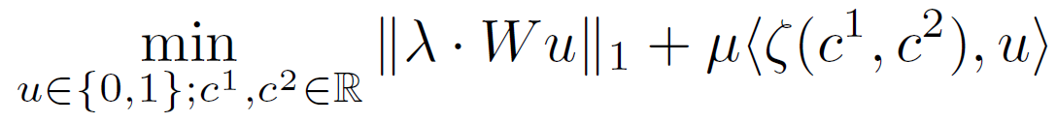
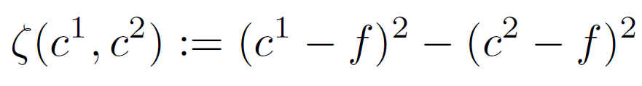


Frame Based Segmentation
Relaxation
Change of variable:
Relaxation of the binary constraints:

Slide 36
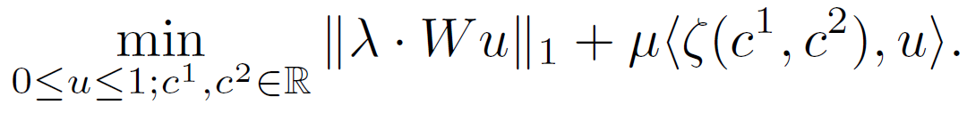



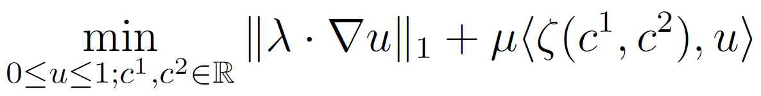

Frame Based Segmentation
Frame based segmentation model:
Let be a solution. Then the domain is a good candidate of segmentation for a.e. .
TV based segmentation model:
For fixed , domain is a solution to the piecewise constant Mumford-Shah model for a.e.
.

Slide 37

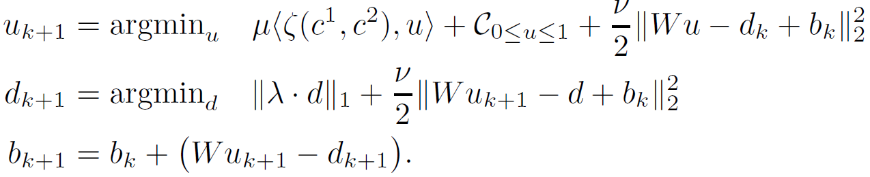
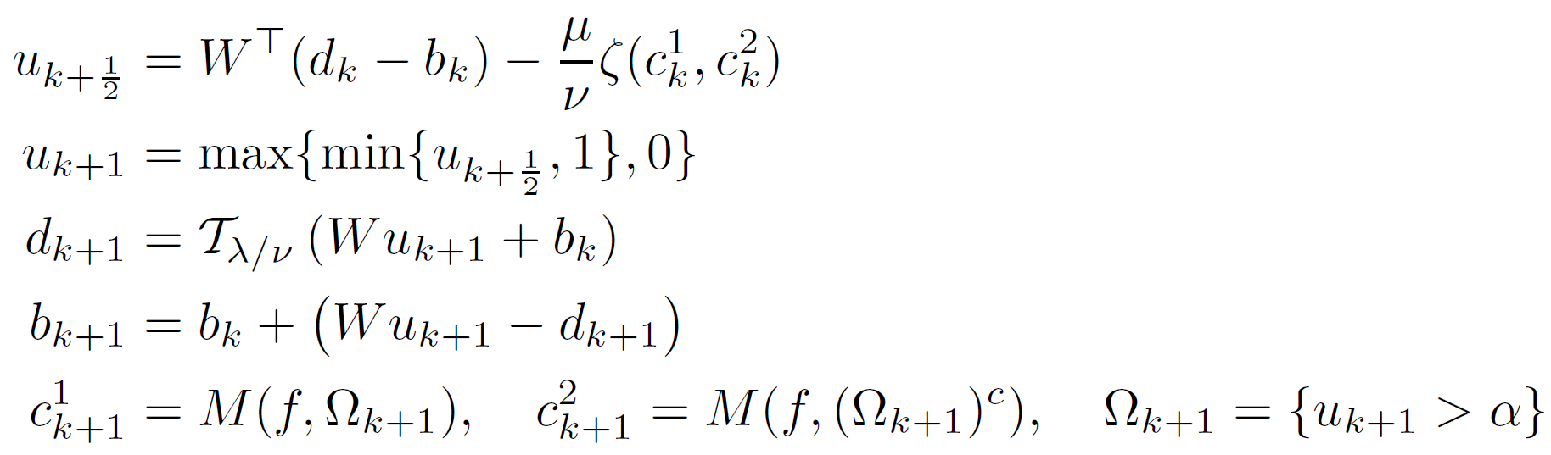
Frame Based Segmentation
Fast algorithm (ADMM/Split Bregman):
Splitting:
ADMM:
Algorithm:

Slide 38
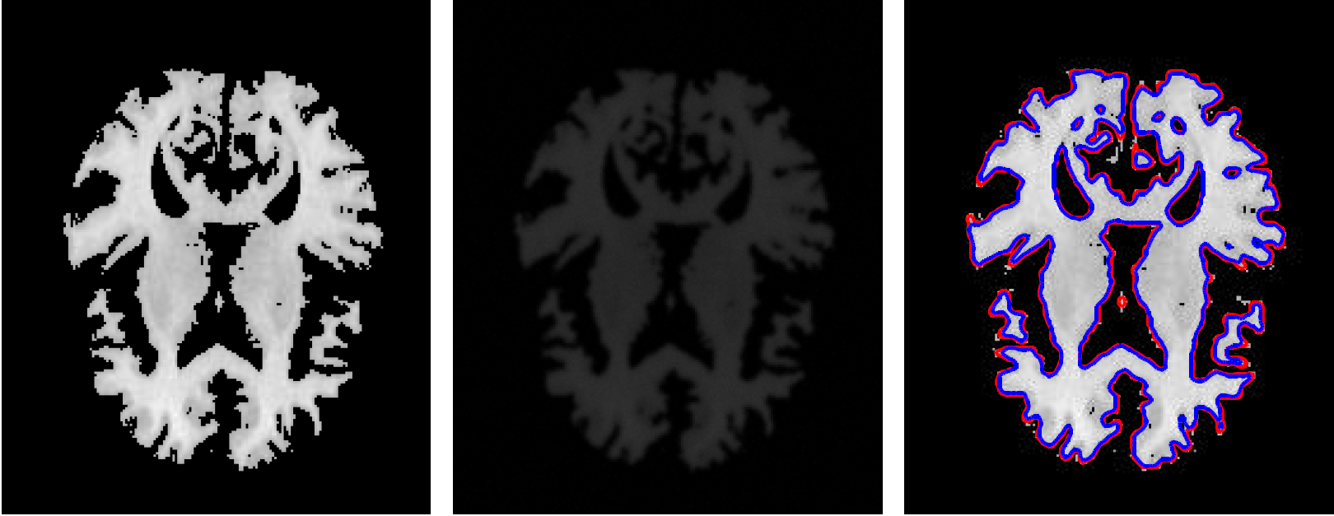
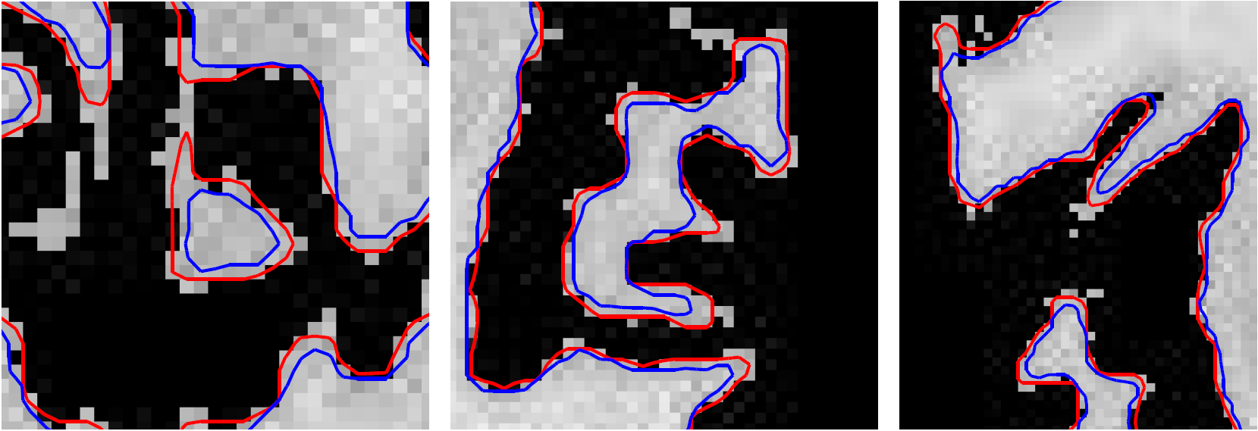
Frame Based Segmentation: Wavelet Frame v.s. TV
Numerical Results: 2D Comparison
Original
Observed
Results
Zoom-In 1
Zoom-In 2
Zoom-In 3

Slide 39
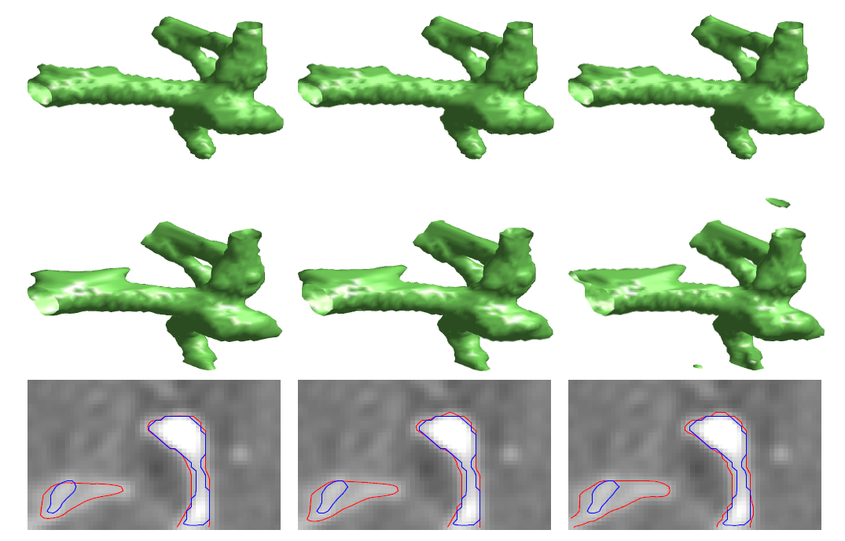
Frame Based Segmentation: Wavelet Frame v.s. TV
Numerical Results: 3D Comparison

Slide 40
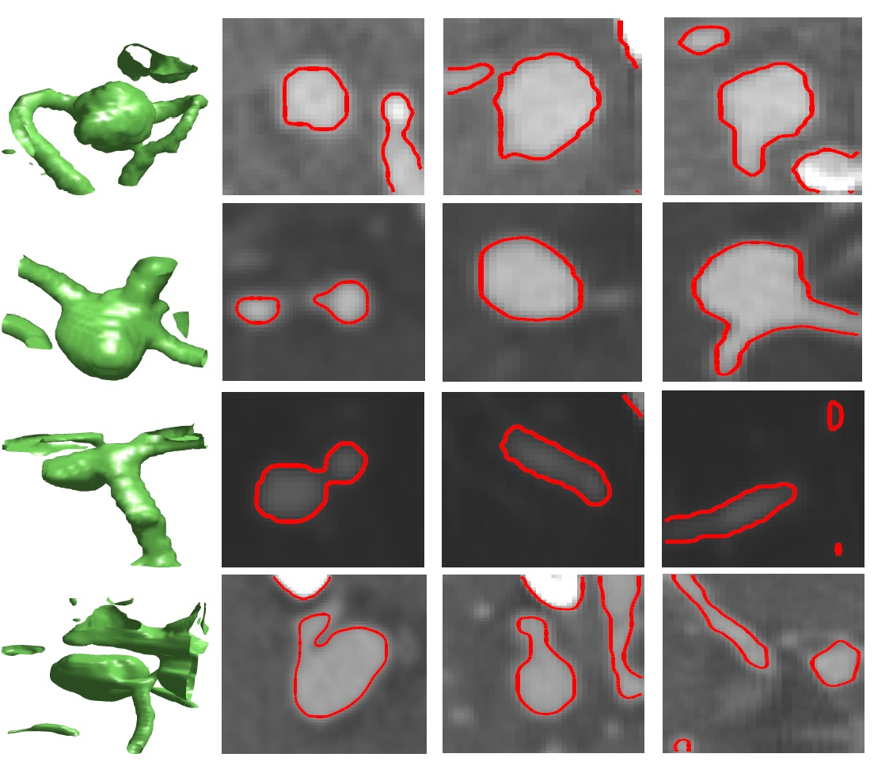
Frame Based Segmentation: More Examples
Numerical Results: More 3D Subjects

Slide 41
Segmentation with Shape Priors
Jointly with J. Liu, X. Zhang, Z. Shen and L. Gu, SIAM J. Imaging Sci. 9(2), 495-536, 2016.

Slide 42
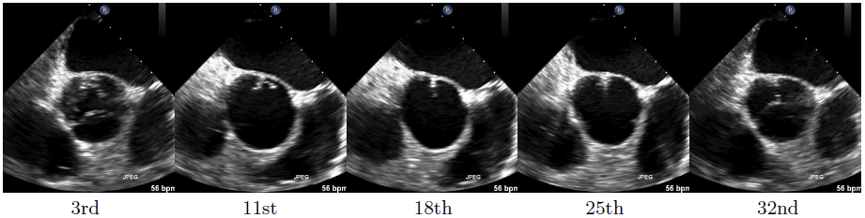
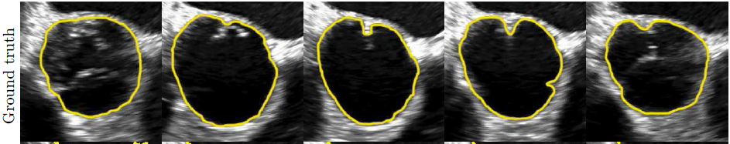
Why Shape Priors?
To restrict the search of segmentation results to a specific set of ROIs.

Slide 43
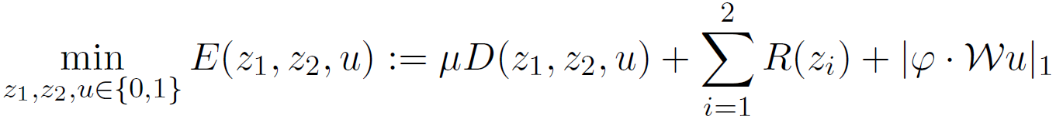

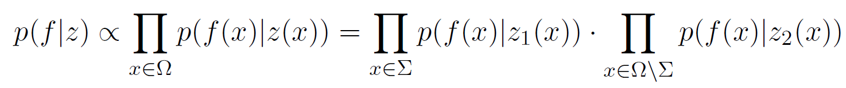

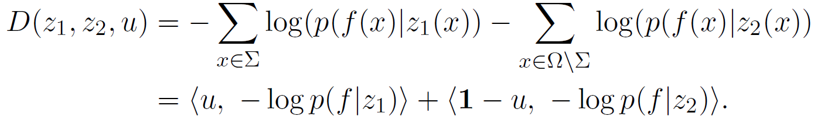
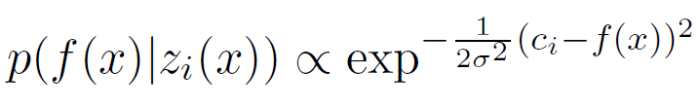
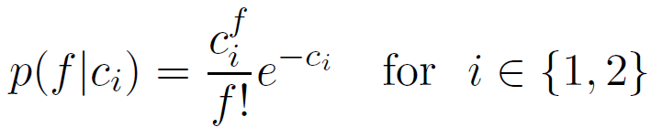

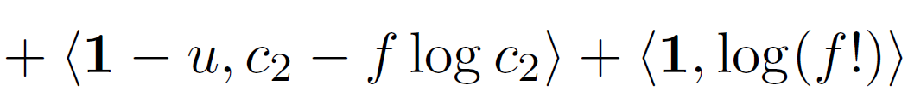
Segmentation Model with Shape Priors
Model (Generic)
Assuming independent noise
Gaussian:
Poisson:

Slide 44
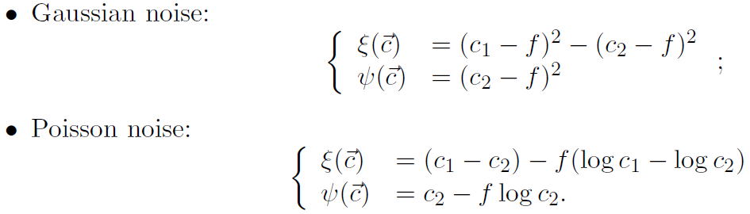
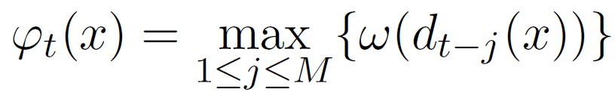
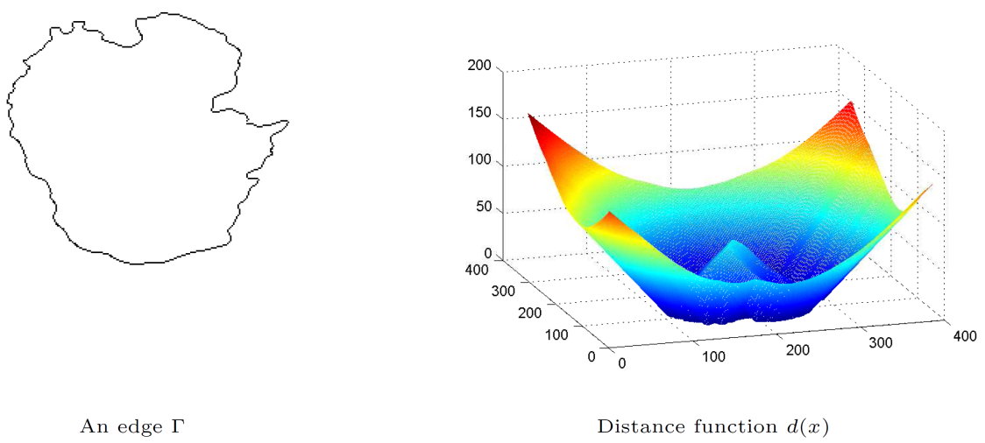

Segmentation Model with Shape Priors
Model (segmentation at frame $t$)
Shape prior at frame $t$:

Slide 45



The Shape Prior
Shape prior at frame t:
  Example: $M=2，t=3$

Slide 46


Optimization Algorithm
Recall the problem:
Proximal alternating minimization (PAM):
Convergence theorem: the sequence $(u^{k},{\vec{c}}^{k})$ generated by the PAM algorithm converges to the critical point of the optimization problem (*).
(*)

Slide 47




CV
No Prior
Frame
No Prior
Frame
with Prior
Ground
Truth

Slide 48
Wavelet Frame Based Surface Reconstruction

Slide 49






Surface Reconstruction
Reconstruct implicit surface from given unorganized point set
Model [Dong and Shen, JCP, 2011]
where

Slide 50
Surface Reconstruction
Synthetic data

Slide 51
Surface Reconstruction
Stanford Bunny
Data
Haar
Linear
Cubic

Slide 52

Surface Reconstruction: More Results

Slide 53

Homework 5
Read the following paper
http://bicmr.pku.edu.cn/~dongbin/Publications/SegSPIE2012.pdf
Implement frame based image segmentation and 3D surface reconstruction from scattered points.
Required results:
  Segmentation: use the images you used in Homework 3, compare geodesic active contour, Chan-Vese and frame based segmentation and discuss what you observe.
  Reproduce the results in Figure 4 of the above paper.
Note on surface reconstruction:
Modify the provided 2D wavelet frame transform to 3D
Use the provided “.mat” data (cndragon, lucy, statuette): $φ, f$

Slide 54
Blind Inpainting

Slide 55






Blind Image Inpainting
Analysis based model for blind image inpainting [Dong, Ji, Li, Shen and Xu, Wavelet frame based blind image inpainting, ACHA, 2010]
Optimization model
Input Image
Inpainting Domain
Output Image

Slide 56


Blind Image Inpainting
Fast algorithm using the same idea as split Bregman algorithm:

Slide 57


Blind Image Inpainting
Fast algorithm using the same idea as split Bregman algorithm:

Slide 58


Blind Image Inpainting
Blind image inpainting: single-system model
Observed
Recovered

Slide 59


Blind Image Inpainting
Blind image inpainting: single-system model
Observed
Recovered: PSNR=24.6

Slide 60

Blind Image Inpainting
Blind image inpainting: two-systems model
Observed
Recovered: PSNR=25.1

Slide 61
Blind Image Deblurring
J.F. Cai, H. Ji, C. Liu, and Z. Shen, Blind motion deblurring from a single image using sparse approximation, Computer Vision and Pattern Recognition, CVPR 2009.

Slide 62

Blind Image Deblurring
Regular deblurring assumes the convolution kernel is known or can be easily estimated, while blind deblurring does not assume that kernel is known.
We need to recover both image and convolution kernel.
Difficulty: too many pairs of solutions, which pair to pick?
Prior knowledge of the convolution kernels is needed.
Blind deblurring:
known

Slide 63

Blind Image Deblurring
Some real blur kernels

Slide 64

Blind Image Deblurring
Some real blur kernels

Slide 65

Blind Image Deblurring
Some real blur kernels

Slide 66




Blind Image Deblurring: Modeling

Slide 67

Blind Image Deblurring: Algorithm
The optimization problem can be solved alternatively by minimizing each of the variables.

Slide 68

Blind Image Deblurring: Algorithm
The optimization problem can be solved alternatively by minimizing each of the variables.

Slide 69




Blind Image Deblurring: Algorithm
Each subproblem can be solved by Linearized Bregman Algorithm

Slide 70


Blind Image Deblurring: Algorithm
Each subproblem can be solved by Linearized Bregman Algorithm

Slide 71

Blind Image Deblurring: Algorithm
Each subproblem can be solved by Linearized Bregman Algorithm

Slide 72


Blind Image Deblurring: Algorithm
Each subproblem can be solved by Linearized Bregman Algorithm

Slide 73
Blind Image Deblurring: Algorithm
Back to Algorithm 4.

Slide 74
Blind Image Deblurring: Algorithm
Back to Algorithm 4.

Slide 75





Blind Image Deblurring: Algorithm
Algorithm 4, subproblem (9) can be solved by:
Algorithm 4, subproblem (10) can be solved by:
Preconditioning

Slide 76

Blind Image Deblurring
Numerical results:

Slide 77

Blind Image Deblurring
Numerical results:

Slide 78

Blind Image Deblurring
Numerical results:

Slide 79

$ℓ_{0}$-Minimization for Wavelet Frame Based Image Restoration
Nonconvex Optimization
Yong Zhang, Bin Dong and Zhaosong Lu, l0 minimization of wavelet frame based image restoration, Math. Comput. 2013.
Yong Zhang and Bin Dong, An efficient algorithm for l0 minimization in wavelet frame based image restoration, JSC, 2013.

Slide 80





Frame Based Models: 0-Norm
Nonconvex analysis based model [Zhang, Dong and Lu, Math. Comput. 2013]
Motivations:
Related work:
Restricted isometry property (RIP) is not
satisfied for many applications
Penalizing “norm” of frame coefficients
better balances sparsity and smoothnes
“norm” with : [Blumensath and Davies, 2008&2009]
quasi-norm with : [Chartrand, 2007&2008]
Notes:
Synthesis: sharper edges but more artifact. Analysis: less artifact but edges are a bit blurry. Balance in between. Which one to choose depends on applications
Key: It works because images are piecewise smooth functions and have sparse representation under tight frame transforms

Slide 81



Fast Algorithm: 0-Norm
Penalty decomposition (PD) method [Lu and Zhang, 2010]
Algorithm:
Change of variables
Quadratic penalty
Notes:
There are other algorithms also, but split Bregman was proved to be efficient for frame based models.

Slide 82




Fast Algorithm: 0-Norm
Step 1:
Subproblem 1a): quadratic
Subproblem 1b): hard-thresholding
Convergence Analysis:
Open question:
convergence of the entire algorithm?
without positive definiteness assumption?
Notes:
There are other algorithms also, but split Bregman was proved to be efficient for frame based models.

Slide 83


Numerical Results
Comparisons (Deblurring)
Balanced
PFBS/FPC: [Combettes and Wajs, 2006] /[Hale, Yin and Zhang, 2010]
Analysis
Split Bregman: [Goldstein and Osher, 2008] & [Cai, Osher and Shen, 2009]
0-Norm
PD Method: [Zhang, Dong and Lu, 2011]
Notes:
Most important: relationship between minimizers.

Slide 84


Numerical Results
Comparisons (deblurring)
Portrait
Couple
Balanced
Analysis
Notes:
Most important: relationship between minimizers.

Slide 85


Faster and Better Algorithm
Start with some fast optimization method for nonsmooth and convex optimizations: doubly augmented Lagrangian (DAL) method [Rockafellar, 1976].
Given the problem:
The DAL method:
where
We solve the joint optimization problem of the DAL method using an inexact alternative optimization scheme
Notes:
There are other algorithms also, but split Bregman was proved to be efficient for frame based models.

Slide 86


Faster and Better Algorithm
Start with some fast optimization method for nonsmooth and convex optimizations: doubly augmented Lagrangian (DAL) method [Rockafellar, 1976].
Given the problem:
The DAL method:
where
Open question: convergence?
Hard thresholding
Notes:
There are other algorithms also, but split Bregman was proved to be efficient for frame based models.

Slide 87




Faster and Better Algorithm
However, the inexact DAL method does not seem to converge!! Nonetheless, the sequence oscillates and is bounded.
The mean doubly augmented Lagrangian method (MDAL) [Dong and Zhang, JSC, 2013] solve the convergence issue by using arithmetic means of the solution sequence as outputs instead:
MDAL:
Notes:
There are other algorithms also, but split Bregman was proved to be efficient for frame based models.

Slide 88

Comparisons: Deblurring
Comparisons of best PSNR values v.s. various noise level
Notes:
There are other algorithms also, but split Bregman was proved to be efficient for frame based models.

Slide 89

Comparisons: Deblurring
Comparisons of computation time v.s. various noise level
Notes:
There are other algorithms also, but split Bregman was proved to be efficient for frame based models.

Slide 90


Comparisons: Deblurring
What makes “lena” so special?
Decay of the magnitudes of the wavelet frame coefficients is very fast, which is what 0-norm prefers.
1-norm
0-norm: PD
0-norm: MDAL
Notes:
There are other algorithms also, but split Bregman was proved to be efficient for frame based models.

Slide 91
Piecewise Smooth Image Model
J.F. Cai, B. Dong and Z. Shen, Image restoration: a wavelet frame based model for piecewise smooth functions and beyond, ACHA, 2016.

Slide 92



Piecewise Smooth Image Model
How images are modeled:
Images are “piecewise smooth” functions:
Functions in BV space (variational and PDE models)
Functions in bounded TGV space
Functions in Besov spaces (wavelets and wavelet frames)
Functions in SBV space (Mumford-Shah)

Slide 93



Piecewise Smooth Image Model
Wavelet frame based image restoration model
When , the model reduces to Tikhonov regularization model (over-smoothing)
When , the model reduces to the analysis based model (introducing unwanted singularities)
The term is to introduce enough smoothness away from singularities
The term regularizes both jumps and hidden jumps
Jump set

Slide 94



Fast Algorithm
Alternative optimization
Fixing jump set, recover image
Fixing image, estimate jump set

Slide 95


Numerical Results: Deblurring
Analysis based model
PSNR=31.72
Piecewise smooth model
PSNR=34.27

Slide 96


Numerical Results: Deblurring
Car
Goldgate
Interior
Pitt
Samantha
Deblurring Results

Slide 97


Other Piecewise Smooth Image Model
Ji, Luo and Shen, Image Recovery via Geometrically Structured Approximation, ACHA, 2016.
Choi, Dong and Zhang, An Edge Driven Wavelet Frame Model for Image Restoration, ACHA, 2020.
Comparisons: image inpainting

Slide 98

Other Piecewise Smooth Image Model
Ji, Luo and Shen, Image Recovery via Geometrically Structured Approximation, ACHA, 2016.
Choi, Dong and Zhang, An Edge Driven Wavelet Frame Model for Image Restoration, ACHA, 2020.
Comparisons: image inpainting

Slide 99
Connections: Wavelet Frame and PDE Based Approaches
Optimization models and iterative algorithms
v.s.
Variational and PDE models

Slide 100


Frame Based Image Restoration Models
Analysis Based Approach
Synthesis Based Approach
Balanced Approach
Notes:
Meaning of minimizing I-WW^top

Slide 101


Iterative Shrinkage Algorithm
Iterative wavelet frame shrinkage algorithm
Choices of shrinkage operators
Here . (bi-frame transforms)
Multiplicative
Anisotropic-Soft
Isotropic-Soft
where
Notes:
Meaning of minimizing I-WW^top

Slide 102



Variational Models
Rudin-Osher-Fatemi (ROF) 1992
BV semi-norm
Euler-Lagrange
Notes:
Difference between BV and W_2^1

Slide 103




Variational Models
Removing staircase effects by better modeling
Chambolle and Lion (CL) 1997
Chan, Esedoglu, and Park (CEP) 2005
Total generalized variation (TGV): Bredies, Kunisch and Pock 2010
Restored Image:

Slide 104





PDE Models
Anisotropic diffusion: Perona-Malik (PM) diffusion [Perona and Malik 1990]
Nonlinear hyperbolic equation: shock filters [Rudin and Osher 1990]
Version 1
Version 2

Slide 105

Connections?

Slide 106
Connections?
菲尔兹奖得主:
David Mumford，1974
Pierre Lions， 1994
Terry Tao，2006

Slide 107
Connections?
Gauss奖得主:
Yves Meyer，2010
Stanley Osher， 2014
David Donoho，2018

Slide 108
Connections?
Wolf奖得主:
David Mumford，2008
Ingrid Daubechies， 2023
Abel奖得主：
Yves Meyer，2017

Slide 109


Connections?
Continuum
Discrete
Variational Models
Wavelet Models
PDEs
Wavelet Shrinkage Alg.

Slide 110
Connections
Continuum
Discrete
Variational Models
Wavelet Models
PDEs
Wavelet Shrinkage Alg.
J. Cai, B. Dong, S. Osher and Z. Shen, Journal of American Mathematical Society, 25(4), 1033-1089, 2012.
J. Cai, B. Dong and Z. Shen, Applied and Computational Harmonic Analysis, 41(1), 94-138, 2016.
B. Dong, Z. Shen and P. Xie, SIAM Journal on Mathematical Analysis, 49(1), 421-445, 2017.
B. Dong, Q. Jiang and Z. Shen, Multiscale Modeling & Simulation, 15(1)，606-660, 2017.

Slide 111
Connections
Continuum
Discrete
Variational Models
Wavelet Models
PDEs
Wavelet Shrinkage Alg.
Significance of the series of studies:
Merging of the two separately developed fields for the first time
PDE/Variational models also have the property of sparse approximation
Granting geometric interpretations to wavelet/wavelet frame models
Giving birth to new and effective models
Spinning off to deep learning

Slide 112
Connections Part I
Analysis based model and variational model

Slide 113




Tight Wavelet Frames - Review
Quasi-affine system:
Refinable and wavelet functions
Unitary extension principle (UEP)
Discrete 2D transformation:

Slide 114



Connections: Motivations
Difference operators in wavelet frame transform:
Thus,
Filters
Transform
Approximation
where

Slide 115



Connections: Motivations
Difference operators in wavelet frame transform:
Thus,
More rigorously [Choi, Dong and Zhang, ACHA, 2019]:
Filters
Transform
Approximation

Slide 116



Connections: Motivations
More examples: piecewise linear B-spline framelets
Illustration of the previous proposition (Haar):

Slide 117




Connections: Analysis Based Model and Variational Model
Summary of main results
The connections give us
Leads to new applications of wavelet frames:
Converges
For any differential operator when proper parameter is chosen.
Geometric interpretations of the wavelet frame transform (WFT)
WFT provides flexible and good discretization for differential operators
Different discretizations affect reconstruction results
Good regularization should contain differential operators with varied orders (e.g., total generalized variation [Bredies, Kunisch, and Pock, 2010])
Image segmentation: [Dong, Chien and Shen, 2010; Tai, Zhang and Shen, 2013; Liu et al. 2015]
Surface reconstruction from point clouds: [Dong and Shen, 2011]
Standard Discretization
Piecewise Linear WFT

Slide 118
Connection II
Iterative wavelet frame shrinkage and nonlinear evolution PDEs

Slide 119

PDEs and Wavelet Shrinkage
Iterative wavelet frame shrinkage algorithm
Nonlinear evolution PDEs
Here . (bi-frame transforms)
PM
SF
Notes:
Meaning of minimizing I-WW^top

Slide 120
Motivations
Earler work
2nd-order diffusion and Haar wavelet: [Mrazek, Weickert and Steidl, 2003&2005]
High-order diffusion and tight wavelet frames in 1D: [Jiang, 2011]
Questions yet to be answered
How general the connections can be?
Can we theoretically justify such connection, at least for some PDEs?
Can we see something new from such connection, design new models and acquire deeper understanding of both approaches?

Slide 121





Wavelet Bi-Frames - Review
Pair of refinable and wavelet functions
Mixed extension principle (MEP): bi-frame filter bank
Discrete 2D transformation
Reconstruction can be defined similarly and
where and

Slide 122




Key Observations
Given bi-frame filter bank
1-step frame shrinkage (Lev$=1$):
Reformulation of 1-step frame shrinkage algorithm
Shrinkage operator

Slide 123



Key Observations
Proof of Proposition 2.1:
By MEP
Then,

Slide 124


Key Observations
Multiple steps:
Multi-channel shrinkage

Slide 125

Key Observations
Links to nonlinear evolution PDE of the form
Splitting W to low and high frequency bands,
Then
Discretization by wavelet frame transform:
where

Slide 126

Key Observations
Vanishing moments and differential operators
  Order and total order of vanishing moments

Slide 127



Key Observations
Vanishing moments and differential operators
  Order and total order of vanishing moments

Slide 128


Key Observations
Vanishing moments and differential operators
  Examples

Slide 129


Key Observations
Proposition 2.1 leads to
Compare it with
Therefore, given any nonlinear evolution PDE, we can find a corresponding wavelet frame shrinkage algorithm, and vice versa.
where

Slide 130



Key Observations
Consider the following PDE
If we use tensor-product Haar wavelet frame system, the above PDE can be discretized by
Iterative wavelet shrinkage algorithm:
Then, we can choose

Slide 131

Examples
Recall:
PDE:
Choice of shrinkage:
Anisotropic Diffusion
Bi-frame involved:

Slide 132


Examples
Recall:
PDE:
Shock Filter
Choice of shrinkage:
Bi-frame involved:

Slide 133



Differences from Existing Methods
Sampling by wavelet frame transform (WFT):
Finite difference approximation:
WFT has a more general sampling
Does not have a left inverse, while WFT has
Not as good a discretization as WFT for image restoration
Wavelet Galerkin method:
Need to calculate the connection coefficients, which is not as convenient and simple as using WFT
Not as flexible as WFT to work for generic evolution PDEs
Function value:
Differentiation:

Slide 134

Main Findings
Such connection leads to new PDEs! For example:
Iterative anisotropic soft-thresholding leads to
Iterative isotropic soft-thresholding leads to
Iterative shrinkage algorithm [Li, Fan, Ji, Shen, 2013]
Accelerated adaptive multiplicative-thresholding (A-AMT)
PDE:
(IRED)
PDE:
(A-IRED)
A blending of parabolic and hyperbolic!
Same observation was given in [Mao, Dong and Osher, MMS, 2010]

Slide 135


Main Findings
Such connection leads to new wavelet frame shrinkage algorithms!
For example:
Adaptive multiplicative-thresholding (AMT) algorithm
Adaptive soft-thresholding (AST) algorithm
where
where

Slide 136


Main Findings
Advantage of the new models for image deblurring:
WFT as better discretization than standard finite differencing
New models are generally better
Acceleration

Slide 137
Summary
What we have known
Wavelet frame transform approximates differential operators in variational and PDE framework, and they are good discretization for image restoration
We have obtained deep understanding and new insights of both approaches: grants variational/PDE models sparse approximation; grants wavelet frame geometric meanings
We managed to created new models and algorithms with combined merits
Lead to a mathematical understanding of deep neural networks

