Slide 1
Learning to Solve Parametric PDEs
Bin Dong (董彬)
Beijing International Center for Mathematical Research &
Center for Machine Learning Research,
Peking University

Slide 2
Outline
Overview
Parametric PDEs
Neural network approach for solving PDEs
Meta-learning perspective
Solving Parametric PDEs via Meta-Learning
Meta-MgNet: improving multigrid method with meta-learning
Meta-Auto-Decoder (MAD): a manifold learning approach
Joint work with Huawei MindSpore AI + Scientific Computing team.
A brute force approach: direct mappings
Joint work with Huawei MindSpore AI + Scientific Computing team
& Shanghai Aircraft Design and Research Institute, The Commercial Aircraft Corporation of China.
Conclusions and Future Work
Notes:
我今天会先给大家梳理一下基于神经网络的PDE数值求解的方法类型，他们之间的优点与缺点，可能的试用场景，这些都仅是我的个人观点。之后，我会介绍参数化PDE的求解，我们是从meta-learning角度出发，等下我会解释什么是meta-learning，以及它与基于深度学习的参数化PDE的求解的关系。
然后我会具体介绍我们两个系列工作，一个是从模型约简（ROM）和流形学习的角度探讨基于深度学习的参数化PDE求解，侧重算法和理论；第二个是面向落地，我们的做法要相对直接，侧重在数据、大模型和算力。当然我们也希望有一天理论算法和落地可以完美结合，但是现阶段看来落地主要还是要依赖数据、大模型和算力。
最后我会对我们的工作进行总结并展望未来。

Slide 3
Overview
A brief literature review

Slide 4
Parametric PDEs
Generic parametric PDEs:
For example: 1D Burgers’ Equation:
$η=\left(ν,u_{0}\right)$.
Objective: solving the PDEs efficiently for all $η$.
A prevailing approach: reduced basis methods (e.g., Ohlberger and Rave, 2016):
Offline stage: approximation of solution manifold;
Online stage: fast adaptation to new parameters.
$\tilde{x}=x$ or $\left(x,t\right)$
$η=(γ_{1},γ_{2})$ or $(γ_{1},γ_{2},Ω)$

Slide 5
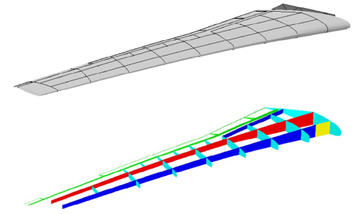
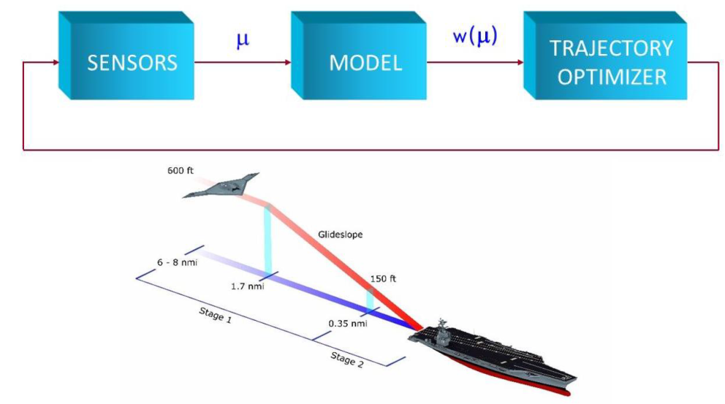
Parameters of Parametric PDEs
Typical parameters of interest:
Shape parameters
Material (properties) parameters
Operation parameters (e.g. flight conditions, cruise conditions, etc.)
Scenarios require solving $u(η)$ for multiple $η$:
Inverse problems
Design optimization
Optimal control
Model predictive control
Etc.
Model predictive control

Slide 6
Semi-Discrete Problem
Discretize the PDE in space by:
Finite difference approximation
Finite element method
Finite volume method
Discontinous Galerkin method
Spectral method …
This leads to a system of $N_{u}=m×N_{space}$ equations:
$$\left\{\begin{matrix}\frac{du_{h}\left(t;η\right)}{dt }=F\left(t,u_{h}(t;η);η\right), & Time dependent \\ F\left(u_{h};η\right)=0, & Steady (nonlinear) \\ A_{η}u_{h}=f, & Steady (linear)\end{matrix}\right.$$

Slide 7
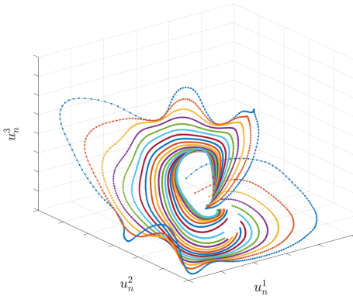
Dimensionality Reduction
Consider the manifold of solutions:
$$ℳ_{h}=\left\{u_{h}\left(t;η\right):η∈D\right\}⊂ℝ^{N_{u}}$$
Often $n=dim\left(ℳ_{h}\right)≪N_{u}$.
Linear reduced order modeling (ROM) is to find ${\tilde{u}}_{h}\left(t;η\right)≈u_{h}\left(t;η\right)$ in the form:
$${\tilde{u}}_{h}\left(t;η\right)=Vu_{n}\left(t;η\right)$$
Assume ${span\left\{v_{1}, …, v_{n}\right\}≈ℳ}_{h}$ and let $V=(v_{i})∈ℝ^{N_{u}×n}$.
Intrinsic coordinates of the ROM approximation is $u_{n}\left(t;η\right)$.
Matrix $V$ is the first $n$ left singular vector of:
$$U=\left[u_{h}\left(t^{1};η_{1}\right),…,u_{h}\left(t^{N_{t}};η_{1}\right),…,u_{h}\left(t^{1};η_{N_{η}}\right),…,u_{h}\left(t^{N_{t}};η_{N_{η}}\right)\right]$$
Reduced dynamics (Petrov-Galerkin projection):
$$\left\{\begin{matrix}Y^{⊤}V{\dot{u}}_{n}\left(t;η\right)=Y^{⊤}F(t,Vu_{n}\left(t;η\right);η) \\ u_{n}\left(0;η\right)={\left(Y^{⊤}V\right)}^{−1}Y^{⊤}u_{0}\left(η\right)\end{matrix}\right..$$
Generally untrue, especially for advection-dominated problems!

Slide 8
Neural Networks-Based PDE Solvers – A Highly incomplete List
arXiv:1710.00211
arXiv:1710.00211
Approximation of solution $u: ℝ^{d}→ℝ^{d^{′}}$:
J. Sirignano and K. Spiliopoulos, JCP, 375:1339-1364, 2018 (arXiv:1708.07469).
W. E and B. Yu, CMS, 6(1), 1-12, 2018 (arXiv:1710.00211).
M. Raissi et al., JCP, 378:686–707, 2019 (arXiv:1711.10561).
W. Cai and Z. Xu, arXiv:1910.11710.
Approximation of the solution manifold $ℳ⊂𝒰$:
K. Lee and K. T. Carlberg, JCP, 404, 108973, 2020 (arXiv:1812.08373).
S. Fresca, L. Dede’ and A. Manzoni, JSC 87(2), 61, 2021 (arXiv:2001.04001).
X. Huang et al., NeurIPS 2022 spotlight (arXiv:2111.08823).
Approximation of solution mapping $𝒮:𝒜→ℳ$:
Integration with classical numerical methods:
Z. Long et al., ICML 2018 (arXiv:1710.09668).
D. Ray, J. S Hesthaven. JCP, 367:166–191, 2018.
Y. Bar-Sinai et al., PNAS, 116 (31), 15344–15349, 2019 (arXiv:1808.04930.).
Z. Long, Y. Lu and B. Dong, JCP, 399, 108925, 2019 (arXiv:1812.04426).
Direct approximation:
Y. Khoo, J. Lu, L. Ying. EJAM 2021 (arXiv:1707.03351).
L. Lu, P. Jin, G. E. Karniadakis, arXiv:1910.03193.
K. Wu and D. Xiu, JCP 2020 (arXiv:1910.06948).
Z. Li et al., ICLR 2020 (arXiv:2010.08895).
Notes:
下面，我来梳理一下基于神经网络的PDE求解方法。我按照 神经网络逼近的目标的不同 来分类，总共分成三大类：逼近解、逼近解流形、逼近解映射
第一类：逼近解，这也可能是最自然的想法，因为和我们传统的做法十分相容，可以理解为是把原来多项式逼近或者Fourier逼近替换成神经网络逼近，把原来求解方程组的算法替换成随机梯度优化。这种做法的优势是当d非常大的时候，传统多项式逼近就无效了，然而神经网络逼近就有了明显的优势，此外，对于一些复杂的场景，比如多孔介质、或者明平兵老师做的刚体大形变，神经网络也有优势，此外，在d较小的情况下，这种方法没有逼近上的优势，反而有难以训练的劣势。也是为了克服这一点，最近陈景润和鄂老师团队合作提出用Random Feature Model来作为ansatz，得到了很好的效果。最后我提一句，这类方法还一个缺点就是如果PDE的参数（比如初边值条件，边界形状等）变了，就要重新训练，这进一步的限制了这类方法的计算效率，不适合参数化PDE的求解。
第二类方法：逼近解流形M，就是面向参数化PDE的求解。M通常是函数空间U一个高维甚至无穷维的子集，经典的ROM，比如POD，用的是对M的线性逼近，这类逼近当PDE是diffusion-dominated的问题是的确有效，但是对于advection-dominated problem的时候效果就大打折扣，这点后面我会具体介绍我们在这方面的一些思考和成果，也就是我此前说的第一个系列工作Meta-Auto-Decoder。
第三类方法：逼近结算子，也是面向参数化PDE的求解。这当然也是一个无穷维的映射，用神经网络去逼近也有一定的优势。这里面还可以分成两个小类，一类是我们在现有的算法（即人工设计的解映射）基础上，用神经网络替换掉其中的某些算子，从而实现算法加速。由于这类方法是基于传统算法做的局部的调整，因此也可以有一些理论上保证；另一个子类就更加直接一些，用的基本上是black-box或者gray-box来近似解映射，虽然理论上要比上一个子类欠缺一些，但是在精度适中的情况下（1e-2-1e-4）可以实现几个数量级的加速，在很多实际工程问题中是十分有效的，比如我要介绍的第二个系列工作，利用深度学习大模型加速机翼的流体仿真。
下面我先介绍一下参数化PDE的一些背景，然后从解流形逼近和解映射逼近两个角度去介绍我们的两个系列工作。

Slide 9
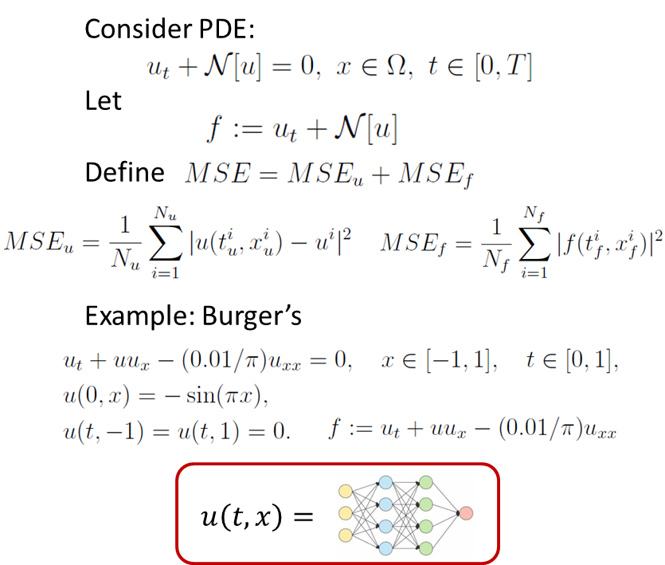
Neural Networks-Based PDE Solvers – A Highly incomplete List
NN as a new ansatz of solution $u$:
M. Raissi et al., JCP, 378:686–707, 2019.

Slide 10
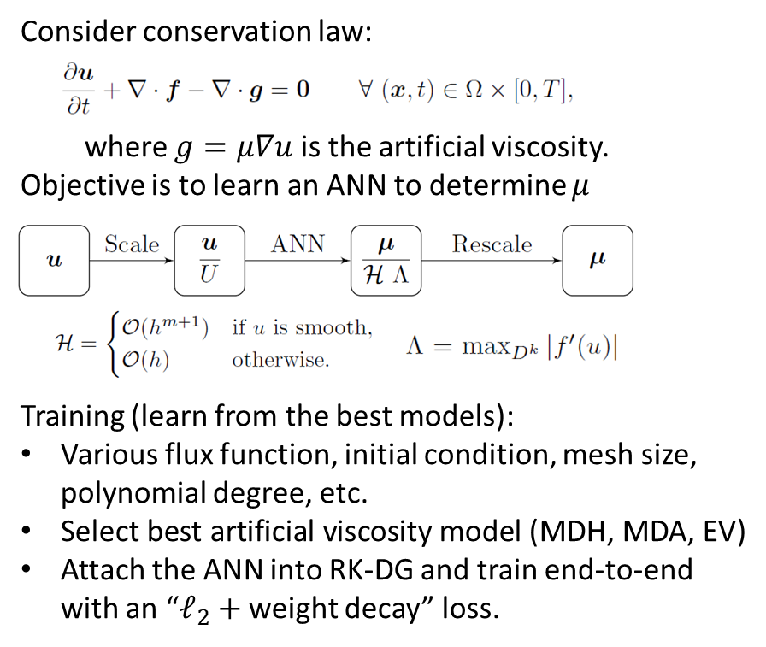
Neural Networks-Based PDE Solvers – A Highly incomplete List
NN as a new ansatz of solution mapping $𝒮$:
Integration with classical solvers
N. Discacciati et al., JCP, p. 109304, 2020.

Slide 11
Bring Meta-Learning to the Design of PDE Solvers
We regard the learning of a solver for a set of $η$ as a multi-task learning problem.
A key difference from supervised learning: leveraging common structures hidden in the tasks!
Meta-learning is effective on learning new tasks faster based on experience from previous tasks.
This approach was first proposed by (Chen, Dong, Xu, 2022)
Interestingly, meta-learning has the same methodology as reduced order modeling!
Offline stage: to extract low-dim structures from the data
Online stage: exploiting the low-dim structures for fast adaptation

Slide 12
A Meta-Learning Approach for Parametrized PDEs: Meta-MgNet
Yuyan Chen, Bin Dong and Jinchao Xu, Meta-MgNet: Meta Multigrid Networks for Solving Parameterized Partial Differential Equations, Journal of Computational Physics, 455, 110996, 2022 (arXiv:2010.14088).

Slide 13
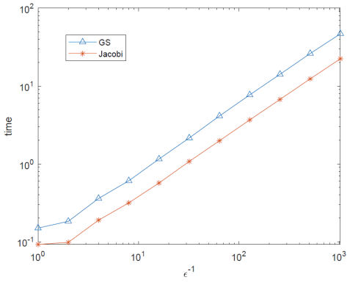
Multigrid Method for Linear Problems
We focus on the linear problem: $A_{η}u=f$
Multigrid method (MG) has linear complexity
However, CPU time for MG can go up significantly when $η$ is within certain range
For example

Slide 14
Multigrid Method for Linear Problems
We focus on the linear problem: $A_{η}u=f$
Multigrid method (MG) has linear complexity
However, CPU time for MG can go up significantly when $η$ is within certain range
This can be improved by modifying crucial components in the MG method:
Smoother
Prolongations
Restrictions
How? Can machine learning help?
Idea: making the algorithm adaptive to $η$ ($f$ as well)

Slide 15
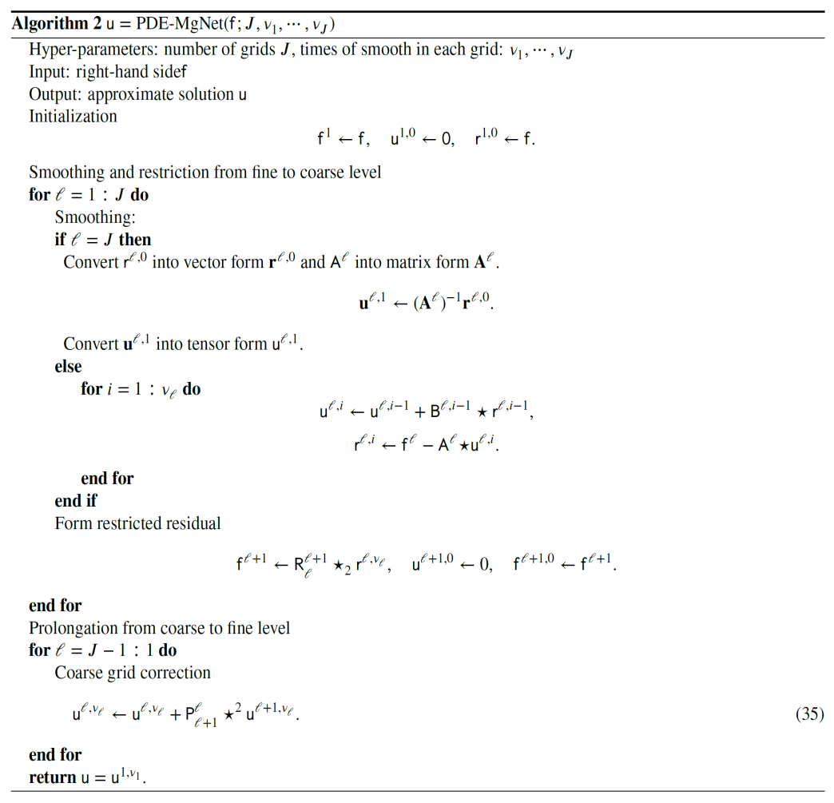
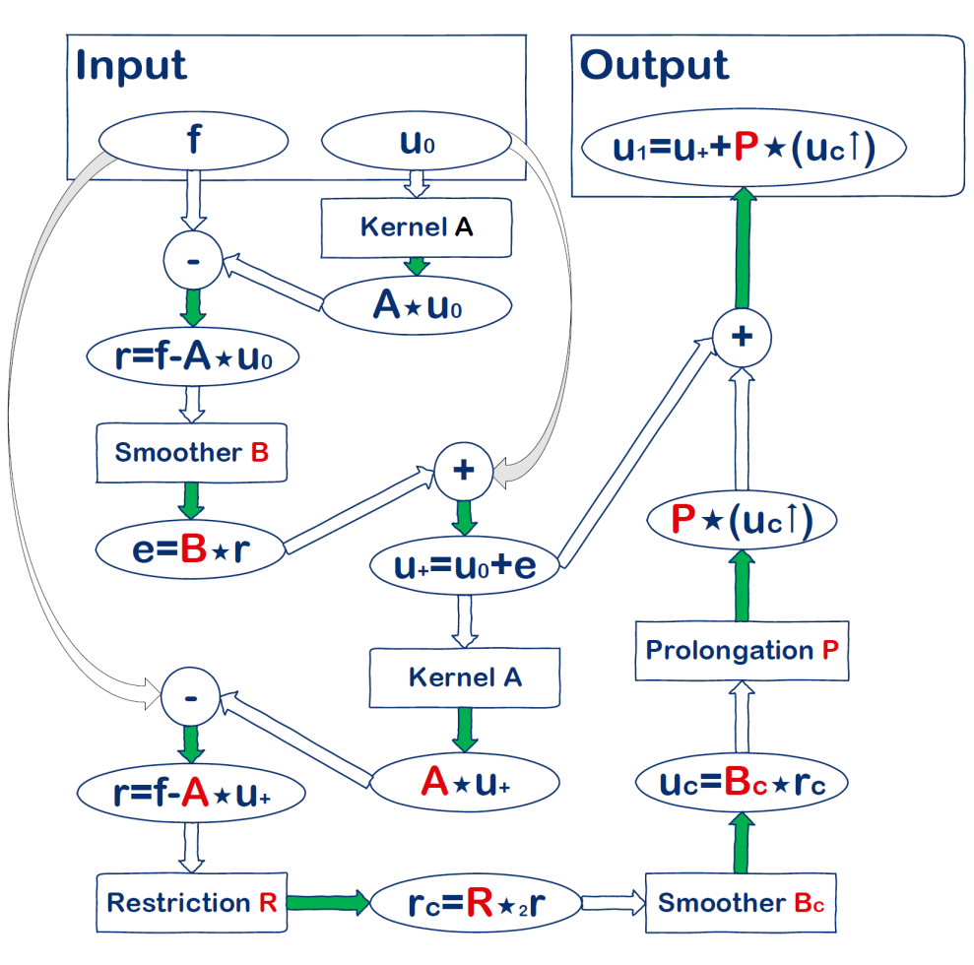
PDE-MgNet: for Solving PDEs
PDE-MgNet (He & Xu, 2019)

Slide 16
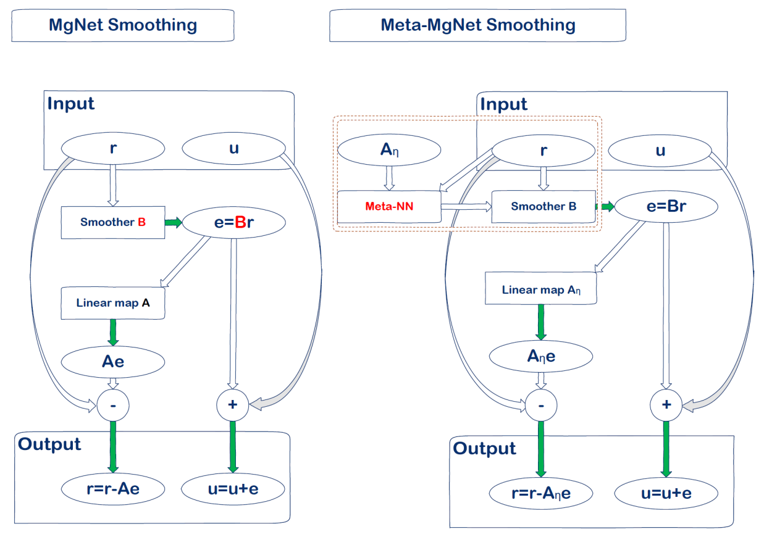
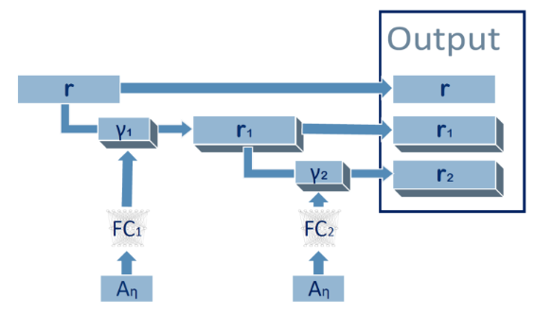
Meta-MgNet
Introducing a hypernetwork (Meta-NN) in MgNet (Xu & He 2019)
Meta-NN induces a smoother adaptive to $η$
Meta-NN：
Input:
Kernel of the operator $A_{η}$
Residual $r$
Output: a set of vectors that spans a subspace for subspace correction
$$𝓖_{θ}(r,A_{η})$$

Slide 17
Meta-MgNet
Introducing a hypernetwork (Meta-NN) in MgNet (Xu & He 2019)
Meta-NN induces a smoother adaptive to $η$
Motivation: Krylov subspace
Meta-NN: $𝒢_{θ}\left(r,A_{η}\right)=𝒩_{FC_{θ}(A_{η})}\left(r\right)\text{,}$
$𝒩_{γ}$ is a 3-layer dense-net block (Huang et al. 2017) with parameter $γ$
$FC_{θ}$ is a 2-layer fully connected neural network with parameter $θ$
Unsupervised training: ${\left\|f−A_{η}u_{t}\right\|}_{2}/{\left\|f\right\|}_{2}<{10}^{−6}$
Convergence guarantee for Poisson problem √

Slide 18
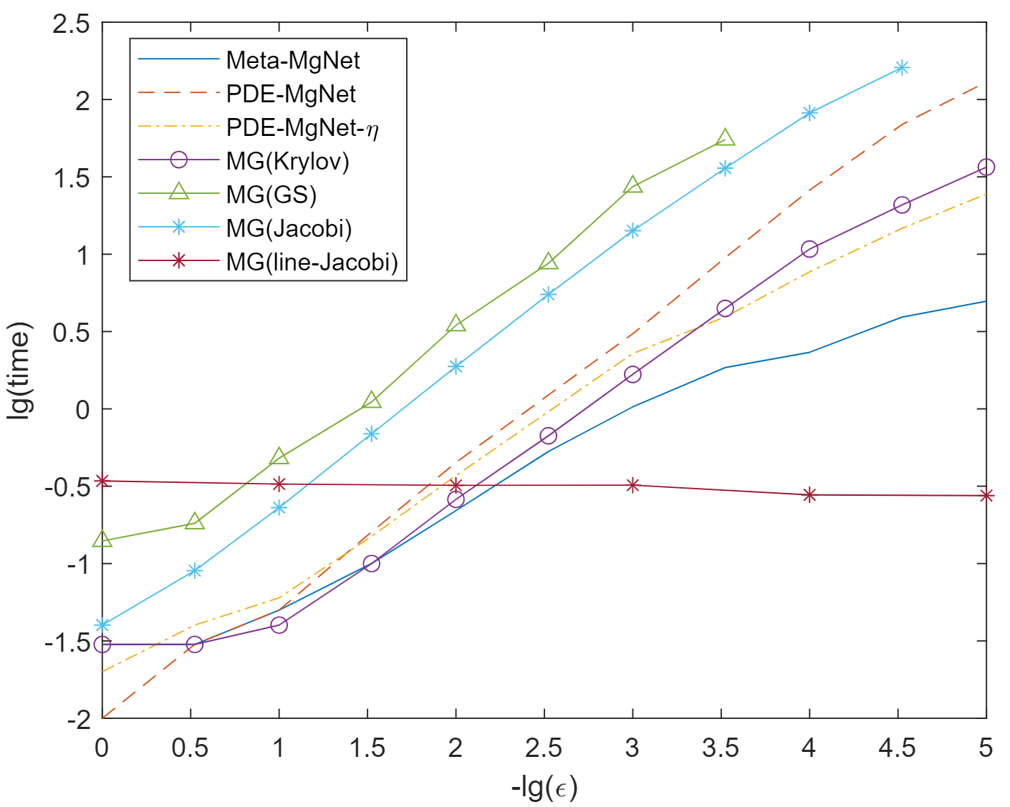
Experiments
2D anisotropic diffusion equation: $θ∈\left[0,π\right],ε∈[{10}^{−5},1]$
Results:
Good performance on extrapolation w.r.t. $η=(θ,ε)$.
Meta-MgNet
$×$7 speedup

Slide 19
A Meta-Learning Approach for Parametrized PDEs: Meta-Auto-Decoder (MAD)
Jointly with Huawei MindSpore AI + Scientific Computing team
X. Huang, Z. Ye, H. Liu, et al., Meta-Auto-Decoder for Solving Parametric Partial Differential Equations, NeurIPS 2022, Spotlight (arXiv:2111.08823).
Z. Ye, X. Huang, H. Liu and B. Dong, Meta-Auto-Decoder: A Meta-Learning Based Reduced Order Model for Solving Parametric Partial Differential Equations, accepted by Communications on Applied Mathematics and Computation, 2023 (arXiv:2302.08263).

Slide 20
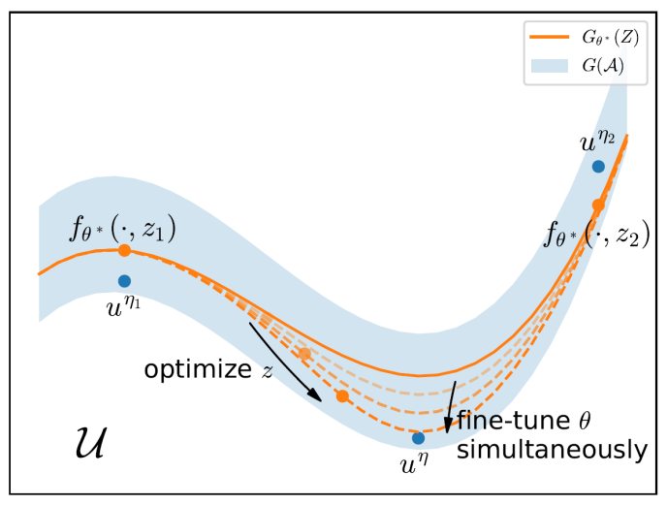
Solving Parametric PDEs as Manifold Learning
Solving the following parametric PDEs
Neural approximation of the solution manifold:
Reducibility of the problem (Quarteroni, Manzoni and Negri, 2015; Ohlberger and Rave, 2016) :
Easier for diffusion-dominated problems (using the Kolmogorov $n$-width);
More difficult for advection-dominated problems.
$\tilde{x}=x$ or $\left(x,t\right)$
$η=(γ_{1},γ_{2})$ or $(γ_{1},γ_{2},Ω)$
$𝓤$ is a function space (e.g., a Hilbert space);
$𝓐$ is the space of all parameters $η$;
$G\left(𝓐\right)=\left\{u^{η}:η∈𝓐\right\}$ is the set of all solutions;
$G_{θ}\left(𝓩\right)=\left\{f_{θ}\left(\tilde{x},z\right):z∈𝓩⊂ℝ^{n}\right\}≈G\left(𝓐\right),$ with $f_{θ}$ a deep neural network.
Key: For any $η$, there exists $z$, such that
${\left\|G_{θ}\left(z\right)−G\left(η\right)\right\|}_{𝓤}<d_{n}$.

Slide 21
The Reducibility Problem
The Kolmogorov $n$-width (Kolmogorov, 1936):
$$d_{n}={\inf_{V_{n}⊂𝒰}{\sup_{η}{\inf_{v∈V_{n}}\left\|v−u^{η}\right\|}}}_{𝒰}, \dim{V_{n}}=n.$$
For some parametrized elliptic equations: $d_{n}≤Ce^{−cn^{1/d}}$.
The manifold $n$-width (DeVore, Howard, Michelli, 1989):
$d_{n}^{Mani}=$ ${\inf_{\begin{aligned}E:𝒰→𝒵 \\ D:𝒵→𝒰\end{aligned}}{\sup_{η}\left\|D\left(E\left(u^{η}\right)\right)−u^{η}\right\|}}_{𝒰}, \dim{𝒵}=n.$
For some parametrized linear wave equations: $d_{n}^{NL}=Ce^{−cn}$.
The decoder $n$-width for our assumption:
$$d_{n}^{Deco}={\inf_{D:𝒵→𝒰}{\sup_{η}{\inf_{z∈𝒵}\left\|D(z)−u^{η}\right\|}}}_{𝒰}, \dim{𝒵}=n.$$
Relationship: $d_{n}^{Deco}≤d_{n}^{Mani}≤d_{n}$.

Slide 22
The Reducibility Problem
More theory on reducibility:
Z. Ye, H. Liu, Z. Wang and B. Dong, Analysis of the Decoder Width for Parametric Partial Differential Equations, arXiv:2306.14390.
Results for fixed computational domain ($Ω∉η$):
There exist cases for which $d_{n}^{Deco}<d_{n}^{Mani}$.
See our work and [G. Petrova and P. Wojtaszczyk, Constr. Approx., 2022].
Elliptic and parabolic problems with variable domains are also analyzed ($Ω∈η$).

Slide 23
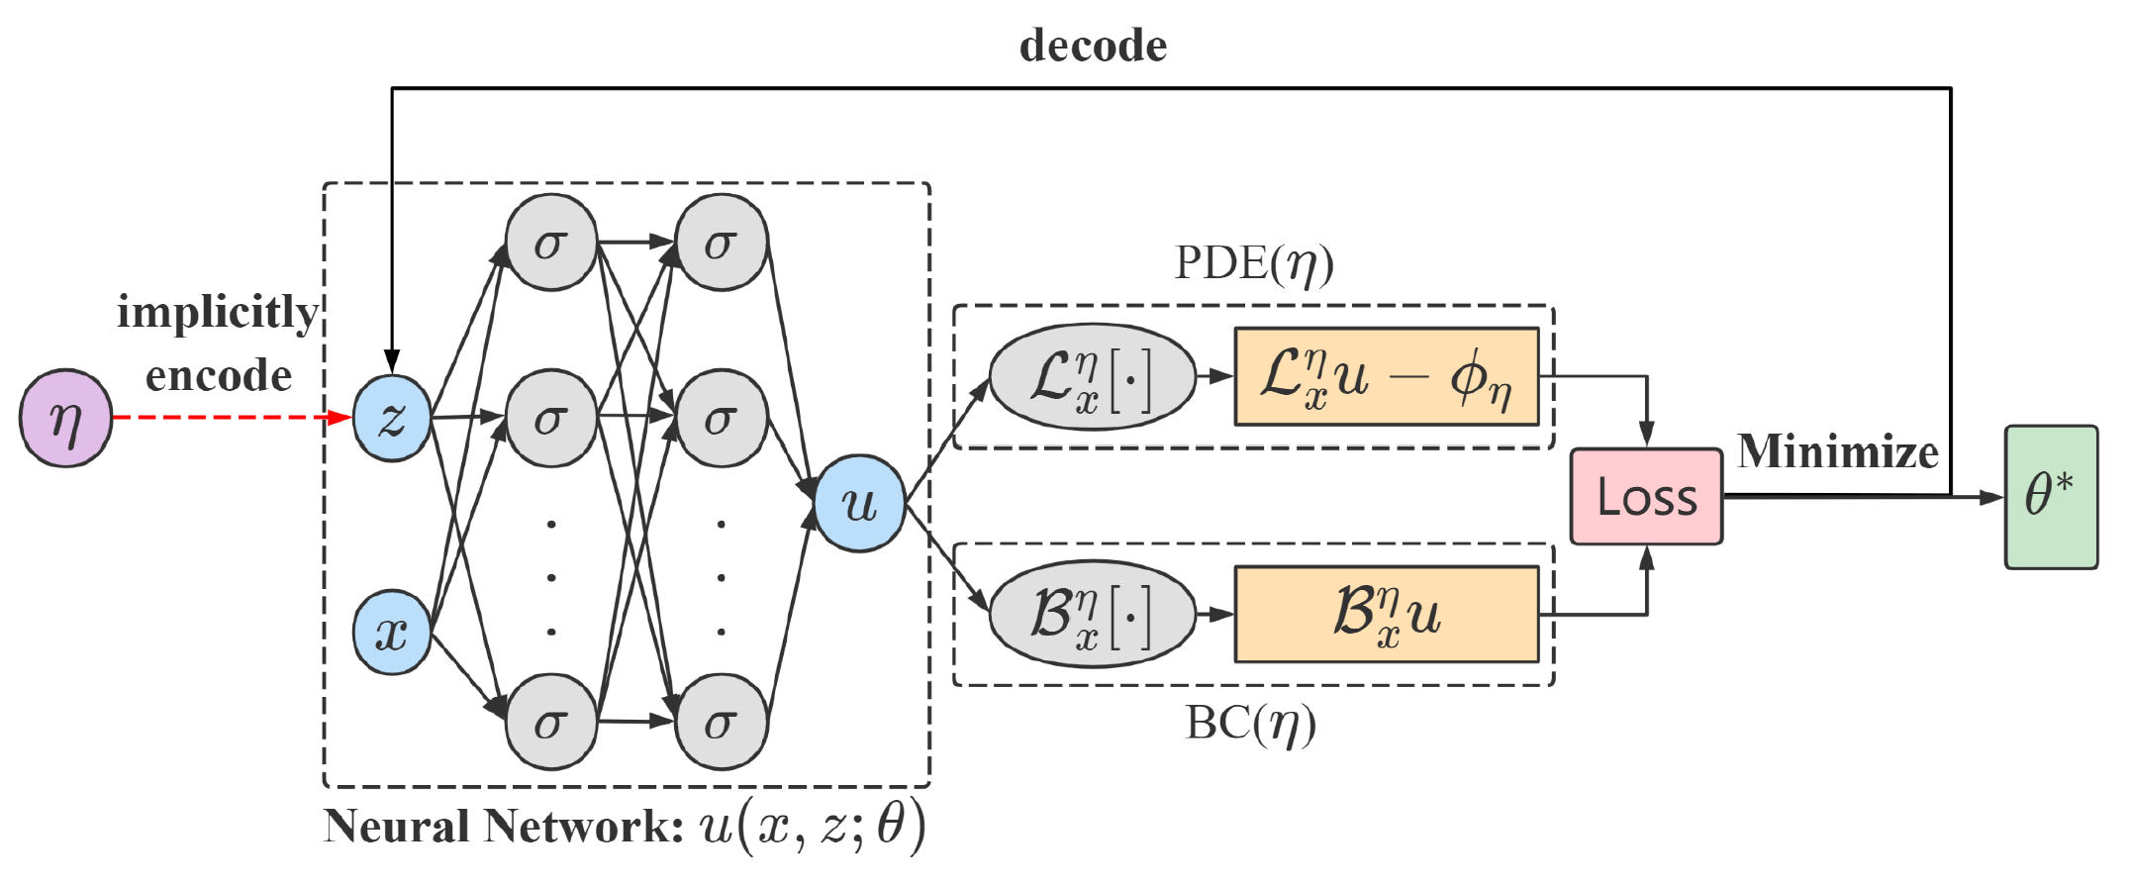
Meta Auto-Decoder (MAD)
Training strategy for finding $G_{θ}\left(𝓩\right)=\left\{f_{θ}\left(\tilde{x},z\right):z∈ℝ^{n}\right\}≈G\left(𝓐\right)$
Pretrain stage:
Fine-tune stage:
Network architecture of MAD: $f_{θ}(x,z)$
PINN loss (Raissi, Perdikaris, Karniadakis, 2019):
Fast adaptation.
Fixed $θ$: Park et al., CVPR 2019
Mesh-free
Encoding of heterogeneous parameters
Unsupervised

Slide 24
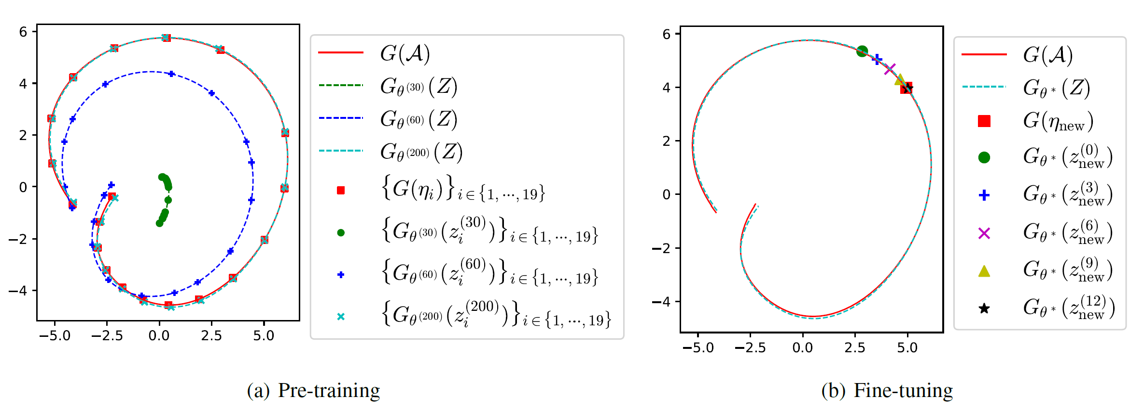
An Illustration on MAD
Demonstration of MAD on a simple example:
Pre-training and fine-tuning of MAD:

Slide 25
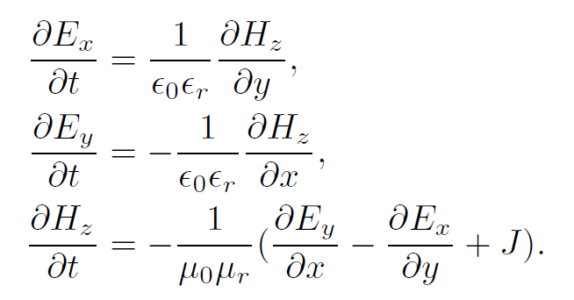
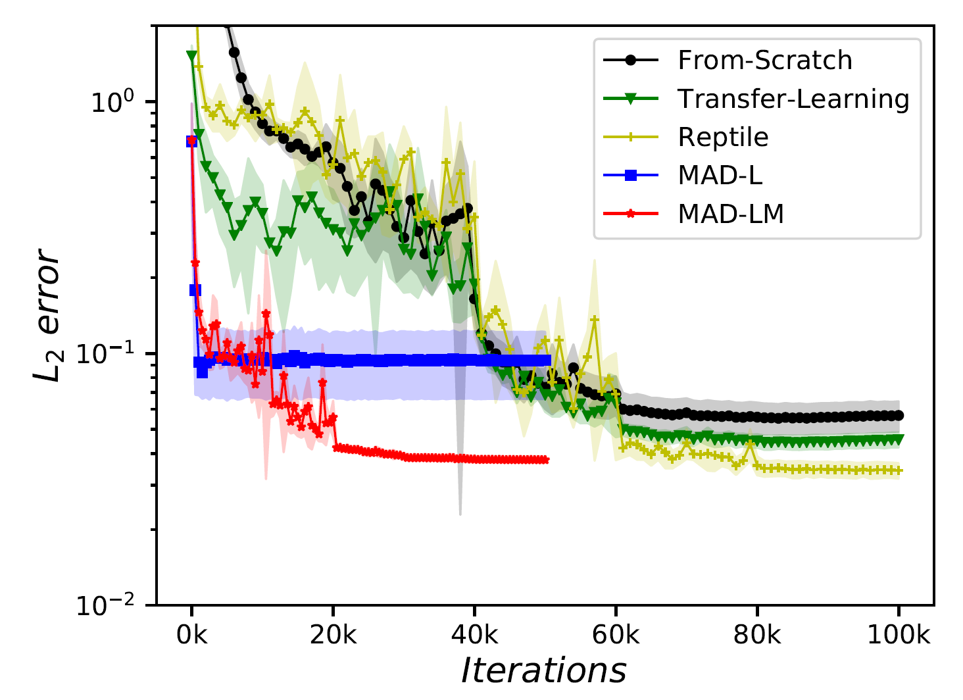
Some Numerical Results
MindSpore AI electromagnetic simulation typical scenario:
Results: Implemented on MindSpore and NPU/GPU. The relative error of the electromagnetic field is $≈10\%$ with $×20$ speedup over PINN.
with Mur’s second-order absorbing boundary condition.
FDTD
Auto-decoder
Error of PI-DeepONet$≈0.67$
Error map

Slide 26
Current Limitations of MAD
Overall, MAD is still slower than traditional numerical solvers.
Possible ways of improving MAD:
Scaling up tasks $\left\{η_{i}\right\}$ and the neural network $f_{θ}\left(\tilde{x},z\right)$.
Better neural architecture than MLP?
Better architecture indeed helps in the case of Helmholtz’s equation.
Better loss function than PINN loss?

Slide 27
The Potential of Direct Mappings
Task: Learn a direct mapping between mobile device structures and S-parameters based on historical data gathered by Huawei Device Co., Ltd.
Methodology: efficient data sampling, grid data compression, and neural architecture design to facilitate structural/material generalization.
Results: Implemented on MindSpore and NPU/GPU. The relative error of the S-parameter is far less than $10\%$ with $×30$ speedup.

Slide 28
Direct Mapping by Large-Scale Deep Learning Models
Jointly with
Huawei MindSpore AI + Scientific Computing team
Shanghai Aircraft Design and Research Institute, The Commercial Aircraft Corporation of China
Z. Deng, et al., Prediction of transonic flow over supercritical airfoils using geometric-encoding and deep-learning strategies, Physics of Fluids, DOI: 10.1063/5.0155383, 2023 (arXiv:2303.03695).

Slide 29
Accelerating Fluid Simulation for Aircraft Design
Joint work with:
Huawei MindSpore AI + Scientific Computing team
Shanghai Aircraft Design and Research Institute, The Commercial Aircraft Corporation of China

Slide 30
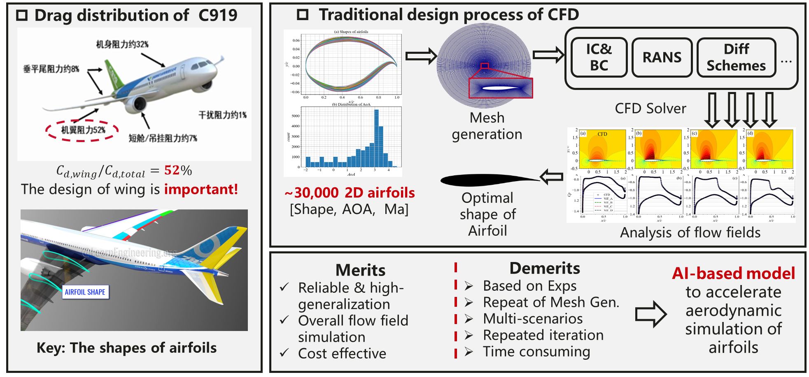
Background of the Project
Notes:
我和华为MindSpore以及商飞的合作已经持续了两年，终极目标是实现全机体和全飞行包线的高速CFD仿真，最终支撑机型的设计。当然现在距离目标还差的很远，我们去年主要是对2D机翼仿真进行了探索，确定了整个方法论，今年推广到了3D的机翼的模拟。下面我就逐一汇报我的目前的研究进展。

Slide 31
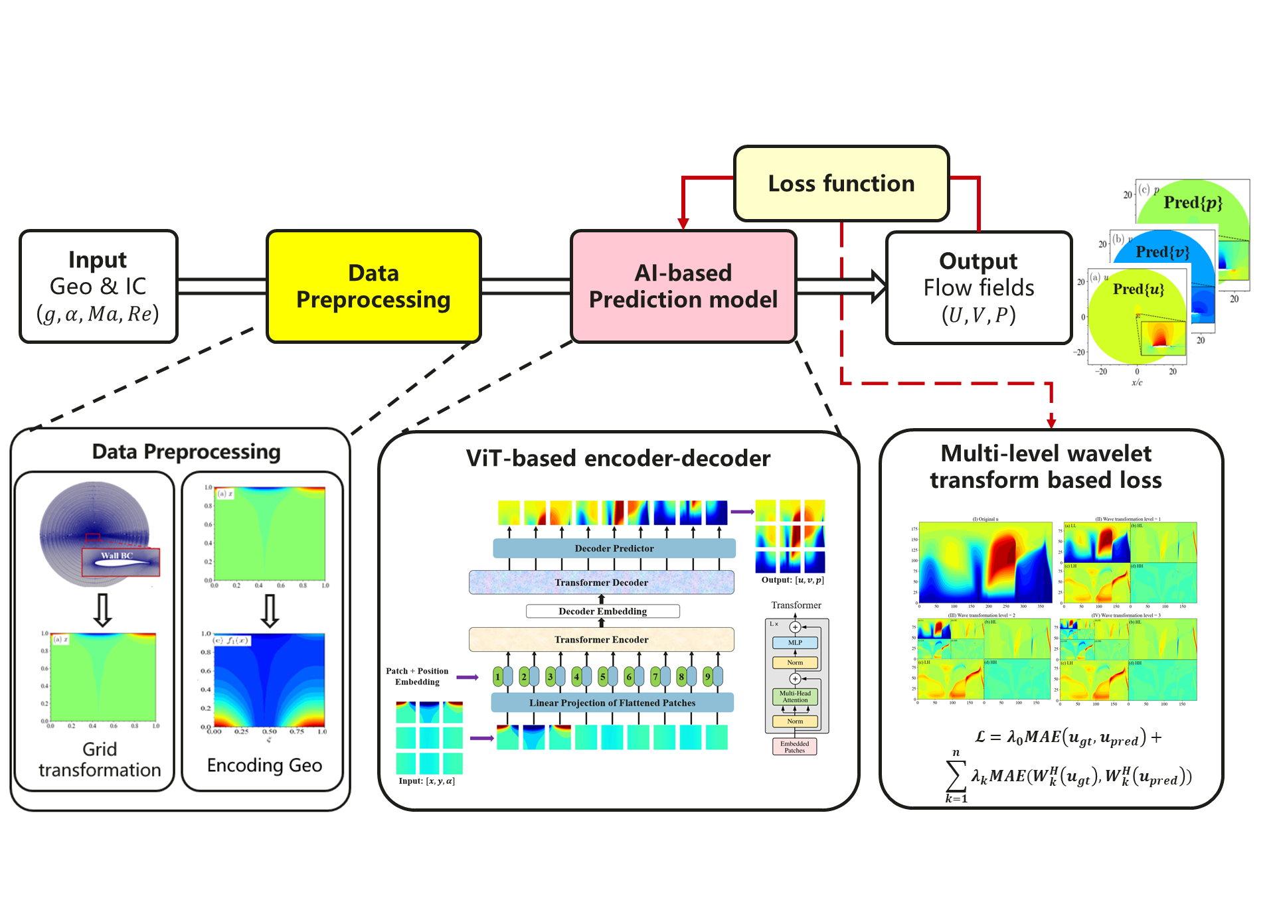
Methodology

Slide 32
Results for Different airfoils at $AOA={3.3}^{∘}$
$∼$ 10 min
$$∼20 ms$$

Slide 33
Results for the Same airfoil at Different $AOA$
$∼$ 10 min
$$∼20 ms$$

Slide 34
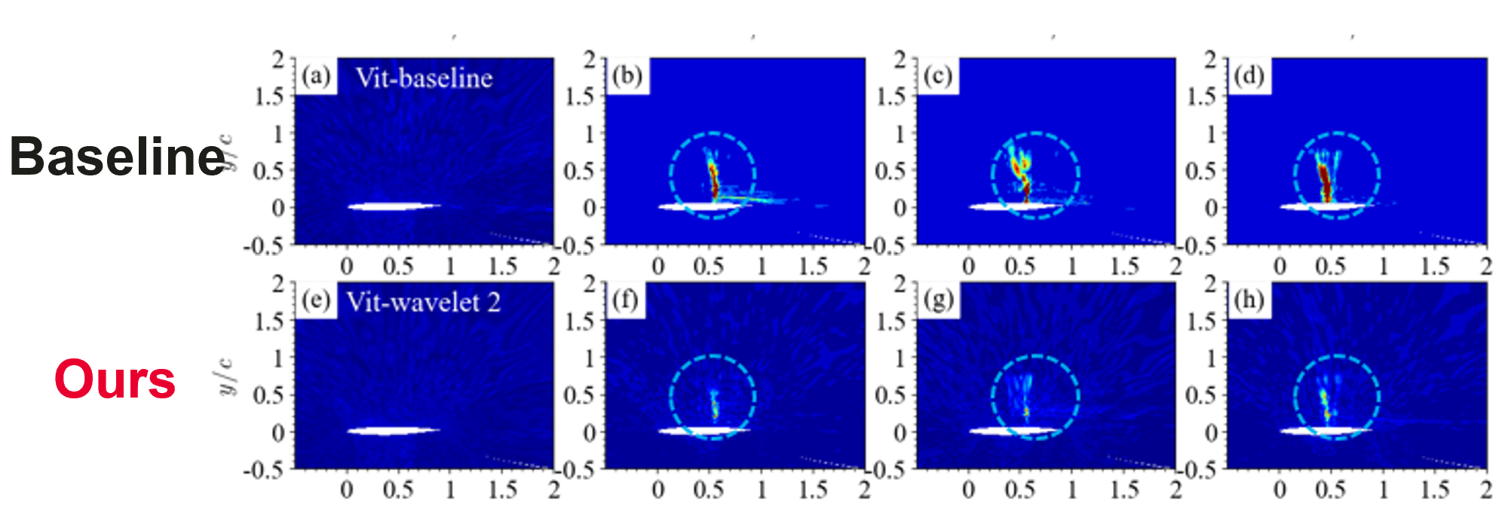
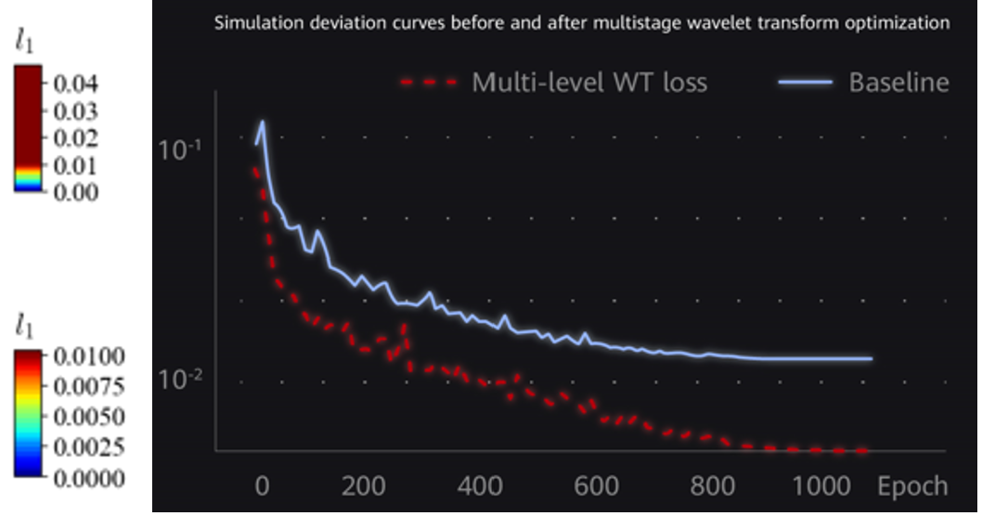
More Experiments
The use of the wavelet loss:
Transferability:
Pre-trained dataset | Airfoil index | $l_{1_avg}$ of the inference dataset
 |  | 0-shot | 1-shot | 3-shot | 5-shot
Tiny | 0-50 | 0.002734 | 0.0012067 | 0.000644 | 0.000448
Small | 0-100 | 0.001831 | 0.0007356 | 0.0004237 | 0.000317
Medium | 0-250 | 0.001077 | 0.000439 | 0.0002798 | 0.000224
Large | 0-450 | 0.000377 | 0.0002388 | 0.00020 | 0.000182
Time consuming (s) |  | - | 164s | 176s | 182s

Slide 35
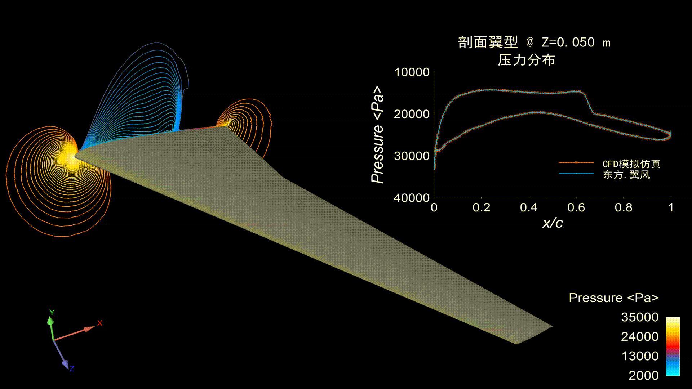
Extension to 3D Simulations
中国商飞：东方系列大模型
东方.御风（2022.09 WAIC）
2D超临界翼型流场仿真
十万网格
巡航状态平面流场
降低仿真时间24倍
东方.翼风（2023.07 WAIC）
全新模型
SAIL奖
3D超临界翼型流场仿真
千万网格流场秒级推理
典型超临界机翼流场预测
降低仿真时间1000倍

Slide 36
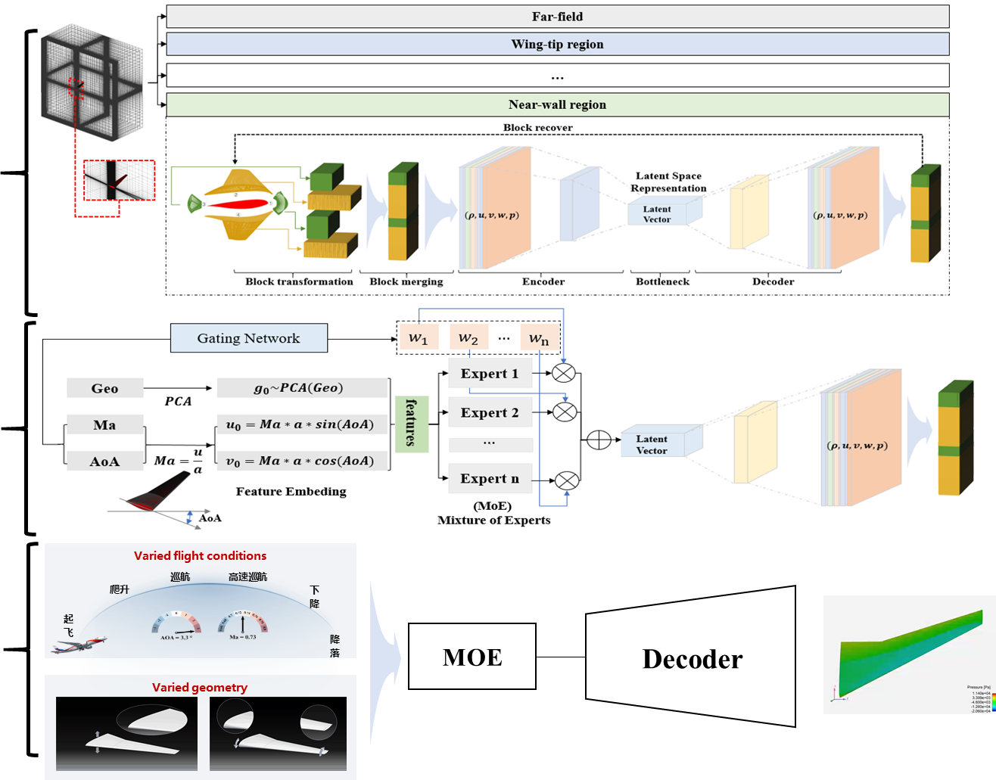
Methodology for 3D Simulation
Unsupervised pretraining
Supervised finetuning
Deployment:
fast adaptation to unseen operating states
Notes:
Unsupervised pretraining:
a) 基于区域感知多块分解技术，分解原始流场区域；
b) 基于雅格比坐标转换变换计算域，融合多块流场，构建AI张量化数据输入；
c) 构建AutoEncoder模型，寻找高维流场特征的隐式空间的低维表征
2. Supervised finetuning
保留AE模型中Decoder模型部分，进行微调；
设计MoE-Decoder模型，构建飞行参数和翼型几何与流场隐式空间低维特征间的映射；
基于仿真经验，MoE部分区分不同飞行参数之间的流场区别，提升模型的表达能力
3. MoE deployment

Slide 37
Conclusions and Future Directions
Deep neural networks (DNNs) are particularly effective in approximating high dimensional and/or complex mappings.
Selecting an appropriate object to be approximated by DNNs is crucial:
Approximate the solution $u(x)$ if $x$ is high dimensional or challenging scenarios where traditional methods fail (miserably);
Approximate the solution mapping/manifold if $x$ is low dimensional.
Deep learning enables us to tackle more complex problems (e.g., inverse design) in an end-to-end fashion:
$$\min_{η}{f(u_{η})}≈f∘𝒮(η;Θ)$$

Slide 38
Thanks for Your Attention! My Webpage: http://bicmr.pku.edu.cn/~dongbin

