Slide 1


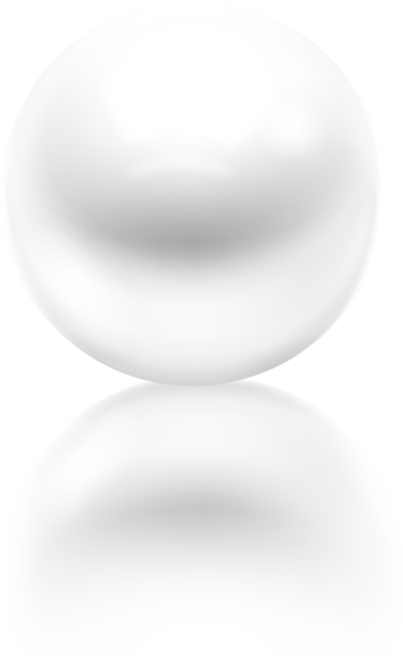
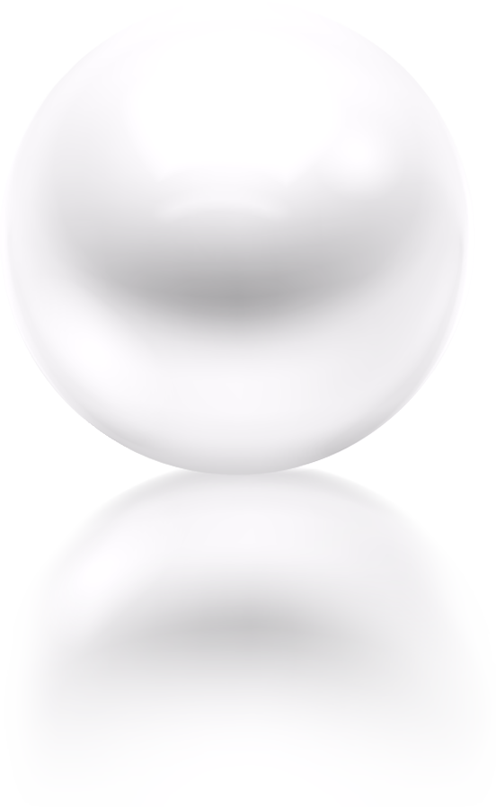
Data- and Model-Driven Approach for Computational Imaging
Bin Dong
Beijing International Center for Mathematical Research &
Center for Machine Learning Research &
National Biomedical Imaging Center,
Peking University

Slide 2
Table of contents
01
02
03
Background
Image Reconstruction
Deep Learning
04
05
06
Computational Imaging
Supporting Biomedical Research
Conclusions
Image-based scientific discovery and computational imaging (sensing, reconstruction and analysis ).
A review of model-driven approaches and the limitations
How deep learning approach may help: combining data- and model-driven approaches.
Integrating sensing, reconstruction and analysis. Building a foundation model.
Multiscale and multimodality biomedical imaging for biological research and clinical studies.

Slide 3
01
Background
Image-based scientific discovery and computational imaging (sensing, reconstruction and analysis ).
Notes:
Now, let me start with the background of imaging.

Slide 4
Background
The development of natural science has been heavily relying on visual examination.
To better analyze the phenomenon-of-interest, images are convenient tools.
Notes:
As you may know that scientific discoveries have been heavily relaying on visual examination, while images are essential tools for that purpose.

Slide 5
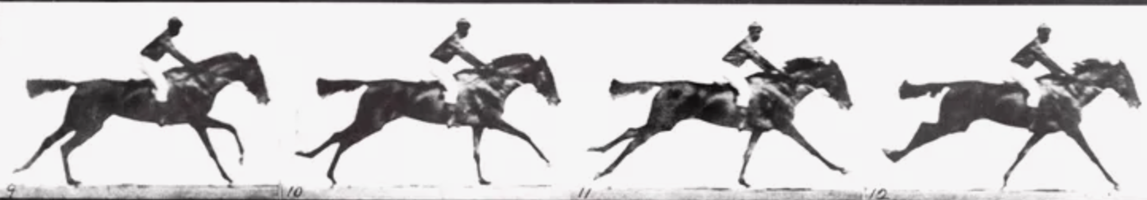
Background
The development of natural science has been heavily relying on visual examination.
To better analyze the phenomenon-of-interest, images are convenient tools.
A historical example: The Horse in Motion (Leland Stanford, 1874)
  Hypothesis of “unsupported transit”: there were indeed moments in a horse’s stride in which all hooves were off the ground and the animal enjoyed “unsupported transit.”
EADWEARD MUYBRIDGE COLLECTION/Getty Images
Notes:
Let us first recall a well-known example in the history of imaging, which is known as the Horse in Motion.
Back in 1874, a former California governor, also a racehorse breeder, named Leland Stanford. He and his wife are also the founders of the Stanford University. Stanford had a theory called “unsupported transit” which says that there were indeed moments in a horse’s stride in which all hooves were off the ground. It is not easy to prove the theory since the speed of a horse’s movement surpasses the sensitivity of human’s eyesight, and the shutter speed of the cameras back then was not quick enough.

Slide 6
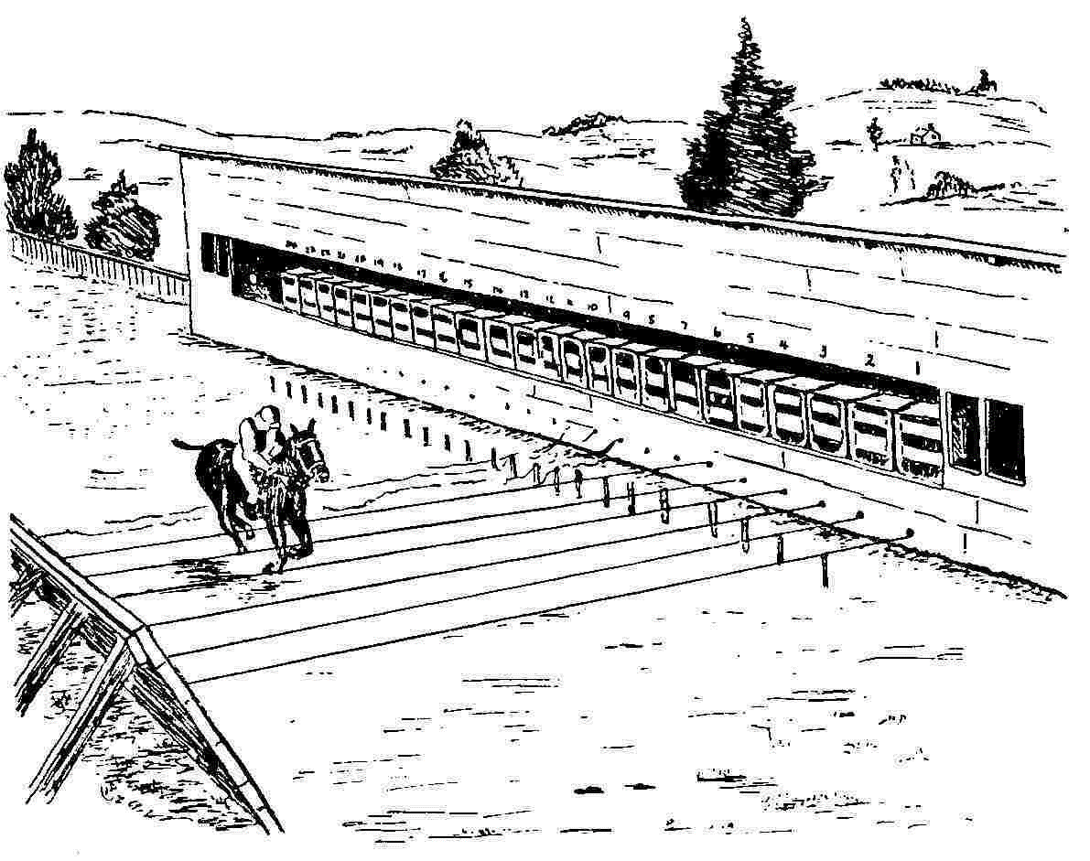
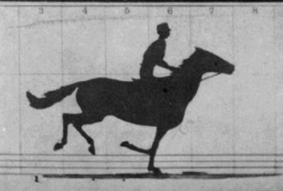
Background
The development of natural science has been heavily relying on visual examination.
To better analyze the phenomenon-of-interest, images are convenient tools.
A historical example: The Horse in Motion (Leland Stanford, 1874)
  Hypothesis of “unsupported transit”: there were indeed moments in a horse’s stride in which all hooves were off the ground and the animal enjoyed “unsupported transit.”
Eadweard Muybridge’s imaging system, Palo Alto, 1878
Notes:
Stanford seek the help from a pioneering photographer named Eadweard (Edward) Muybridge (Moibridge) and conducted experiments at Palo Alto in 1878. He created an imaging system using multiple cameras and wires as triggers. When a running horse triggers a wire, the attached camera takes a picture.
This is the first time a rapid motion is captured by cameras and it proves Stanford’s theory.
If you look closely at the video, you will see that all four hooves were off the ground when all the feet are under the horse’s body.

Slide 7
Background
Computational imaging
Sensing
Analysis
Reconstruction
Notes:
“The Horse in Motion ” is an early example of image-based scientific discovery. It consists of three key steps: sensing (Muybridge’s imaging system), reconstruction (image formation), analysis (human examination).
Now, with significant advancements of information technology, we are able to do much better in all three steps. Putting them together is what we call computational imaging, which is now the discipline that supports image-based scientific discovery and decision making.

Slide 8
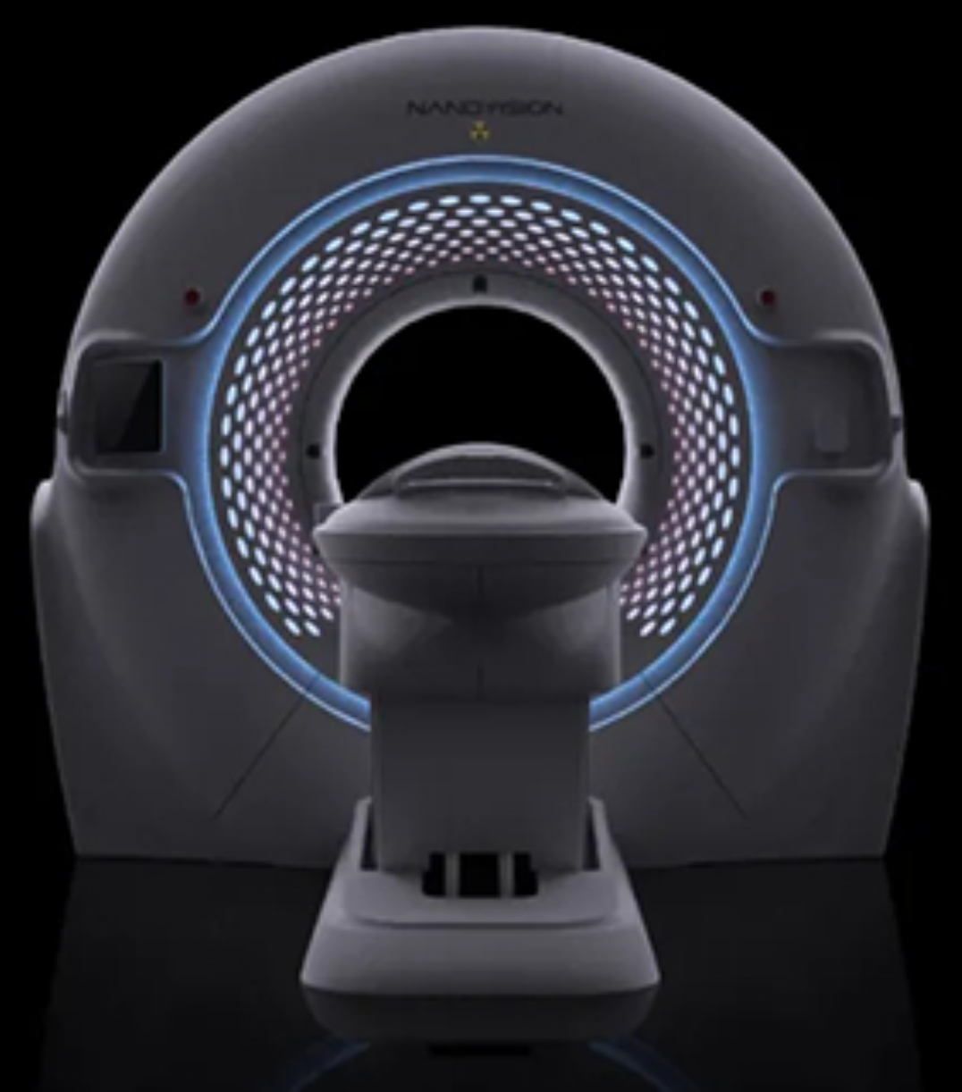
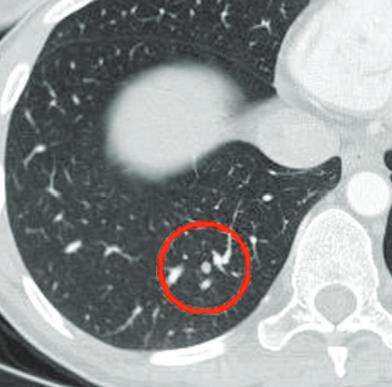
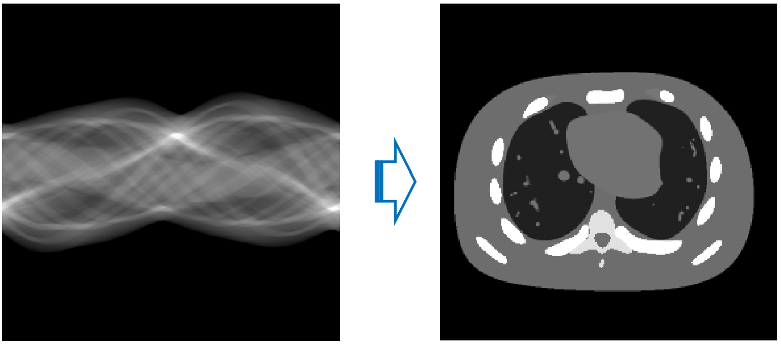
Background
Computational imaging
Example: computed tomography (CT)
Sensing
Analysis
Reconstruction
CT Scanner
Image Reconstruction
Diagnosis
Notes:
Taking CT as an example, the CT imaging system collects sinogram data which is reconstructed to a CT image using a certain inversion algorithm and was then analyzed by another algorithm.
For the first portion of my talk, I will focus on image reconstruction problems and I’ll come back to the whole picture of computational imaging near the end.

Slide 9
02
Image Reconstruction
A review of model-driven approaches and the limitations
Notes:
Now, I will give a brief review of some prevailing mathematical models.

Slide 10
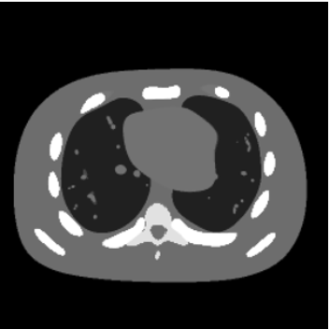
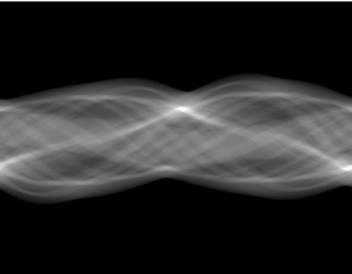


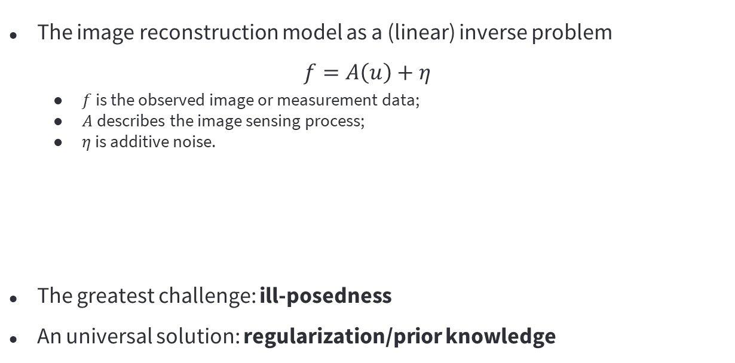

The Image Reconstruction Model
The image reconstruction model as a (linear) inverse problem
$$f=A\left(u\right)+η$$
  $f$ is the observed image or measurement data;
  $A$ describes the image sensing process;
  $η$ is additive noise.
The greatest challenge: ill-posedness
An universal solution: regularization/prior knowledge
$$u$$
$$f$$
$$A$$
Notes:
Image reconstruction can be written as a linear inverse problem. For many applications such as CT imaging, this is only an approximation. Here, $f$ is the data collected by the imaging system, $A$ describes the forward problem of the imaging system and $η$ is the additive noise.
In practice, the problem is quite ill-posed, since the operator $A$ can be singular or has an unbounded inverse. This is the biggest challenge for image reconstruction. It is widely agreed by the imaging community that to resolve this issue, using regularizations or image priors is an effective approach.

Slide 11

Mathematical Approaches for Image Reconstruction
Image reconstruction: $f=Au+η$
PDE approach:
$$u_{t}=F\left(A, f,u,∇u,∇^{2}u\right) or \inf_{u}{L\left(A,f,u\right)+λR(u)}$$
Wavelet approach:
$$u^{k}=\tilde{W}S_{α^{k}}\left(Wu^{k}\right)+G(A,f,Wu^{k}) \text{or} \inf_{u}{\tilde{L}\left(A,f,u\right)+λ\tilde{R}(u)}$$
$$u$$
$$f$$

Slide 12
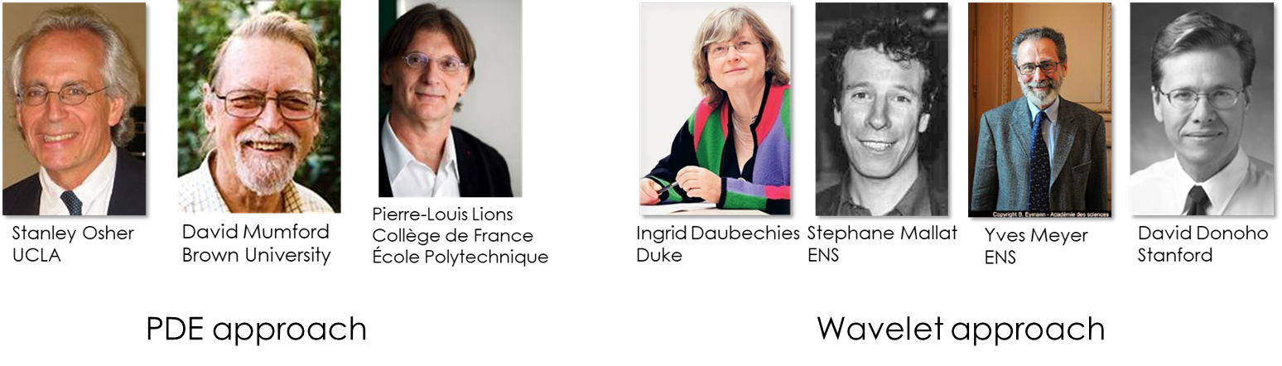
Mathematical Approaches for Image Reconstruction
Image reconstruction: $f=Au+η$
PDE approach:
$$u_{t}=F\left(A, f,u,∇u,∇^{2}u\right) or \inf_{u}{L\left(A,f,u\right)+λR(u)}$$
Wavelet approach:
$$u^{k}=\tilde{W}S_{α^{k}}\left(Wu^{k}\right)+G(A,f,Wu^{k}) \text{or} \inf_{u}{\tilde{L}\left(A,f,u\right)+λ\tilde{R}(u)}$$
$$u$$
$$f$$
Notes:
There are quite a few leading figures in mathematics who has made significant contributions in mathematical models for computational imaging. This includes …
After working with both approaches for a while, I started to wonder whether they have connections. However, what I often heard when I was still a graduate student was like this. The PDE people would say that wavelets does not have a geometric interpretation, and often lead to oscillations or Gibbs phenomena in the restored images. While the wavelet people would say that wavelets provide a multiscale sparse approximation to piecewise smooth functions (which are suitable to model images) and performs better in practice than, e.g. the TV model.

Slide 13
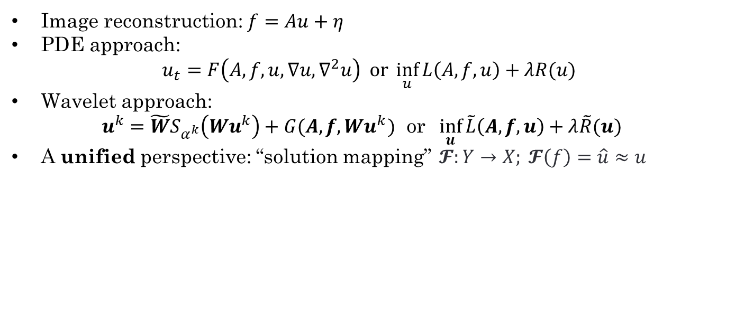
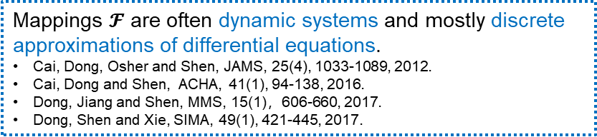
Mathematical Approaches for Image Reconstruction
Image reconstruction: $f=Au+η$
PDE approach:
$$u_{t}=F\left(A, f,u,∇u,∇^{2}u\right) or \inf_{u}{L\left(A,f,u\right)+λR(u)}$$
Wavelet approach:
$$u^{k}=\tilde{W}S_{α^{k}}\left(Wu^{k}\right)+G(A,f,Wu^{k}) \text{or} \inf_{u}{\tilde{L}\left(A,f,u\right)+λ\tilde{R}(u)}$$
A unified perspective: “solution mapping” $𝓕:Y→X; 𝓕\left(f\right)=\hat{u}≈u$
$$u$$
$$f$$
Mappings $𝓕$ are often dynamic systems and mostly discrete approximations of differential equations.
    Cai, Dong, Osher and Shen, JAMS, 25(4), 1033-1089, 2012.
    Cai, Dong and Shen, ACHA, 41(1), 94-138, 2016.
    Dong, Jiang and Shen, MMS, 15(1)，606-660, 2017.
    Dong, Shen and Xie, SIMA, 49(1), 421-445, 2017.
Notes:
At the algorithmic level, I see a lot of similarities between the two approaches. We can view both of the approaches as solution mappings.
(Next) Then, through a series of theoretical studies, we found that …

Slide 14
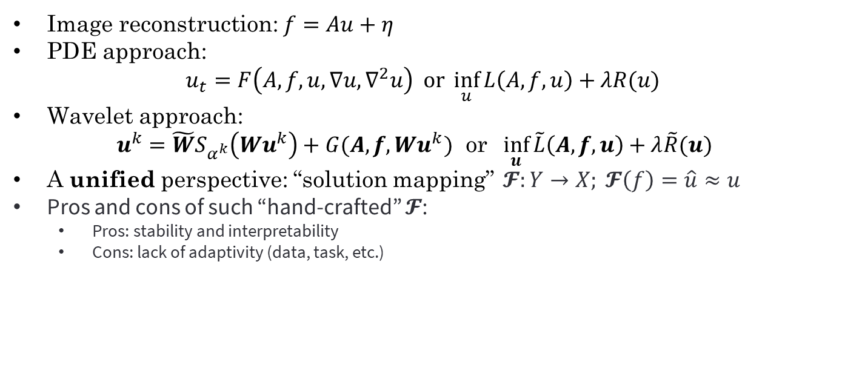
Mathematical Approaches for Image Reconstruction
Image reconstruction: $f=Au+η$
PDE approach:
$$u_{t}=F\left(A, f,u,∇u,∇^{2}u\right) or \inf_{u}{L\left(A,f,u\right)+λR(u)}$$
Wavelet approach:
$$u^{k}=\tilde{W}S_{α^{k}}\left(Wu^{k}\right)+G(A,f,Wu^{k}) \text{or} \inf_{u}{\tilde{L}\left(A,f,u\right)+λ\tilde{R}(u)}$$
A unified perspective: “solution mapping” $𝓕:Y→X; 𝓕\left(f\right)=\hat{u}≈u$
Pros and cons of such “hand-crafted” $𝓕$:
  Pros: stability and interpretability
  Cons: lack of adaptivity (data, task, etc.)
$$u$$
$$f$$

Slide 15
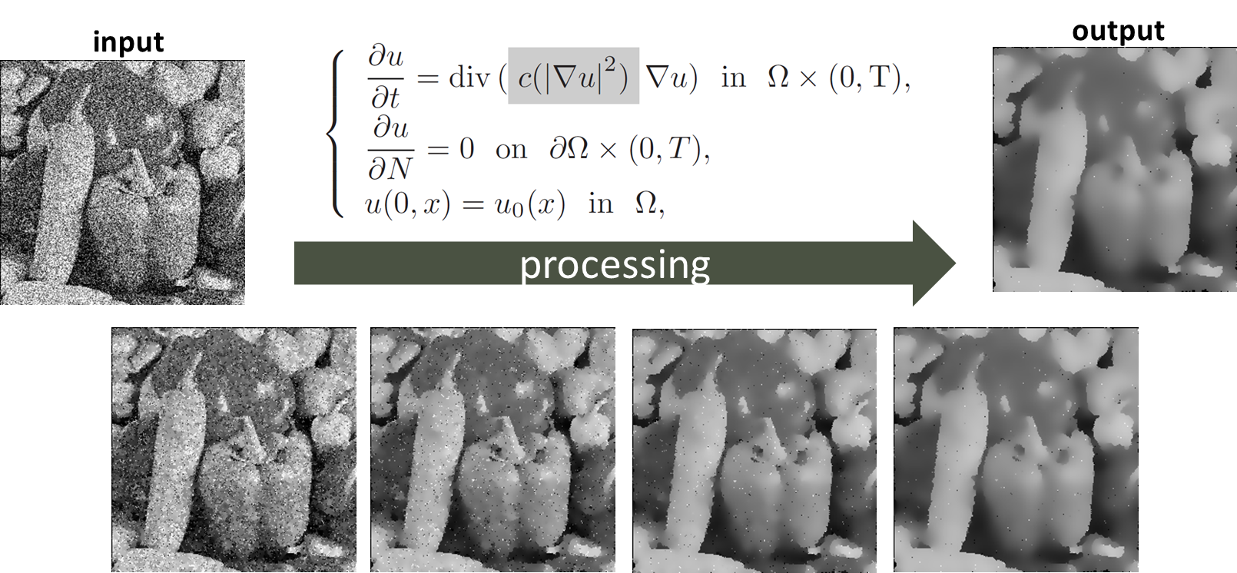
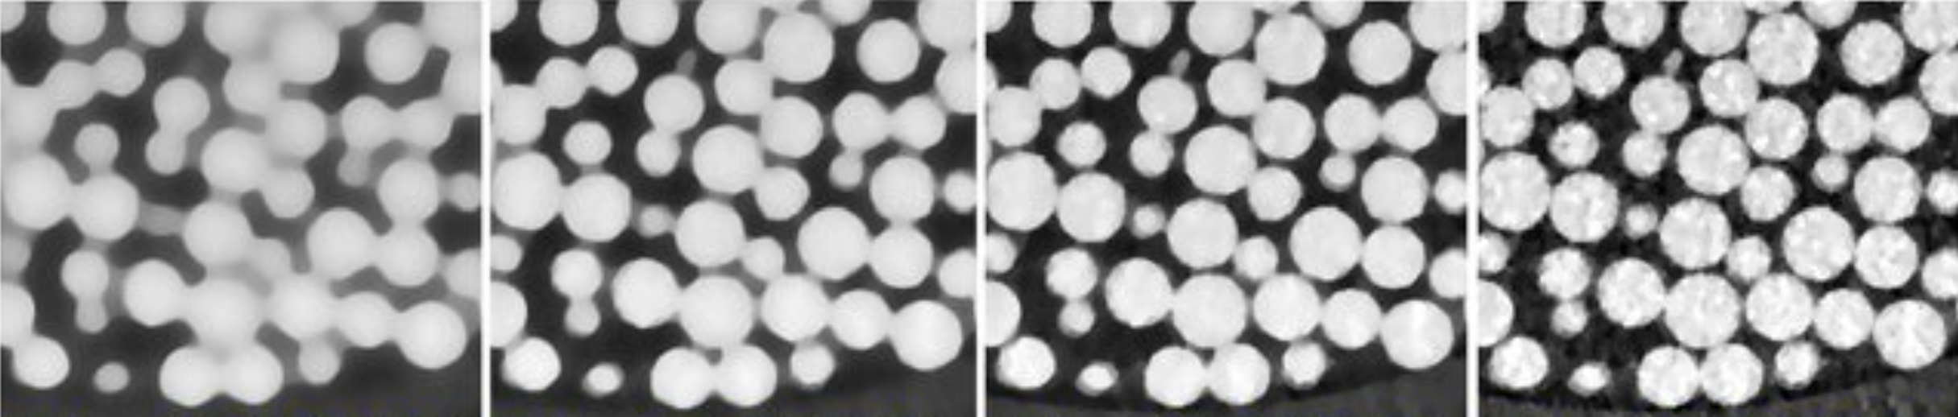


Mathematical Approaches for Image Reconstruction
Importance of adaptivity:
  Terminal time $T$ of PDEs
  Regularization parameter $λ$: $\inf_{u∈𝒰}{L\left(A, f,u\right)}+λ⋅∫\left|∇u\right|$
Decreasing $λ$

Slide 16
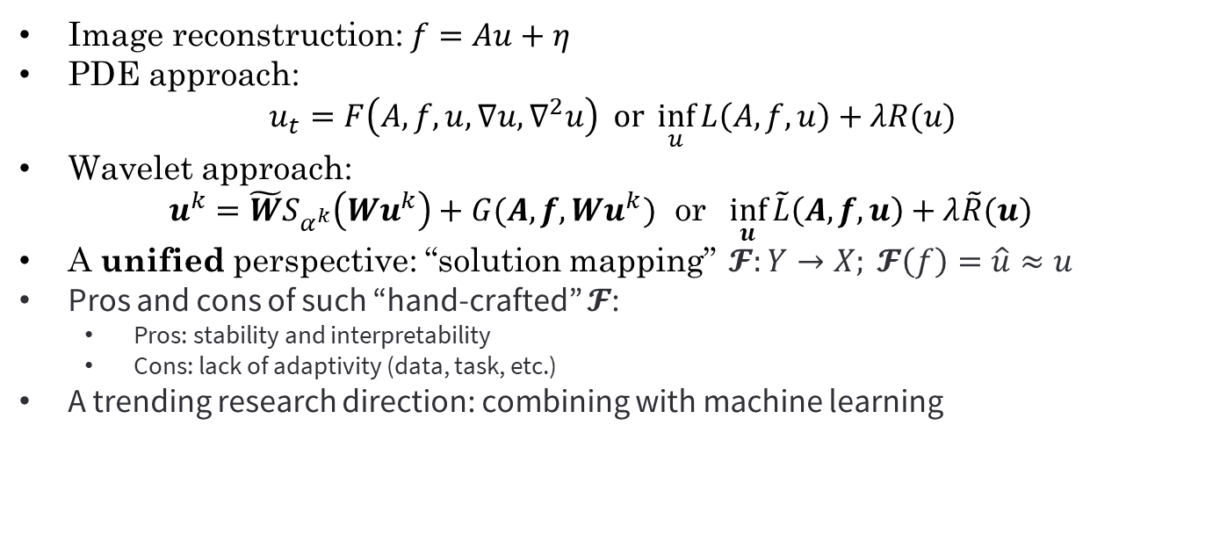
Mathematical Approaches for Image Reconstruction
Image reconstruction: $f=Au+η$
PDE approach:
$$u_{t}=F\left(A, f,u,∇u,∇^{2}u\right) or \inf_{u}{L\left(A,f,u\right)+λR(u)}$$
Wavelet approach:
$$u^{k}=\tilde{W}S_{α^{k}}\left(Wu^{k}\right)+G(A,f,Wu^{k}) \text{or} \inf_{u}{\tilde{L}\left(A,f,u\right)+λ\tilde{R}(u)}$$
A unified perspective: “solution mapping” $𝓕:Y→X; 𝓕\left(f\right)=\hat{u}≈u$
Pros and cons of such “hand-crafted” $𝓕$:
  Pros: stability and interpretability
  Cons: lack of adaptivity (data, task, etc.)
A trending research direction: combining with machine learning
$$u$$
$$f$$

Slide 17
03
Deep Learning
How deep learning approach may help: combining data- and model-driven approaches.
Notes:
This brings us to the study of deep learning models, especially deep convolutional neural networks or deep CNNs. Specifically, our studies have lead to a generic strategy on combining data- and model-driven approaches, which I will discuss at the end of this section.

Slide 18


Deep Learning
Recall $f=A\left(u\right)+η$ and solution mapping: $𝓕:Y→X; 𝓕\left(f\right)=\hat{u}≈u$
Supervised Learning: given $\left(f_{i},u_{i}\right)∼𝒫$, find $𝓕_{\hat{Θ}}:Y→X$ through
$$\hat{Θ}={argmin}_{Θ}{\frac{1}{N}\sum_{i=1}^{N}{L(𝓕_{Θ}\left(f_{i}\right),u_{i})}}$$
  with $𝓕_{Θ}$ a deep neural network, e.g., $𝓕_{Θ}\left(x\right)=$ $W_{3}σ\left(W_{2}σ\left(W_{1}x+b_{1}\right)+b_{2}\right)$
Image denoising: average PSNR on BSD68 dataset (Zhang et al. 2017).
Note: $PSNR\left(\hat{u},u\right)=10\log_{10}{\frac{{\left\|u\right\|}_{∞}^{2}}{{\left\|\hat{u}−u\right\|}_{2}}}$
Notes:
A typical machine learning approach for finding solution mappings is supervised learning. It’s goal is to find a nonlinear mapping F between X and Y by solving the empirical risk minimization. For deep learning, the hypothesis set of the mapping F are deep neural networks, like deep CNNs. (We know very well by now that such hypothesis set is quite effective in approximating high-dimensional mappings and for many practical problems both X and Y are indeed high dimensional.)
(next) Here is a table I borrowed from a work by Zhang et al. in 2017, BM3D and WNNM were state-of-the-art handcrafted methods, while methods on the right portion of the table such as TNRD and DnCNN are deep learning methods. You can see that deep learning methods beat traditional methods by a large margin.

Slide 19
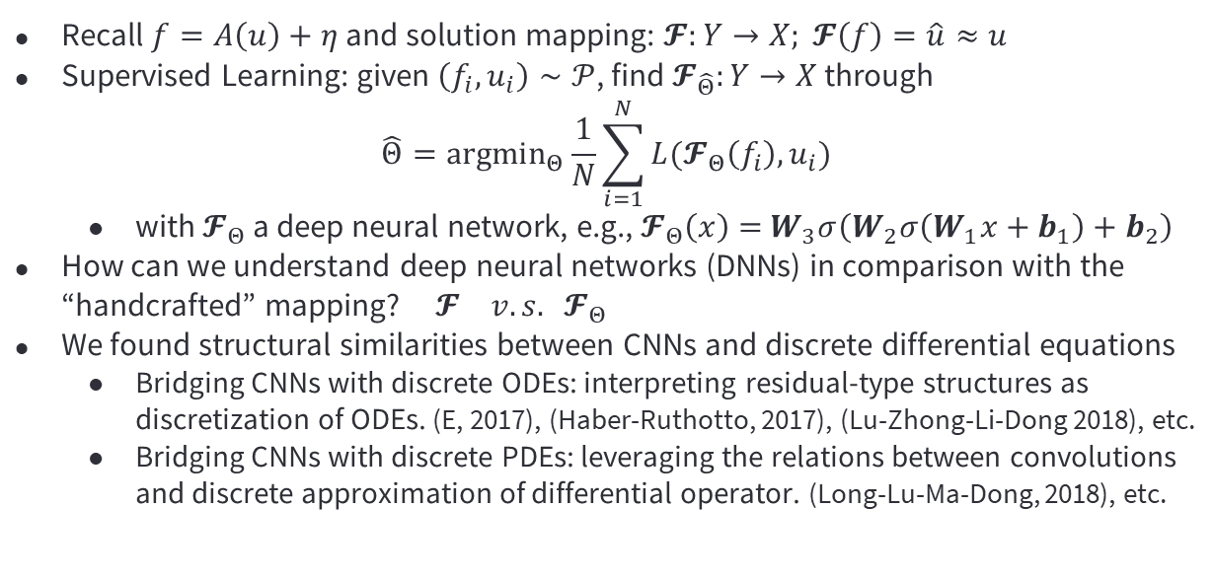
Deep Learning
Recall $f=A\left(u\right)+η$ and solution mapping: $𝓕:Y→X; 𝓕\left(f\right)=\hat{u}≈u$
Supervised Learning: given $\left(f_{i},u_{i}\right)∼𝒫$, find $𝓕_{\hat{Θ}}:Y→X$ through
$$\hat{Θ}={argmin}_{Θ}{\frac{1}{N}\sum_{i=1}^{N}{L(𝓕_{Θ}\left(f_{i}\right),u_{i})}}$$
  with $𝓕_{Θ}$ a deep neural network, e.g., $𝓕_{Θ}\left(x\right)=$ $W_{3}σ\left(W_{2}σ\left(W_{1}x+b_{1}\right)+b_{2}\right)$
How can we understand deep neural networks (DNNs) in comparison with the “handcrafted” mapping? $𝓕_{} v.s. 𝓕_{Θ}$
We found structural similarities between CNNs and discrete differential equations
  Bridging CNNs with discrete ODEs: interpreting residual-type structures as discretization of ODEs. (E, 2017), (Haber-Ruthotto, 2017), (Lu-Zhong-Li-Dong 2018), etc.
  Bridging CNNs with discrete PDEs: leveraging the relations between convolutions and discrete approximation of differential operator. (Long-Lu-Ma-Dong, 2018), etc.
Notes:
Now, one natural question is how does deep learning beat us so badly? Is deep learning always superior? What is its inner-workings? I think these are still open questions in general. But for image reconstruction, since we have the solution mapping perspective and deep learning methods also induce solution mappings, it is only natural to compare $F$ and $F_{Θ}$. That is why we started by exploring structural similarities between deep neural networks with discrete dynamic systems such as ODEs and PDEs.
(Next): What we have discovered in general is that there are very interesting structure similarities between deep CNNs and discrete ODEs and PDEs.

Slide 20

The ODE-Nets
The success of residual networks (ResNet, He et al. 2015)
$$x^{k+1}=x^{k}+f\left(x^{k},t_{k}\right), x^{0}=x, k=0,1,…$$
ResNet can be interpreted as forward-Euler discretization of the dynamic system $\dot{x}=f\left(x\right)$, and training ResNets can be viewed as an optimal control problem (E 2017).
Notes:
Another motivation that there might be a strong connection between discrete differential equations and deep neural networks was the success of residual network or ResNet and the optimal control perspective on residual learning proposed by Weinan E.
Before ResNet, it was difficult to train a neural network with a few dozens layers. ResNet tells that if we do residual learning like what’s shown by the formula here, we can train a neural network with hundreds of layers and significantly outperforms the benchmarks at that time. Then, Weinan E beautifully observed that ResNet can be interpreted as the forward-Euler discretization of an ODE system.
(To this date, the residual structure is still one of the most commonly used structures in deep learning. To me, this is a strong indication that exploring structural similarities between deep CNNs and discrete differential equations can be beneficial. )

Slide 21
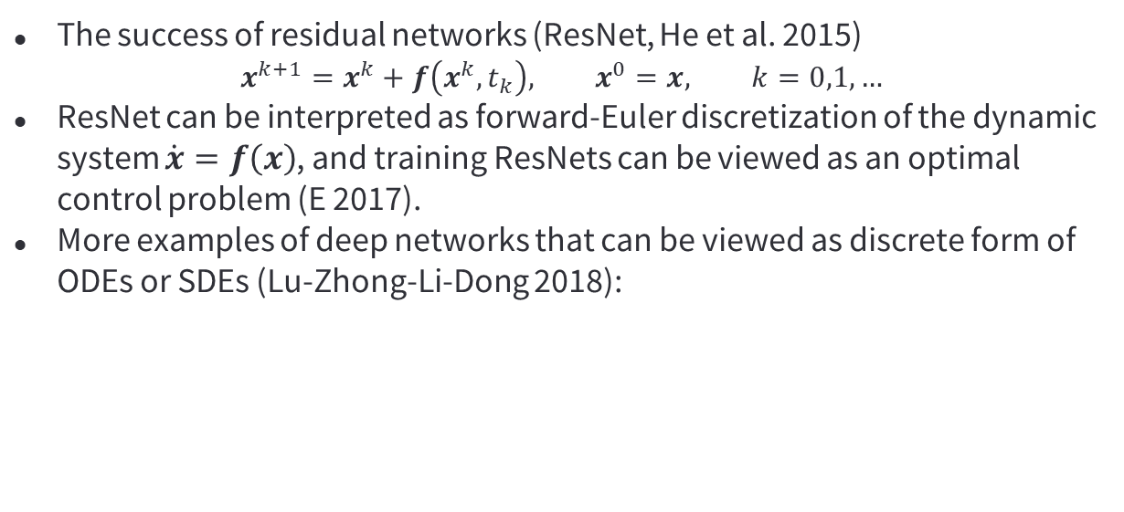
The ODE-Nets
The success of residual networks (ResNet, He et al. 2015)
$$x^{k+1}=x^{k}+f\left(x^{k},t_{k}\right), x^{0}=x, k=0,1,…$$
ResNet can be interpreted as forward-Euler discretization of the dynamic system $\dot{x}=f\left(x\right)$, and training ResNets can be viewed as an optimal control problem (E 2017).
More examples of deep networks that can be viewed as discrete form of ODEs or SDEs (Lu-Zhong-Li-Dong 2018):
Notes:
In our work in 2018, we showed that not only ResNet, there were other deep networks that adopts the idea of residual learning such as PolyNet can be interpreted as different discretization of ODEs. Some ResNets with randomized structures such stochastic depth are discrete approximations of SDEs. This made us wonder, if we could use discrete schemes of ODEs/SDEs to generate novel and effective deep networks. And we call this type of networks ODE-Nets.

Slide 22
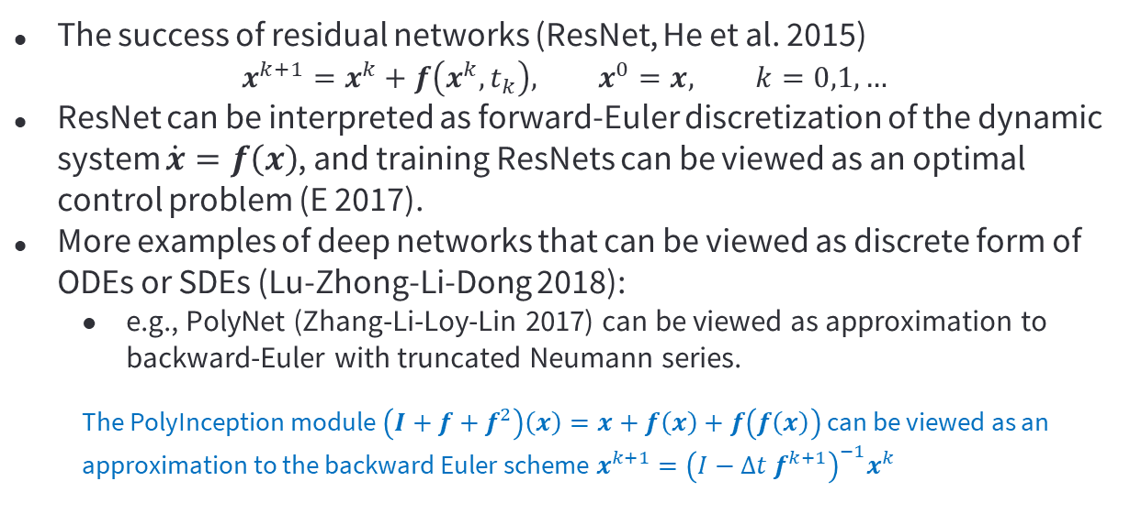
The ODE-Nets
The success of residual networks (ResNet, He et al. 2015)
$$x^{k+1}=x^{k}+f\left(x^{k},t_{k}\right), x^{0}=x, k=0,1,…$$
ResNet can be interpreted as forward-Euler discretization of the dynamic system $\dot{x}=f\left(x\right)$, and training ResNets can be viewed as an optimal control problem (E 2017).
More examples of deep networks that can be viewed as discrete form of ODEs or SDEs (Lu-Zhong-Li-Dong 2018):
  e.g., PolyNet (Zhang-Li-Loy-Lin 2017) can be viewed as approximation to backward-Euler with truncated Neumann series.
  The PolyInception module $\left(I+f+f^{2}\right)\left(x\right)=x+f\left(x\right)+f\left(f\left(x\right)\right)$ can be viewed as an approximation to the backward Euler scheme $x^{k+1}={\left(I−Δt f^{k+1}\right)}^{−1}x^{k}$
Notes:
In our work in 2018, we showed that not only ResNet, there were other deep networks that adopts the idea of residual learning such as PolyNet can be interpreted as different discretization of ODEs. Some ResNets with randomized structures such stochastic depth are discrete approximations of SDEs. This made us wonder, if we could use discrete schemes of ODEs/SDEs to generate novel and effective deep networks. And we call this type of networks ODE-Nets.

Slide 23
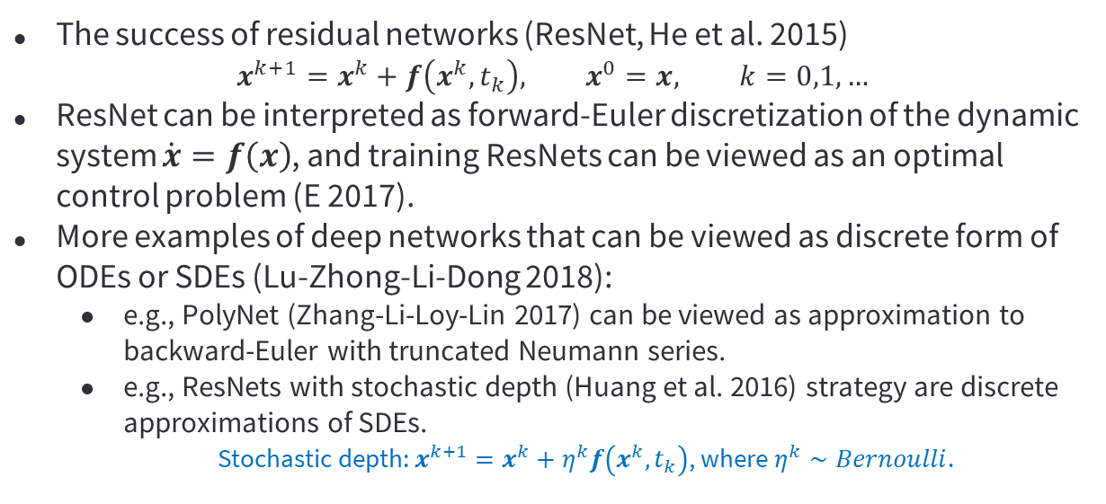
The ODE-Nets
The success of residual networks (ResNet, He et al. 2015)
$$x^{k+1}=x^{k}+f\left(x^{k},t_{k}\right), x^{0}=x, k=0,1,…$$
ResNet can be interpreted as forward-Euler discretization of the dynamic system $\dot{x}=f\left(x\right)$, and training ResNets can be viewed as an optimal control problem (E 2017).
More examples of deep networks that can be viewed as discrete form of ODEs or SDEs (Lu-Zhong-Li-Dong 2018):
  e.g., PolyNet (Zhang-Li-Loy-Lin 2017) can be viewed as approximation to backward-Euler with truncated Neumann series.
  e.g., ResNets with stochastic depth (Huang et al. 2016) strategy are discrete approximations of SDEs.
  Stochastic depth: $x^{k+1}=x^{k}+η^{k}f\left(x^{k},t_{k}\right)$, where $η^{k}∼Bernoulli$.
Notes:
In our work in 2018, we showed that not only ResNet, there were other deep networks that adopts the idea of residual learning such as PolyNet can be interpreted as different discretization of ODEs. Some ResNets with randomized structures such stochastic depth are discrete approximations of SDEs. This made us wonder, if we could use discrete schemes of ODEs/SDEs to generate novel and effective deep networks. And we call this type of networks ODE-Nets.

Slide 24
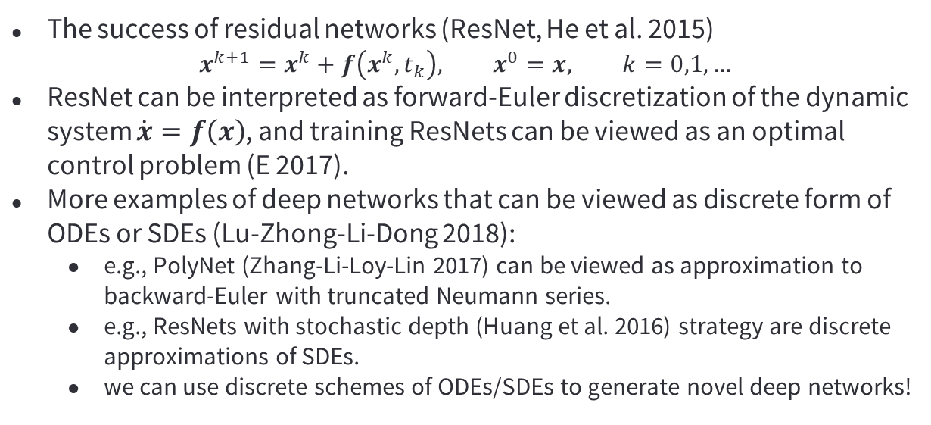
The ODE-Nets
The success of residual networks (ResNet, He et al. 2015)
$$x^{k+1}=x^{k}+f\left(x^{k},t_{k}\right), x^{0}=x, k=0,1,…$$
ResNet can be interpreted as forward-Euler discretization of the dynamic system $\dot{x}=f\left(x\right)$, and training ResNets can be viewed as an optimal control problem (E 2017).
More examples of deep networks that can be viewed as discrete form of ODEs or SDEs (Lu-Zhong-Li-Dong 2018):
  e.g., PolyNet (Zhang-Li-Loy-Lin 2017) can be viewed as approximation to backward-Euler with truncated Neumann series.
  e.g., ResNets with stochastic depth (Huang et al. 2016) strategy are discrete approximations of SDEs.
  we can use discrete schemes of ODEs/SDEs to generate novel deep networks!
Notes:
In our work in 2018, we showed that not only ResNet, there were other deep networks that adopts the idea of residual learning such as PolyNet can be interpreted as different discretization of ODEs. Some ResNets with randomized structures such stochastic depth are discrete approximations of SDEs. This made us wonder, if we could use discrete schemes of ODEs/SDEs to generate novel and effective deep networks. And we call this type of networks ODE-Nets.

Slide 25

The ODE-Nets
Using the linear two-step method (LM-ResNet):
$$x^{k+1}=\left(1−α_{k}\right)x^{k}+α_{k}x^{k−1}+f\left(x^{k},t_{k}\right), x^{0}=x, k=0,1,…$$
In comparison with ResNet via the modified equation analysis:
Notes:
To demonstrate that this can be a viable approach, we introduced a new network called LM-ResNet which is constructed using the linear two-step method. The scalar $α_{k}$ together with all the parameters in $f$ are trainable parameters.
A simple modified equation analysis reveals that, LM-ResNet has one more degree of freedom than ResNet, that is the parameter $α_{k}$ which is able to dynamically balance between the first and second order derivative of $x$.
We know from earlier analysis on Nesterov accelerated algorithms that putting bigger weights on the second order derivative of $x$ can speed up the dynamics.

Slide 26

The ODE-Nets
Using the linear two-step method (LM-ResNet):
$$x^{k+1}=\left(1−α_{k}\right)x^{k}+α_{k}x^{k−1}+f\left(x^{k},t_{k}\right), x^{0}=x, k=0,1,…$$
In comparison with ResNet via the modified equation analysis:
Empirical results
ImageNet (1.28m training, 50k testing, 1k classes)
Notes:
Of course, this is not rigorous since $f$ may not be the negative gradient of a potential. But our intuition matches with our empirical results.
First of all, on the famous image classification benchmark known as the ImageNet, the LM-ResNet outperforms ResNet with the same number of layers, meaning almost the same number of parameters.
On the other hand, the LM-ResNet managed to achieve a comparable test accuracy as ResNet with only half of the layers. One way to look at this is that, if we view the network as a dynamical system that processes image data, then LM-ResNet processes data faster than ResNet because of the presence of the trainable parameter $α_{k}$.

Slide 27

The ODE-Nets
Using the linear two-step method (LM-ResNet):
$$x^{k+1}=\left(1−α_{k}\right)x^{k}+α_{k}x^{k−1}+f\left(x^{k},t_{k}\right), x^{0}=x, k=0,1,…$$
In comparison with ResNet via the modified equation analysis:
Empirical results
$$α_{k}$$
ImageNet (1.28m training, 50k testing, 1k classes)
Notes:
But of course you may wonder if the actually learned $α_{k}$ indeed helps to speed up the information propagation. To valid this empirically, we plotted the learned $α_{k}$s in the bottom right figure. You can see that most of the $α_{k}$s are negative, especially when we go deeper in depth.
This means that LM-ResNet indeed places a bigger weight on the second derivative of $x$ in deeper layers. This enables it to accelerate the information propagation, while ResNet has no such flexibility.
There were many follow up studies alone the same line of research which I won’t have time to discuss today. But you can find a brief review of them in my proceeding paper.

Slide 28
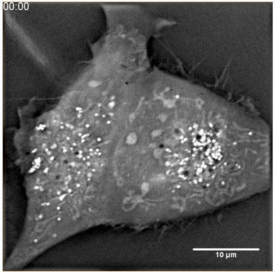
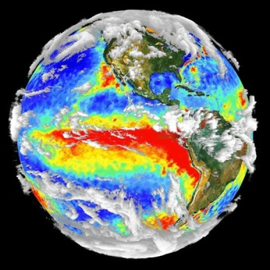
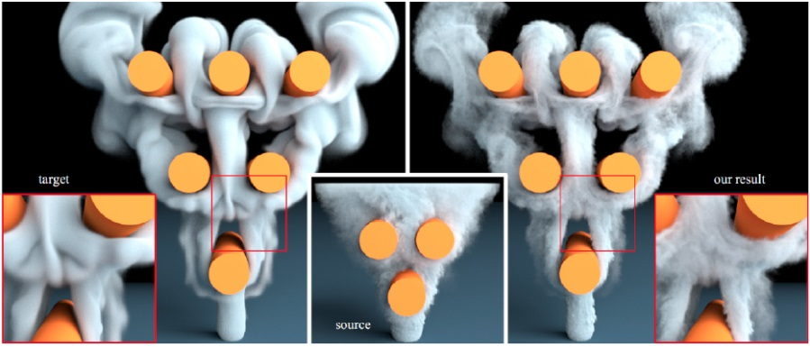
The PDE-Nets
Motivation of PDE-Nets: given a sequence of observed dynamics
  Find a PDE that best describes the observed data.
  Enable fast simulations with the learned PDE.
Key to PDE-Nets:
  Exploiting the structural similarity between deep convolutional neural networks (CNNs) and discrete schemes of PDEs.
S. Sato et al. 2018
Notes:
While ODE-Nets explore structural similarity between DNNs with discrete ODEs by relating temporal discretizations with different designs of the residual structure. PDE-Nets tend to look closer at the dynamics $f$.
PDE-Nets are deep CNNs with architectures inspired by numerical PDEs, or physics-informed so to speak. By training a properly design PDE-Net, we hope to achieve two objectives: first one is to estimate a PDE (with an interpretable form) that best describes the observed data and second one is to enable fast simulations.

Slide 29
The PDE-Nets
Motivation of PDE-Nets: given a sequence of observed dynamics
  Find a PDE that best describes the observed data.
  Enable fast simulations with the learned PDE.
Key to PDE-Nets:
  Exploiting the structural similarity between deep convolutional neural networks (CNNs) and discrete schemes of PDEs.
Related works on system identification:
  Schmidt-Lipson 2009, Brunton-Proctor-Kutz 2016 (SINDy), Raissi-Perdikaris-Karniadakis 2019 (PINNs).
S. Sato et al. 2018
Notes:
This problem is a typical inverse problem, often called system identification. This is a very active field, especially after the recent progress of machine learning. Here, I am just showing a few examples.

Slide 30

The PDE-Nets
We first assume
  $\frac{∂u}{∂t}=F\left(u,∇u,∇^{2}u,…\right), u∈ℝ^{m};$
  Maximum order of the PDE is known;
  $F$ is a multivariate function with simple operations (e.g., a polynomial).
Notes:
For given observed dynamical data, PDE-Nets assume certain prior knowledge on the hidden mechanics that drives the dynamics.
We assume that the dynamics can be approximated by a nonlinear evolution PDE with a known maximum order, for instance 2nd or 4th order. We also assume that the nonlinear function $F$ has only simple operations. For example, we assume in our studies that $F$ has only addition and multiplications of its variables, which makes it a multivariate polynomial. Although this may seem too restrictive, in fact this already covers a lot of known PDEs.

Slide 31
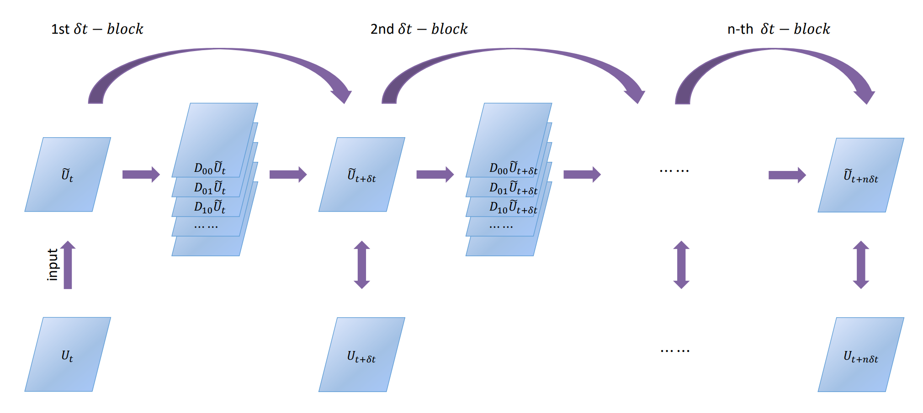
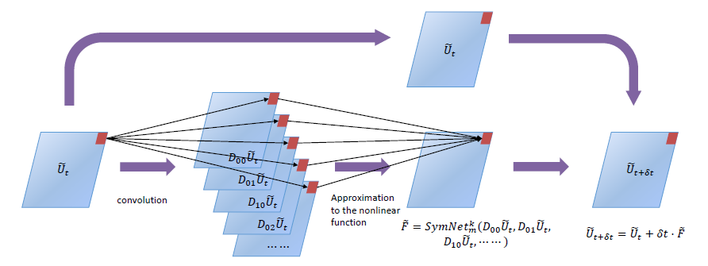
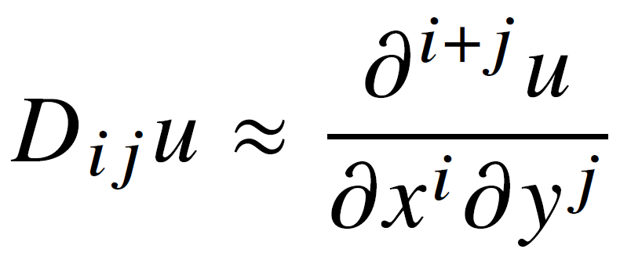

The PDE-Nets
We first assume
  $\frac{∂u}{∂t}=F\left(u,∇u,∇^{2}u,…\right), u∈ℝ^{m};$
  Maximum order of the PDE is known;
  $F$ is a multivariate function with simple operations (e.g., a polynomial).
The PDE-Nets (Long-Lu-Ma-Dong 2018, Long-Lu-Dong 2019):
Notes:
With these assumptions, we can now define our PDE-Nets. The idea is to use finite difference approximations to discretize the PDE and use the corresponding discrete dynamics as the backbone, and then specify the learnable components of the dynamics.
We discretize the PDE using finite differencing and introduce a deep symbolic network to approximate $F$. Then, we have an iterative scheme as shown by the formula here which is essentially a deep CNN. The trainable parameters are the convolution kernels that correspond to the finite difference approximation to the differential operators. The parameters in the symbolic network are trainable as well. So we call the deep CNNs that are constructed in this specific way the PDE-Nets.

Slide 32
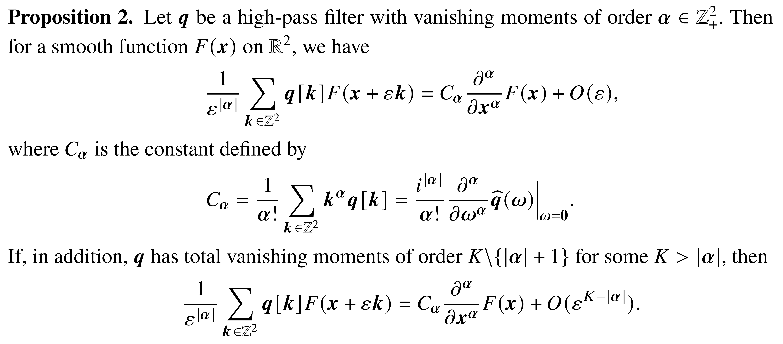


The PDE-Nets
Enforcing $D_{ij}u≈\frac{∂^{i+j}u}{∂x^{i}∂y^{j}}$ by applying the Proposition.
  Define the moment matrix
Notes:
One crucial component of PDE-Nets is the approximation of spatial derivatives by convolutions. However, if we do not place any constraints on the convolution kernels, these convolutions may not approximate differential operators at all, making the trained PDE-Nets uninterpretable.
This is where the Proposition 2 comes in handy. If we want to control the convolution to approximate a certain differential operator with a certain approximation order, we can simply control the constants $C_{α}$ by for instance letting all but one specific $C_{α}$ to be non-zero. We denote these factors $C_{α}$ as the moment matrix just for convenience.

Slide 33
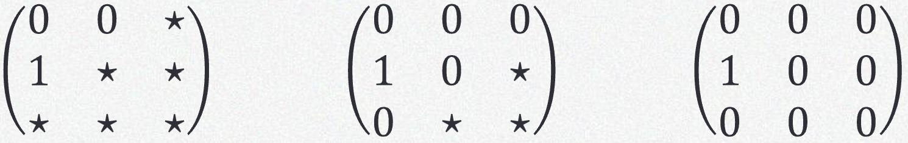
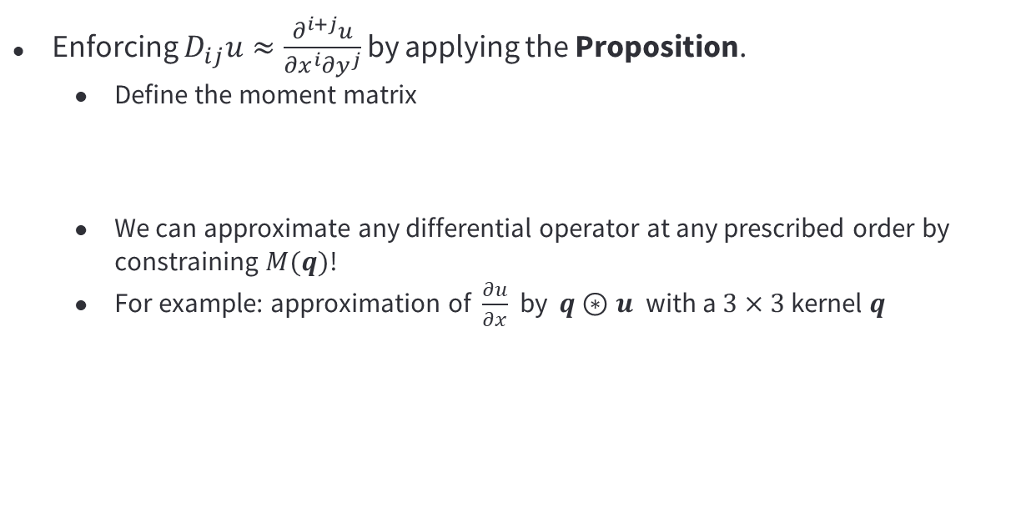
The PDE-Nets
Enforcing $D_{ij}u≈\frac{∂^{i+j}u}{∂x^{i}∂y^{j}}$ by applying the Proposition.
  Define the moment matrix
  We can approximate any differential operator at any prescribed order by constraining $M(q)$!
  For example: approximation of $\frac{∂u}{∂x}$ by $q⊛u$ with a $3×3$ kernel $q$
Notes:
The moment matrix is just a convenient tool to enforce linear constraints on the convolution kernels.
For example, if we want to approximate partial x with convolution using a 3x3 kernel, the corresponding moment matrix is also 3x3 and we can use the following three matrix constraints. The third one gives us a deterministic kernel while the first two are learnable approximations. The stars label the unconstrained slots. The more starts means the more degree of freedom we have for the learnable filter q.
Our empirical studies show that having learnable filters helps with the estimation of the analytical form of the hidden PDEs, and it enables more accurate simulations as well.

Slide 34
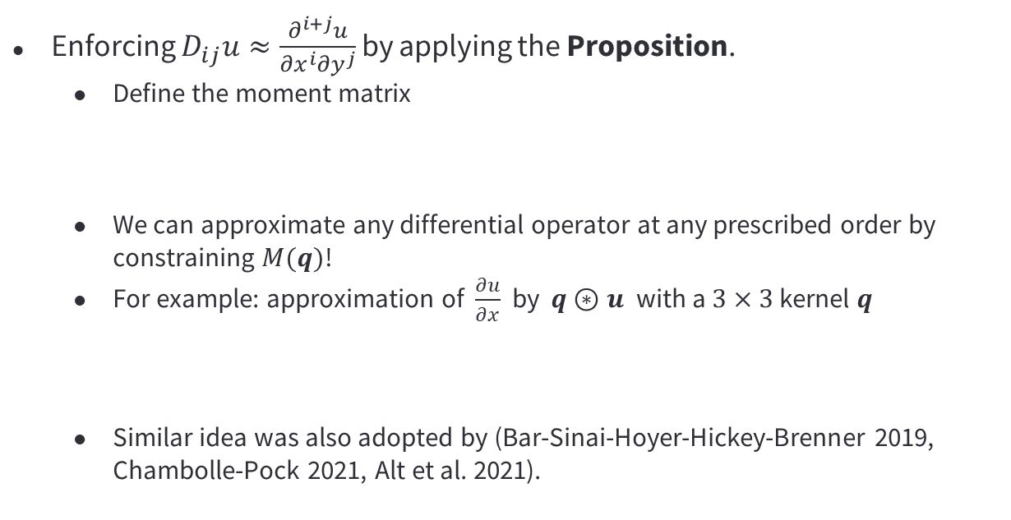
The PDE-Nets
Enforcing $D_{ij}u≈\frac{∂^{i+j}u}{∂x^{i}∂y^{j}}$ by applying the Proposition.
  Define the moment matrix
  We can approximate any differential operator at any prescribed order by constraining $M(q)$!
  For example: approximation of $\frac{∂u}{∂x}$ by $q⊛u$ with a $3×3$ kernel $q$
  Similar idea was also adopted by (Bar-Sinai-Hoyer-Hickey-Brenner 2019, Chambolle-Pock 2021, Alt et al. 2021).
Notes:
Similar idea was also used by some later studies.
(For example, Bar et al., used learnable finite difference approximations to solve PDEs. Chambolle and Pock use learnable discretizations for total variation. Alt et al. they gave a a more extended discussion on the connections between numerical scheme of PDEs and neural networks.)

Slide 35

The PDE-Nets
Empirical results: learning Burgers’ equation
$$u_{t}+\left(u⋅∇\right)u=ε ∇^{2}u, u=\left(u,v\right), ε=0.05.$$
Notes:
As a proof of concept, we conduct experiments using Burgers’ equation.
(We generate observational data using a high-accuracy scheme and added some noise.)
Here we do not assume that we know it’s burgers or whether its parabolic or hyperbolic. All we assumed is that the maximum order of this PDE doesn’t exceed 4, and the nonlinear function $F$ is a certain polynomial.

Slide 36
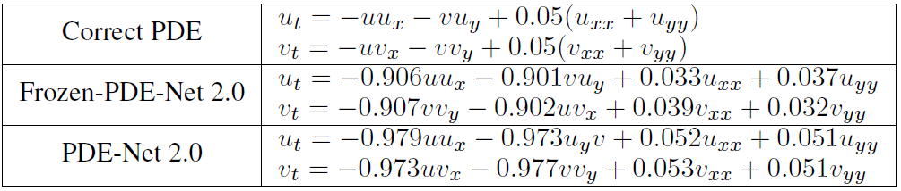
The PDE-Nets
Empirical results: learning Burgers’ equation
$$u_{t}+\left(u⋅∇\right)u=ε ∇^{2}u, u=\left(u,v\right), ε=0.05.$$
Ground truth
Frozen PDE-Net
PDE-Net
Model recovery
Notes:
This is the results of model recovery. The leading terms of the symbolic network after training are given in this table. You can see that PDE-Net is able to accurately approximate the ground. Here, Frozen PDE-Net means that we cheated a little bit by using a fixed discretization that is stable for Burgers which we should not know. The estimation by PDE-Net is even more accurate than the Frozen PDE-Net which assumes more prior knowledge on the hidden PDE model. This shows that having learnable discretizations of differential operator not only require a weaker prior knowledge on the PDE to be discovered, but can also make the estimation more accurate.

Slide 37
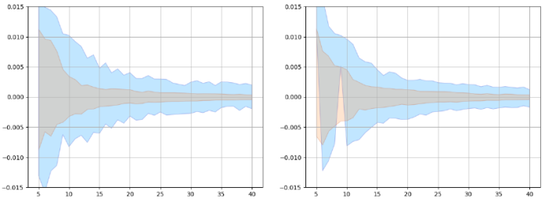

The PDE-Nets
Empirical results: learning Burgers’ equation
$$u_{t}+\left(u⋅∇\right)u=ε ∇^{2}u, u=\left(u,v\right), ε=0.05.$$
Ground truth
Frozen PDE-Net
PDE-Net
Model recovery
Remainer weights of $u, v$
28
Notes:
Since we assume that the maximum order is 4, while burgers is a 2nd order PDE, we also have remainder terms. But they are all relatively small.
(Here the orange region shows the distribution of the values of the remainders when using an $ℓ_{1}$ penalty on the symbolic network. The blue region shows the same distribution but without the $ℓ_{1}$ penalty. So enforcing sparsity on the coefficients of the symbolic network help with cleaning up the analytical expressions of the learned PDE.)

Slide 38
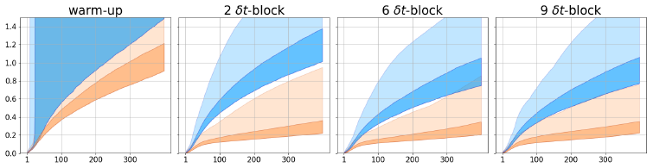
The PDE-Nets
Empirical results: learning Burgers’ equation
$$u_{t}+\left(u⋅∇\right)u=ε ∇^{2}u, u=\left(u,v\right), ε=0.05.$$
Ground truth
Frozen PDE-Net
PDE-Net
Model recovery
Remainer weights of $u, v$
Frozen PDE-Net
PDE-Net
Simulations
Notes:
Once the PDE-Net is trained, we can use it for simulations using unseen initial conditions without retraining. Since the PDE-Nets are CNNs, the simulation is very fast using GPUs.
The plots tell us two things. One is that using learnable discretizations, i.e. the PDE-Nets (as shown by the orange regions) generate more accurate simulations than using pre-selected discretizaitons (i.e. the Frozen PDE-Net associated to the blue region). Second is that using layered training, i.e. training the PDE-Nets with multiple $δt$-blocks or time steps helps with finding a more stable spatial discretizations which in turn help to generate more stable simulations.

Slide 39
The PDE-Nets
Incorporation of PDEs (physics) into the architecture of the network is beneficial!
Notes:
The studies on both ODE-Nets and PDE-Nets made us believe that the incorporation of differential equations or physics or any fundamental principles is beneficial in general.

Slide 40

The PDE-Nets
Incorporation of PDEs (physics) into the architecture of the network is beneficial!
  Machine learning accelerated simulations: e.g., learning an operator
  $$𝓕_{Θ}:u\left(t,⋅\right)→u(t+Δt,⋅)$$
Notes:
Here is a simple experiments on machine learning based accelerated simulations of PDEs. The main objective is to learn an operator $F_{θ}$, typically a neural network, that approximate the flow maps between two snapshots.

Slide 41

The PDE-Nets
Incorporation of PDEs (physics) into the architecture of the network is beneficial!
  Machine learning accelerated simulations: e.g., learning an operator
  $$𝓕_{Θ}:u\left(t,⋅\right)→u(t+Δt,⋅)$$
  A comparison between PDE-Nets, U-Net (Ronneberger-Fischer-Brox 2015) and Fourier Neural Operator (FNO, Li et al. 2020)
Notes:
I am going to compare the approximation of $F_{Θ}$ with the U-Net, the Fourier neural operator and PDE-Net.
U-Net is a black-box model with an encoder-decoder structure, assumes no knowledge on the underlying PDE and has the most number of trainable parameters, the design of the FNO is motivated by Green’s functions which incorporates certain knowledge on the PDE, while PDE-Nets assume the most knowledge on the underlying PDE and have the fewest number of trainable parameters.

Slide 42
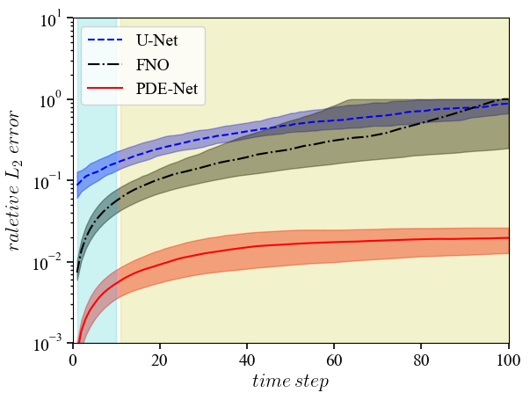
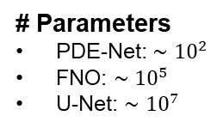
The PDE-Nets
Incorporation of PDEs (physics) into the architecture of the network is beneficial!
  Machine learning accelerated simulations: e.g., learning an operator
  $$𝓕_{Θ}:u\left(t,⋅\right)→u(t+Δt,⋅)$$
  A comparison between PDE-Nets, U-Net (Ronneberger-Fischer-Brox 2015) and Fourier Neural Operator (FNO, Li et al. 2020)
# Parameters
PDE-Net: $∼{10}^{2}$
FNO: $∼{10}^{5}$
U-Net: $∼{10}^{7}$
2D Burgers’ Eqn.
Notes:
The results are as expected. Because if you want to solve a PDE, your algorithm better use as much knowledge of the equation as possible. It’s obviously not a good idea to assume no knowledge of the PDE that you want to solve.
As you can see from the plot, the PDE-Net has lowest prediction errors, FNO is second and U-Net is the worst. The required number of trainable parameters is exactly reversed, where the PDE-Net needs the fewest number of parameters.

Slide 43

Deep Learning – Back to Main Track
Recall $f=A\left(u\right)+η$ and solution mapping: $𝓕:Y→X; 𝓕\left(f\right)=\hat{u}≈u$
Supervised Learning: given $\left(f_{i},u_{i}\right)∼𝒫$, find $𝓕_{\hat{Θ}}:Y→X$ through
$$\hat{Θ}={argmin}_{Θ}{\frac{1}{N}\sum_{i=1}^{N}{L(𝓕_{Θ}\left(f_{i}\right),u_{i})}}$$
  with $𝓕_{Θ}$ a deep neural network, e.g., $𝓕_{Θ}\left(x\right)=$ $W_{3}σ\left(W_{2}σ\left(W_{1}x+b_{1}\right)+b_{2}\right)$
How can we understand deep neural networks (DNNs) in comparison with the “handcrafted” mapping? $𝓕_{} v.s. 𝓕_{Θ}$
We found structural similarities between CNNs and discrete differential equations
In a nutshell:
Discrete differential equations induce meaningful deep CNNs
Shed lights on understanding of deep CNNs
Bring concepts and techniques of deep learning to scientific computing

Slide 44

Deep Learning – Back to Main Track
Recall $f=A\left(u\right)+η$ and solution mapping: $𝓕:Y→X; 𝓕\left(f\right)=\hat{u}≈u$
Supervised Learning: given $\left(f_{i},u_{i}\right)∼𝒫$, find $𝓕_{\hat{Θ}}:Y→X$ through
$$\hat{Θ}={argmin}_{Θ}{\frac{1}{N}\sum_{i=1}^{N}{L(𝓕_{Θ}\left(f_{i}\right),u_{i})}}$$
  with $𝓕_{Θ}$ a deep neural network, e.g., $𝓕_{Θ}\left(x\right)=$ $W_{3}σ\left(W_{2}σ\left(W_{1}x+b_{1}\right)+b_{2}\right)$
How can we understand deep neural networks (DNNs) in comparison with the “handcrafted” mapping? $𝓕_{} v.s. 𝓕_{Θ}$
We found structural similarities between CNNs and discrete differential equations
  Bridging CNNs with discrete ODEs: interpreting residual-type structures as discretization of ODEs. (E, 2017), (Haber-Ruthotto, 2017), (Lu-Zhong-Li-Dong 2018), etc.
  Bridging CNNs with discrete PDEs: leveraging the relations between convolutions and discrete approximation of differential operator. (Long-Lu-Ma-Dong, 2018), etc.
These studies lead to a generic strategy of combining data- and model-based modeling.

Slide 45

Data + Model: A General Strategy
A typical workflow:
  For a given problem of interest, start with your favorite algorithm which is most likely a discrete dynamic system
  Identify the component(s) that is hard to handcraft (parameters, operators)
  Approximate the it with a properly designed deep neural network, making the solution mapping $𝓕_{Θ}$ learnable.
  Select a loss function and training algorithm
Notes:
I think now the community of scientific machine learning gradually picked up a general strategy to effectively combine mathematical modeling with machine learning. Here, I summarize it into an workflow which I mostly follow during my own research. But different people may have very different perspectives on this.
It goes like this, (Read the texts). The same workflow can also be applied to many problems in scientific computing and the rising field of AI for science.

Slide 46


Data + Model: A General Strategy
A typical workflow:
  For a given problem of interest, start with your favorite algorithm which is most likely a discrete dynamic system
  Identify the component(s) that is hard to handcraft (parameters, operators)
  Approximate the it with a properly designed deep neural network, making the solution mapping $𝓕_{Θ}$ learnable.
  Select a loss function and training algorithm
For example: learned image segmentation (Zhang-Dong-Li, 2020)
  Start with the active contour model for image segmentation
  Introduce a neural network to infer the initialization and parameters

Slide 47
04
Computational Imaging
Integrating sensing, reconstruction and analysis. Building a foundation model.
Notes:
Now, I think it is safe to say that we have more powerful tools that enable us to do things we couldn’t do well in the past.
Let’s come back to computational imaging and see what we can do now with these new tools.

Slide 48

Integration of Computational Imaging
Computational imaging revisited:
Sensing
Analysis
Reconstruction
Integrated computational imaging
Analysis
Reconstruction
Sensing
Notes:
For a long time, we have been seeking (and we still do) for general-purposed computational imaging systems. For example, compressed sensing specifies a rather universal sampling strategy to facilitate a robust image reconstruction. But such universal sampling strategy may not be optimal to each subject-of-interest or to a specific downstream task.
Now with the advancement of machine learning, we can design special-purposed imaging system to achieve possibly unraveled performance comparing to general purposed-systems. This has become an emerging area in computational imaging and has vast potential applications.
(Next) To achieve special-purposed imaging, we need to integrate all the three components of computational imaging. This has been make possible, or at least much easier than in the past, by deep learning. It is mainly because deep models are effective in approximating complex high-dimensional mappings, can make very fast inferences and are differentiable. These attributes of deep models makes it tractable to do end-to-end training of the entire pipeline, meaning that we now have a way to jointly train $Θ_{1}$ for sensing, $Θ_{2}$ for image reconstruction and $Θ_{3}$ for image analysis.

Slide 49
Integration of Computational Imaging
Computational imaging revisited:
Motivation: why such integration is needed?
  Reconstruction + Analysis: Liu et al. 2018, Wu et al. 2018, Huang et al. 2019
Sensing
Analysis
Reconstruction
Notes:
Now, you may ask, why should we integrate the pipeline. What’s the potential benefit?
For example, you can combine image reconstruction with image analysis. The benefit of doing so is twofold. One is to improve the accuracy since any image reconstruction inevitably introduces bias that can negatively impact on the downstream tasks. Thus, it is potentially more effective to grab information directly from the measurement data. Secondly, from the standpoint of improving image reconstruction itself. We have being using generic metrics such as the PSNR or SSIM to evaluate the quality of the reconstructed images. However, such generic metric can be very misleading.

Slide 50

Integration of Computational Imaging
Computational imaging revisited:
Motivation: why such integration is needed?
  Reconstruction + Analysis: Liu et al. 2018, Wu et al. 2018, Huang et al. 2019
Sensing
Analysis
Reconstruction
J. Webster Stayman, JHU
Slides from “Deep Recon Workshop, 2021”
Notes:
Here is an example I borrowed from Professor Stayman’s slides who is a medical professional at JHU. It shows that the CT image on the right has higher SSIM (meaning better) than the CT image on the left. However, the image on the right missed out a key feature, which is lung nodule due to over-smoothing by the reconstruction algorithm.
This example shows that we cannot simply rely on generic quality metrics such as SSIM. We should have a quality metric that is conditioned on the downstream task.

Slide 51




Integration of Computational Imaging
Computational imaging revisited:
Motivation: why such integration is needed?
  Reconstruction + Analysis: Liu et al. 2018, Wu et al. 2018, Huang et al. 2019
Sensing
Analysis
Reconstruction
A network for nodule detection
A network for reconstruction
Notes:
In one of our earlier attempts (highlighted in bold), we combined CT image reconstruction at human’s chest area with lung nodule detection.
The idea is simple. Then explain it’s the combination of an unrolled dynamics plus learning modules with a detection network. Pretrain+finetuning.
What I would like to highlight here, is that if you examine the reconstructed CT images, it appears that the reconstruction network does a lot more regularizations inside the lung region than outside the lung region, which is something traditional reconstruction algorithms or standard deep models wouldn’t do intentionally. I think this is because our reconstruction network knows that the images it reconstructs will be used for nodule detection and thus it shouldn’t care about the regions outside the lung area and focus more inside the lungs.
Although this was only a simple proof-of-concept study and can be improved in multiple ways, it shows that combining reconstruction with analysis can be beneficial.

Slide 52
Integration of Computational Imaging
Computational imaging revisited:
Motivation: why such integration is needed?
  Reconstruction + Analysis: Liu et al. 2018, Wu et al. 2018, Huang et al. 2019
  Sensing + Reconstruction: Jin-Unser-Yi 2019, Pineda et al. 2020, Ede 2021, Yin et al. 2021, Shen et al. 2022.
Sensing
Analysis
Reconstruction
Notes:
You may also combine sensing and reconstruction to make the sensing has a dependence on the imaging subject and the reconstruction algorithm to achieve better imaging quality.

Slide 53



Integration of Computational Imaging
Computational imaging revisited:
Personalized CT scanning (Shen et al. 2022)
Sensing
Analysis
Reconstruction
Goal: to optimize
projection angles;
dose allocation,
so that image quality is maximized for a given total dose.
$$f=Au+η$$
Notes:
For example, in our work Shen et al. 2022, we showed how deep reinforcement learning can be applied to CT imaging to achieve personalized scanning.
This is essentially a mixed integer programming problem. What we are optimizing for each imaging subject is the angles of projection and the dose allocation for each angle. We want to maximize the imaging quality while keeping the total dose within a certain range. We reformulated the imaging procedure into a Markov decision process and solved it using a deep reinforcement learning algorithm.
So unlike compressed sensing that gives a generic sampling plan which is the same for all subjects, our method generates different scanning plans for different subjects so that the image quality is maximized for each subject.

Slide 54
Integration of Computational Imaging
Computational imaging revisited:
Motivation: why such integration is needed?
  Reconstruction + Analysis: Liu et al. 2018, Wu et al. 2018, Huang et al. 2019
  Sensing + Reconstruction: Jin-Unser-Yi 2019, Pineda et al. 2020, Ede 2021, Yin et al. 2021, Shen et al. 2022.
  Sensing + Reconstruction + Analysis: Wetzstein et al. 2020.
Sensing
Analysis
Reconstruction
Notes:
Finally, Wetzstein et al. are trying to combine all the three components for optic imaging. They call it deep optics. We are also working on the integration of all the three components for CT imaging.

Slide 55

Integration of Computational Imaging
We can do such integration for each modalities
ICI-$M_{1}$
ICI-M_1

Slide 56

Integration of Computational Imaging
We can do such integration for each modalities
ICI-M1
ICI-M2
CT
ICI-M3
ICI-M4
MRI
ICI-M5
OCT
ICI-$M_{n}$
ICI-M_𝑛
ODT
EIT
PAT
$$⋯$$

Slide 57


Integration of Computational Imaging
A crazy thought: Or we may try full integration across multiple modalities.
ICI-M1
ICI-M2
CT
ICI-M3
ICI-M4
MRI
ICI-$ℳ$
ICI-M5
OCT
ICI-$M_{n}$
ICI-M_𝑛
ODT
EIT
PAT
$$⋯$$
Foundation model for computational imaging may be possible:
  Shared principles for sensing: wave-matter interactions
  Consensus on reconstruction methodology: regularization-based
  Common downstream tasks: image captioning (i.e., image $→$ text)
  Key: a foundation model for PDE forward & inverse problems.

Slide 58
05
Supporting Biomedical Research
Multiscale and multimodality biomedical imaging for biological research and clinical studies.
Notes:
So far I have been talking about algorithmic design for computational imaging. But as I have discussed at the very beginning that the ultimate purpose of computational imaging is to support biomedical research and clinical applications which is what I am going to discuss in the last part of my talk.

Slide 59


Imaging Technology Drives Biomedical Research

Slide 60

Multi-Modality and Cross-Scale Imaging for Clinical Applications
Therapeutic Decision-making: Selecting the optimal treatment regimen is a central concern for both patients and physicians.
Treatment decision-making is a meticulous task with limited data.
It involves individualized differences such as personal characteristics, genes, and cells.
There are constantly emerging new treatment methods.
A single modality is often insufficient to provide enough information for doctors or models to make treatment decisions.

Slide 61

Multi-Modality and Cross-Scale Imaging for Clinical Applications
Therapeutic Decision-making: Selecting the optimal treatment regimen is a central concern for both patients and physicians.

Slide 62




Importance of Multiscale and Multimodality Imaging
Case Studies in Tumor Diagnosis and Treatment
Immunotherapy: An Effective Treatment for Cancer
Established a multi-immunofluorescence imaging system and spatial analysis method
Less benefitial for gastric cancer patients
Proposed a 3D multi-scale analysis algorithm
Clinical issues:
  The response rate of PD-1 first-line combination therapy in the late stage is only about 60%;
          Some patients (about 20%) experience hyperprogression after treatment."
Notes:
Programmed Death-1 (PD-1) has emerged as a crucial biomarker and therapeutic target in the treatment of various cancers, including skin cancer and notably melanoma. The PD-1 pathway plays a vital role in tumor evasion from immune responses, acting as an "immune checkpoint." When a tumor cell binds to PD-1 on a T-cell through its ligand (PD-L1), the T-cell becomes inhibited, suppressing its cytotoxic function and thereby allowing tumor cells to evade immune detection and destruction. Several anti-PD-1 monoclonal antibodies, such as nivolumab and pembrolizumab, have been developed to block this inhibitory pathway.

Slide 63
Importance of Multiscale and Multimodality Imaging
Case Studies in Tumor Diagnosis and Treatment
Immunotherapy: An Effective Treatment for Cancer
This is a joint work with Dr. Lin Shen’s team at Peking University Cancer Hospital
  Improvement in treatment efficacy prediction AUC: +15%-20%.
  From detection to scanning to analysis report, one-stop completion!
  4 patents have been acquired by a hospital for large-scale clinical trials.
Less benefitial for gastric cancer patients
Clinical issues:
  The response rate of PD-1 first-line combination therapy in the late stage is only about 60%;
          Some patients (about 20%) experience hyperprogression after treatment."
Nature Comm. 2022
Notes:
This is a research-oriented hospital established with investment from Hillhouse Capital

Slide 64


Creating a Panorama of Life
The National Biomedical Imaging Center (NBIC)

Slide 65






Creating a Panorama of Life
The National Biomedical Imaging Center (NBIC)
Platform 4: Data Center
Co-leading PIs
Consultants
Bin Dong
Lei Ma
Wei Sun
Jingjing Lin

Slide 66
Creating a Panorama of Life
The National Biomedical Imaging Center (NBIC)
Vast opportunities for applied mathematics and machine learning:
  Foundation model(s) for computational imaging
  Data engine
    Standardization
    Compression
    Fusion and visualization
    Semantic embedding
  Service to the community
    Data sharing
    Platform for interdisciplinary research
Division 4: Data Center
Co-leading PIs
Consultants
Bin Dong
Lei Ma
Wei Sun
Jingjing Lin

Slide 67

The National Biomedical Imaging Center (NBIC)
An insight into what the future holds
Life sciences and medical research driven by imageomics and digital twins.

Slide 68
06
Conclusions
Notes:
Now, let me briefly conclude my talk and then I will ready for some questions.

Slide 69
Concluding Remarks
Multiscale, multimodality and end-to-end computational imaging is a trending research direction.
Data- and model-driven approach can be beneficial in many scenarios.
As AI evolving at an unprecedent speed, we (human) should be more focused on the frontiers and conduct multiciliary research (using AI as a co-pilot)
Some references on the technical part of this talk：
  H. Zhang and B. Dong, A Review on Deep Learning in Medical Image Reconstruction, Journal of the Operations Research Society of China, 8(2): 311-340, 2020.
  B. Dong, On Mathematical Modeling in Image Reconstruction and Beyond, Proceedings of the International Congress of Mathematicians, 2022.
  B. Dong, A Note on Machine Learning Approach for Computational Imaging, arXiv:2202.11883.

Slide 70
Thanks!
Questions?
You can reach me at dongbin@math.pku.edu.cn
https://bicmr.pku.edu.cn/~dongbin/
Notes:
With that, I conclude my talk and thanks for listening.

